Slide 1


Introducing
ACEN

Slide 2

ACEN’S VISION
Our vision is to build a restorative African economy that generates well-being and prosperity, inclusive of all its people, through new forms of economic production and consumption which maintain and regenerate its environmental resources.
Ingoude Company

Slide 3


About ACEN
ACEN is a network of circular economy experts from different fields looking at ways to reinvent inclusive growth on the African continent.
The Networks aims at promoting new business practices according to the concept and principles that form the Circular Economy, with a socially inclusive strategy for long-term bottom-line gains. ACEN is a registered Non-Profit Organisation in South Africa (195-590 NPO) and has a continental wide footprint.

Slide 4
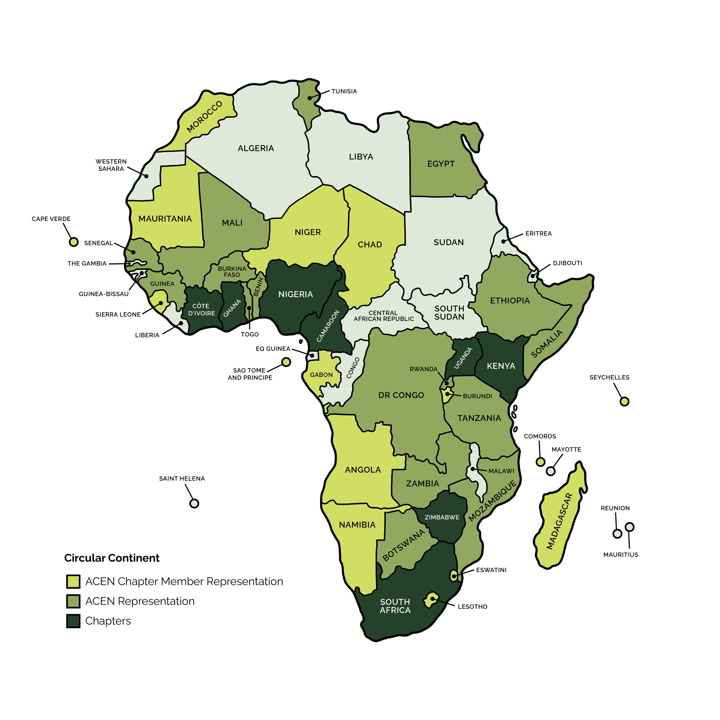
Our Representation
ACEN is recognised globally for its efforts in driving the circular transition across Africa and the Global South.
500+ members across 42 African countries
Partnerships with World Economic Forum, the World Bank, UNEP, UNIDO, the African Development Bank, Chatham House, Circle Economy, CECOLAB, CIEC, Ellen MacArthur Foundation, Sitra, Nordic Innovation, and the European Commission

Slide 5




WE AIM TO ACHIEVE OUR VISION THROUGH FOUR PILLARS:
Knowledge Sharing
Training and Awareness
Networking and Events
Research
ACEN shares circular economy knowledge via LinkedIn, Facebook, and other online channels, aiming for a robust information base and Africa-wide outreach.
We prioritise awareness and training in key African sectors: public (government, education), private (corporates, SMEs), and civil society. We promote circular economy principles.
ACEN advocates interdisciplinary solutions, emphasizing stakeholder involvement and fostering regional, African, and global partnerships through collaborative platforms and engagements.
ACEN research addresses African-context issues, involving members, academics, and diverse stakeholders from Africa as well as internationally where required.

Slide 6


Slide 7

ACEN’s selected Projects

Slide 9
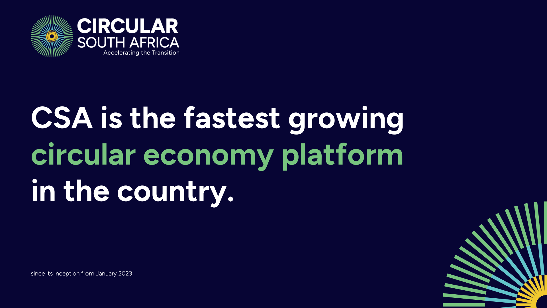

Slide 10


Slide 11
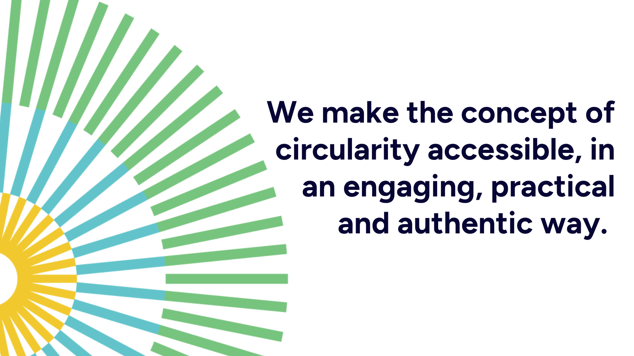

Slide 12


Slide 13







Join us!
circularsouthafrica.co.za
What’s App Channel
Circular South Africa (CSA)

Slide 14












19&20 September
Hasso Plattner D-School Afrika Cape Town, South Africa

Slide 15
What are Circular
Economy Hotspots (CEH)?
Initiated in 2016, the Circular Economy Hotspot (CEH) is hosted annually in alternating cities and regions across the globe. These hotspot events aim to spotlight native circular economy solutions, initiatives, and innovation and demonstrate best practices through exhibitions and field trips, while facilitating culturally and politically diverse multi-stakeholder exchange and discussions.
2024
2016
2017
2018
2019
2020
2022
2023
NETHERLANDS
LUXEMBURG
SCOTLAND
BELGIUM
SPAIN
GERMANY
NIGERIA
+
IRELAND
+
CHILE
WALES
+
CANADA
+
BRAZIL

Slide 16
#SACEH24 Overview
250 delegates
2-days,
in-person,
Cape Town
Solutions & Tools
6
Plenary Sessions + 2 Pitch Challenges
4
Field Trips
4
Master-classes
25+
Expo Stands

Slide 17
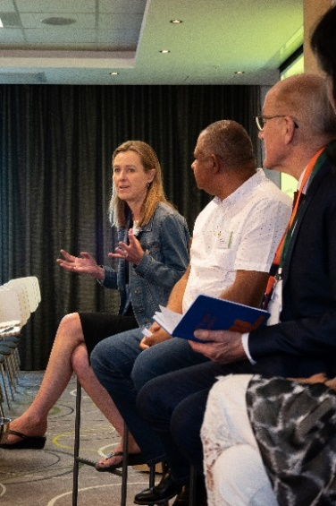
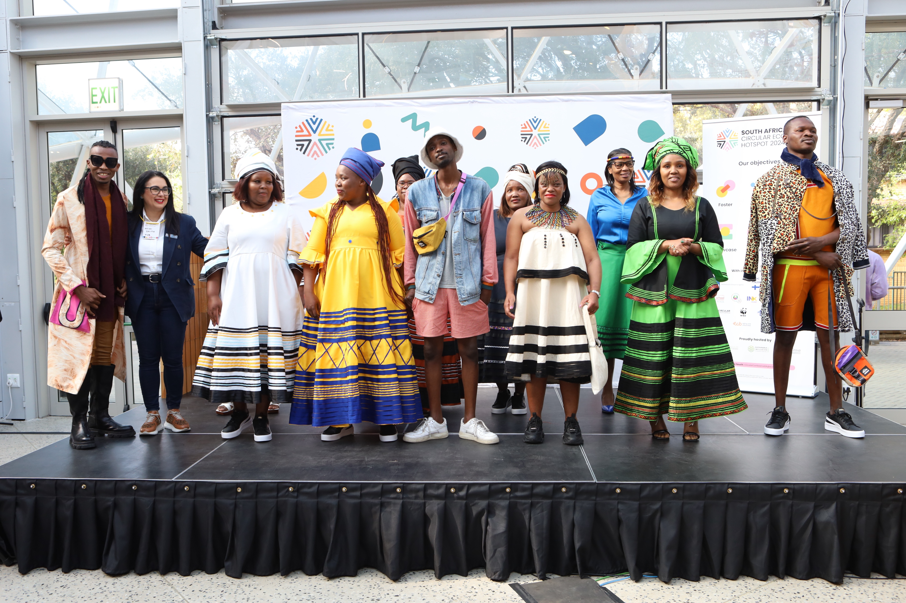
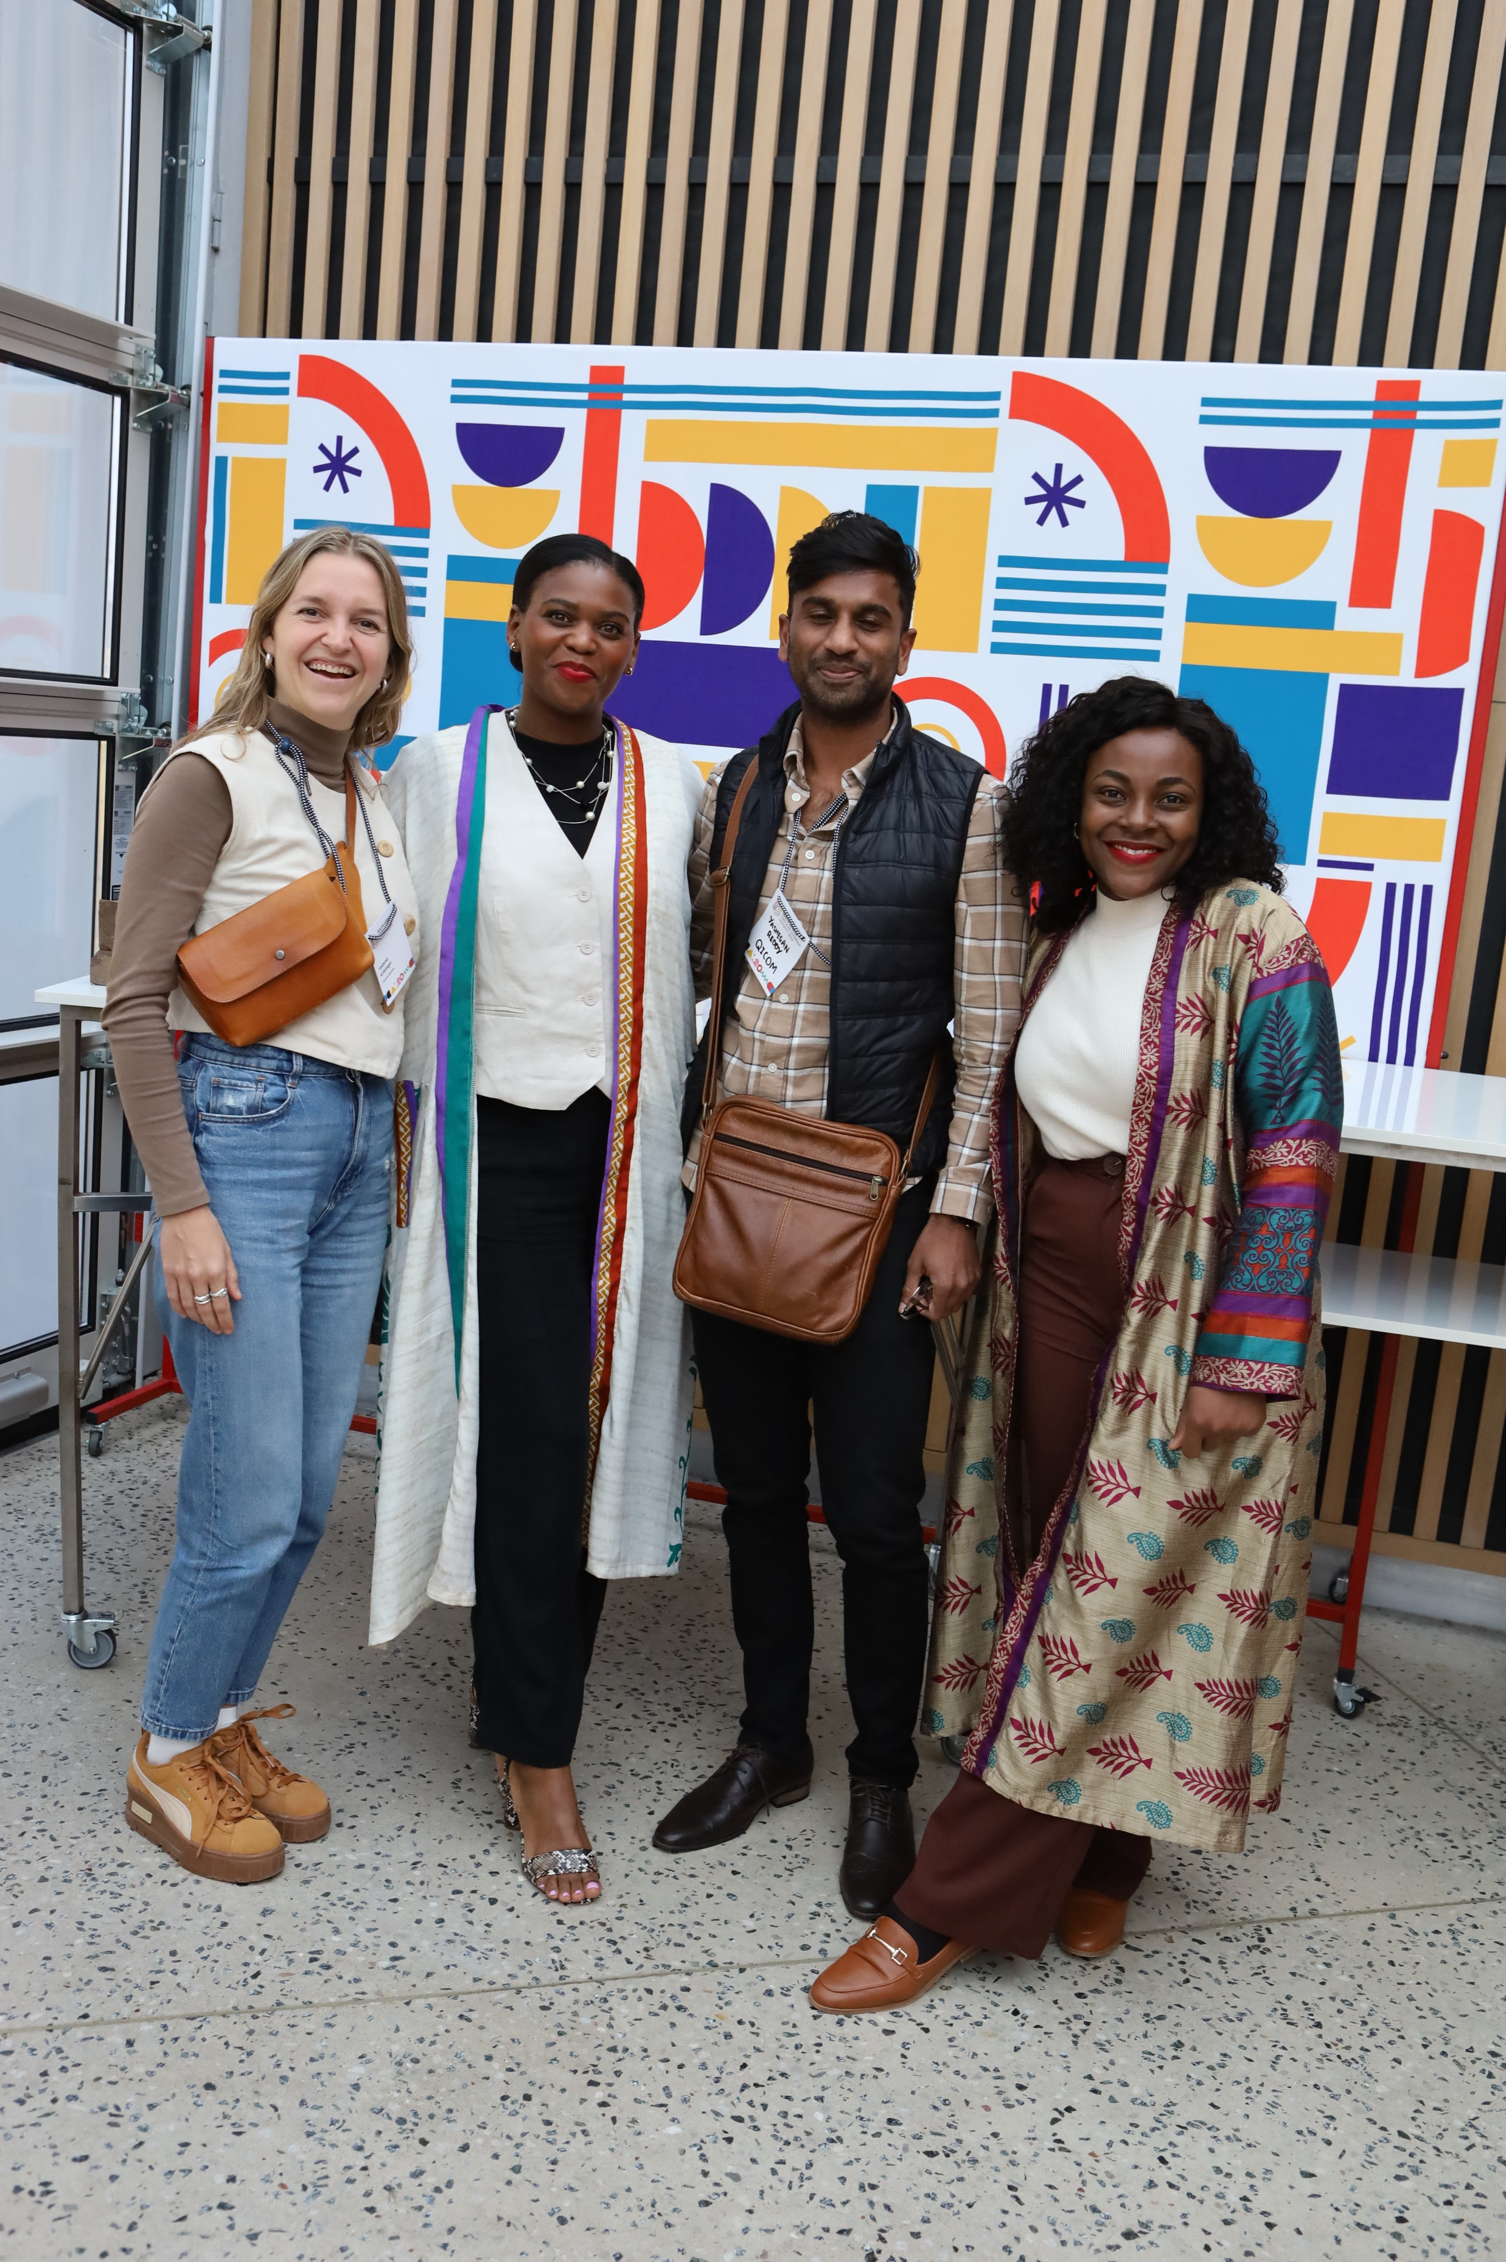
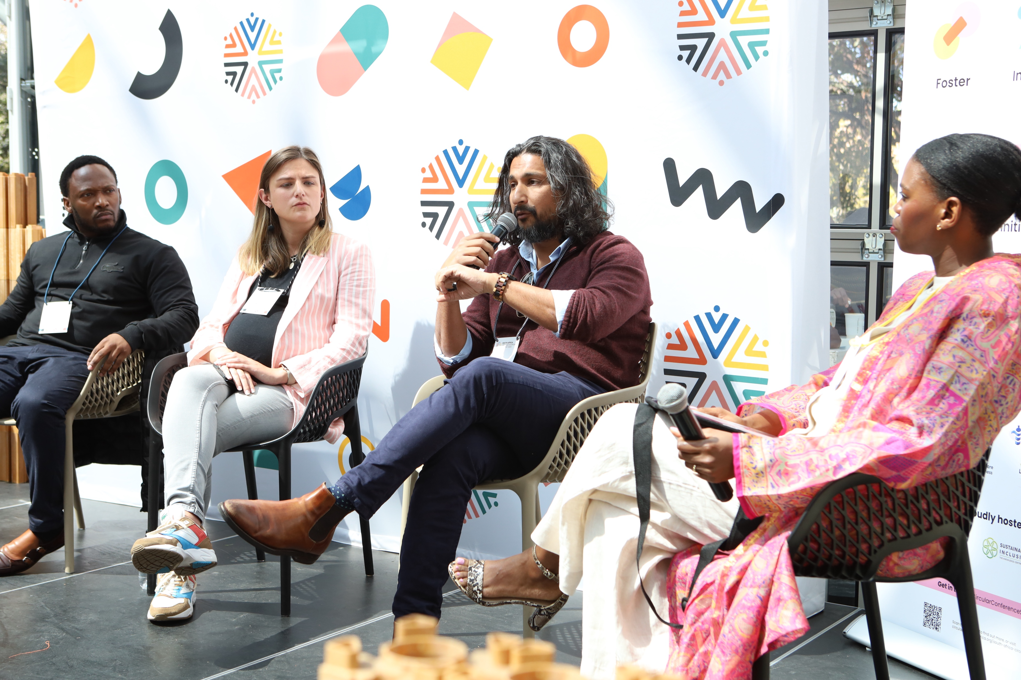
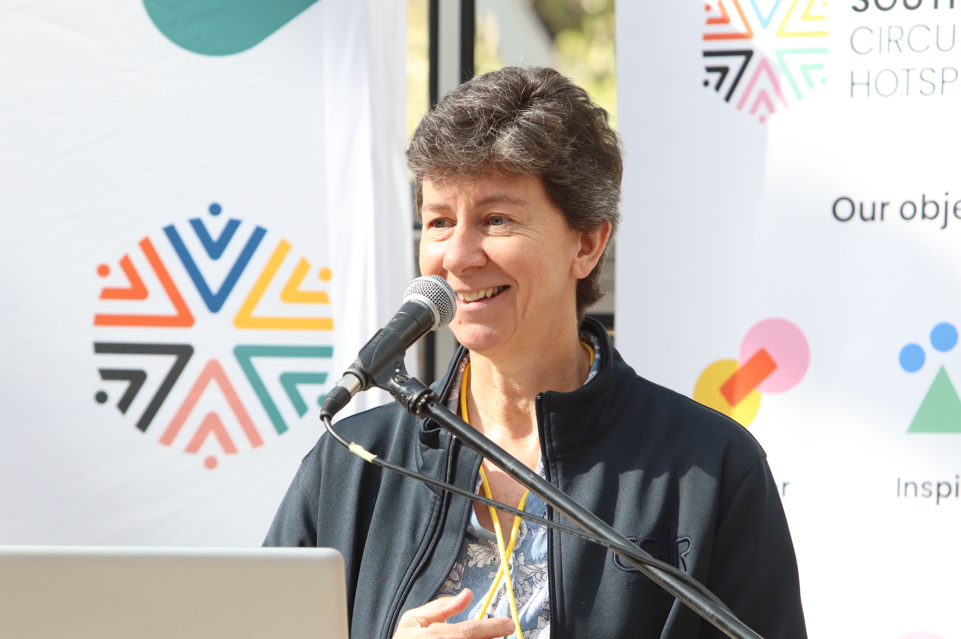

Slide 18













With incredible support from

Slide 19































In very proud collaboration with

Slide 20




Slide 21

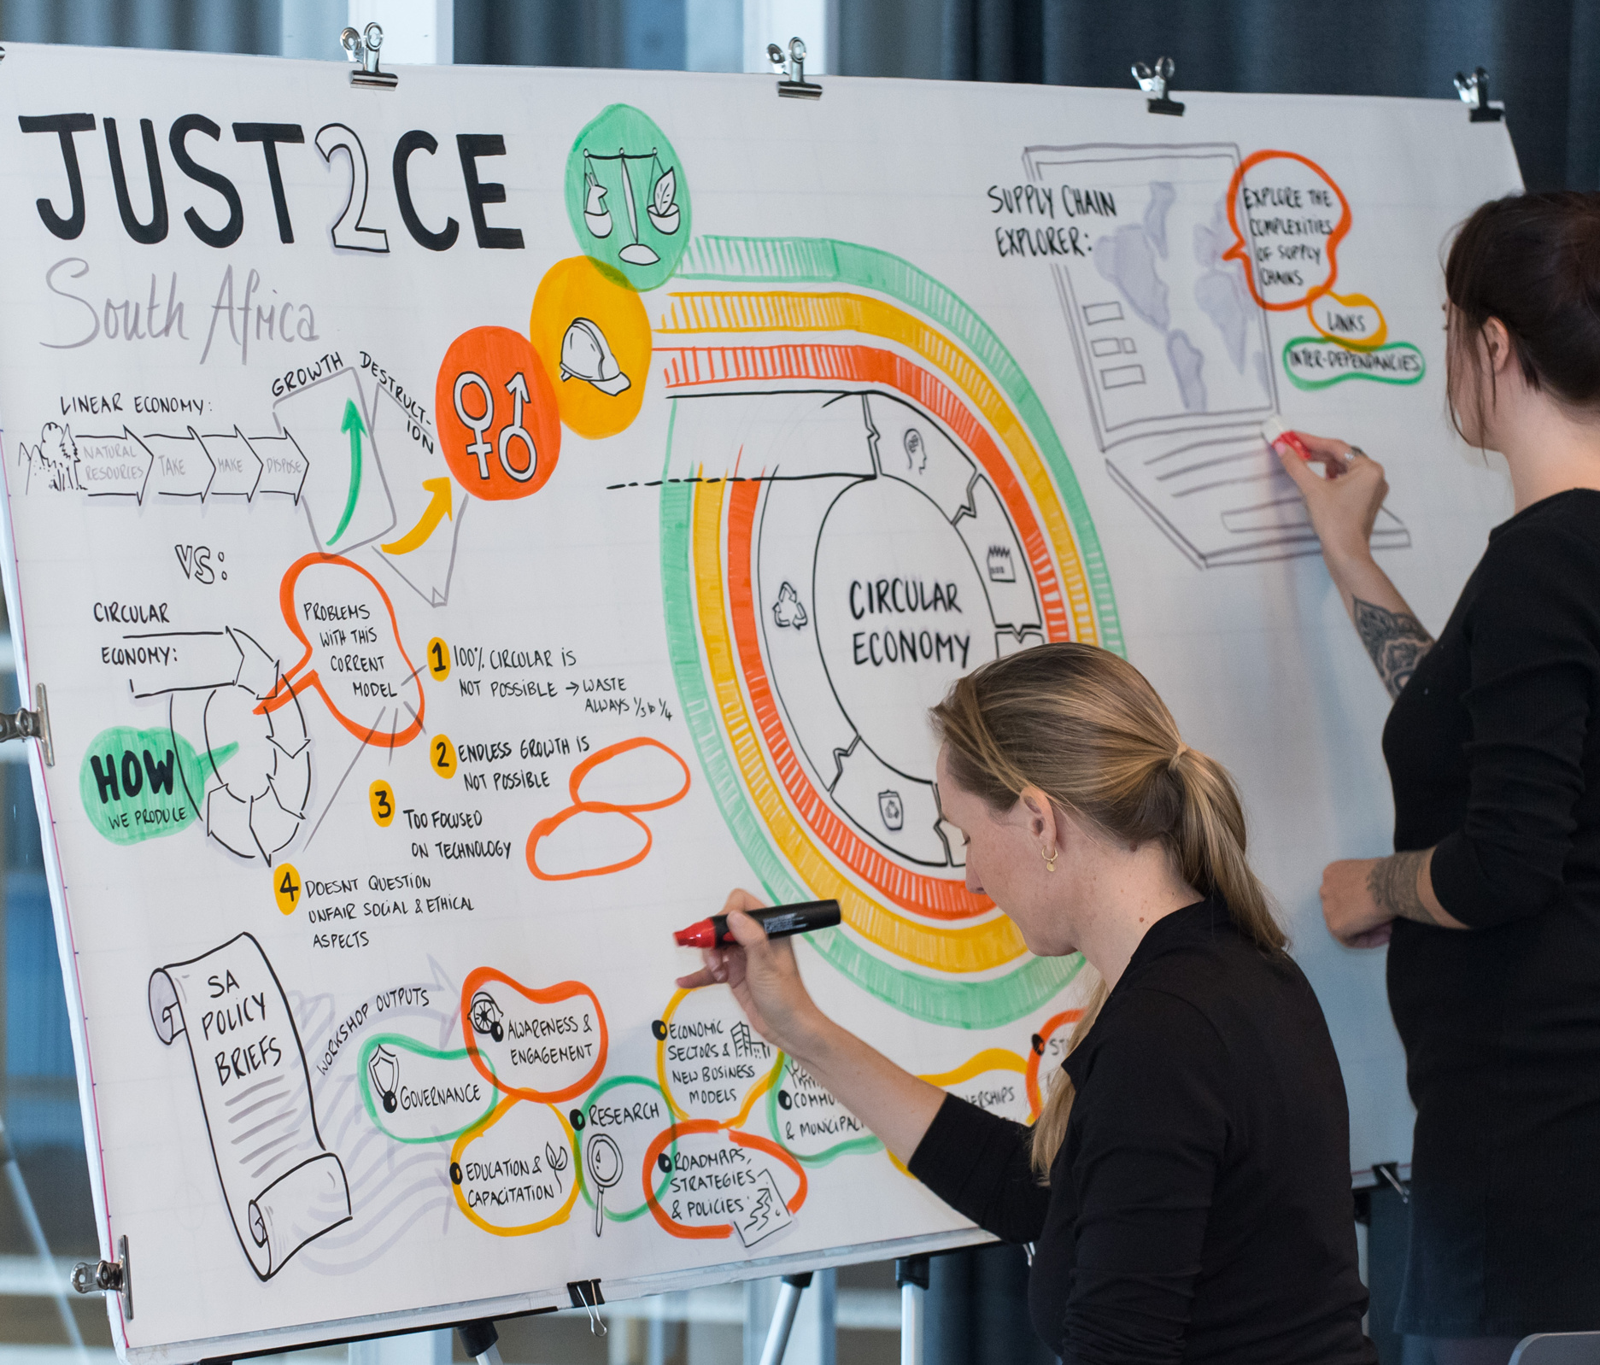

Overview
JUST2CE aims at understanding, in a critical and thoughtful way, under which conditions a responsible, inclusive and socially just transition to a circular economy is possible and desirable, what technical, geopolitical and social factors can enable or hamper such transformation and how these aspects can contribute to the development of transitional policy measures. ​
Visit: just2ce.eu

Slide 22
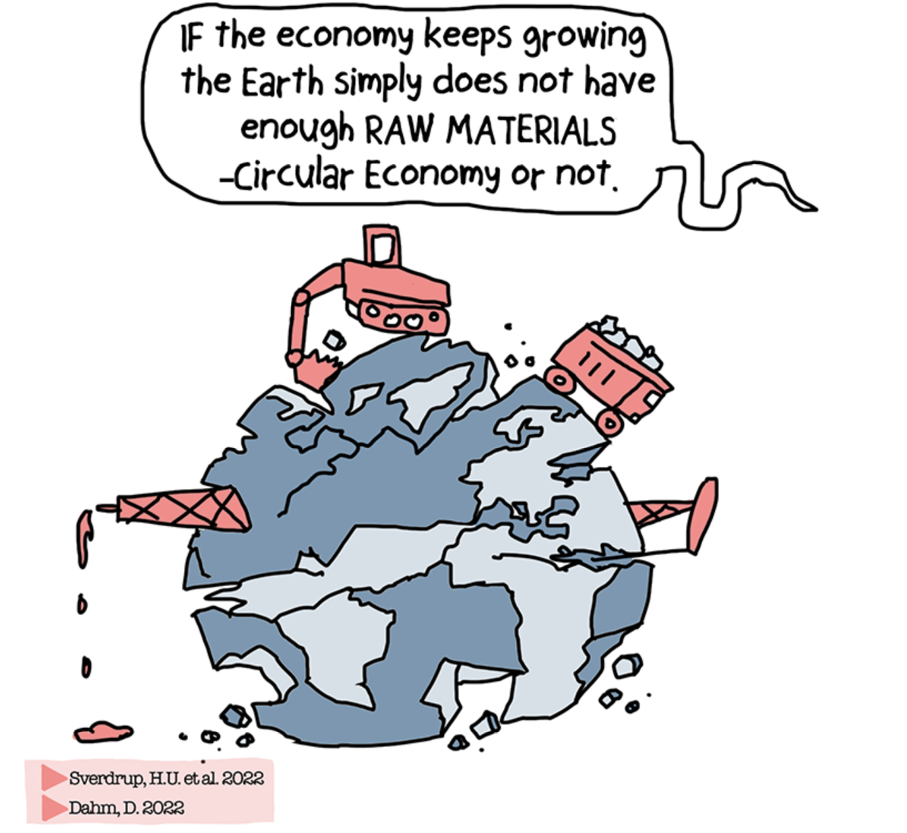
How just is the current Circular Economy?
Key Outcomes H2020 JUST2CE Project
The circular economy ignores the law of thermodynamics > infinite growth is not possible and materials cannot be infinitely recycled without energy
The circular economy has focused on materials circulation and mostly ignored gender, labour and environmental justice –> peace building
The circular economy has mostly ignored North-South relationships > global supply-chains and injustices
The Impossibilities of the Circular Economy

Slide 23








Slide 24
Circular Food Systems for Rwanda is a three-year project that aims to transform Rwanda’s food systems so that it is more circular and sustainable.
Objectives of the project
Accelerate business growth for companies within the circular economy for the food arena (Workstream 1)
Advance the development of a supportive enabling environment for the circular economy for food via smart policy design (Workstream 2)
Generate and distil actionable learnings to accelerate food system transformations in other geographies (MEL & Communications)

Slide 25
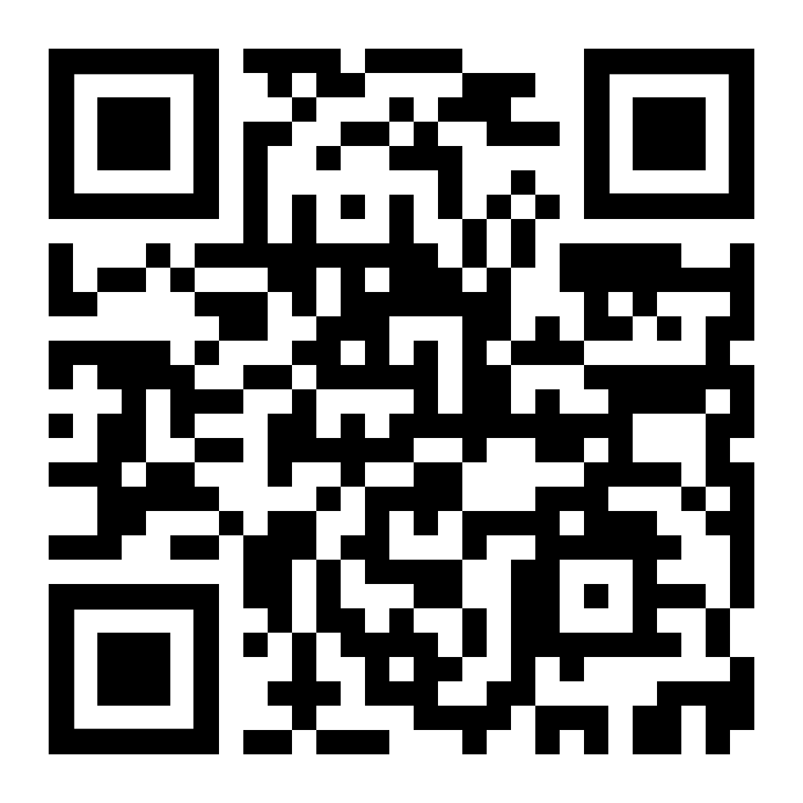
Find out more:
www.circularfoodsystemsrwanda.org

Slide 26
Together, we can find ways to reinvent inclusive growth
in the African continent.

Slide 27




Thank you!
GET IN TOUCH:
info@ACEN.africa| ACEN.africa
To get involved, become a member of ACEN!

