Slide 1
Textile & Garment Circular Economy Project
Inception Workshop – November 24
Dr.Siva Pariti

Slide 2
About BluWin

Slide 3
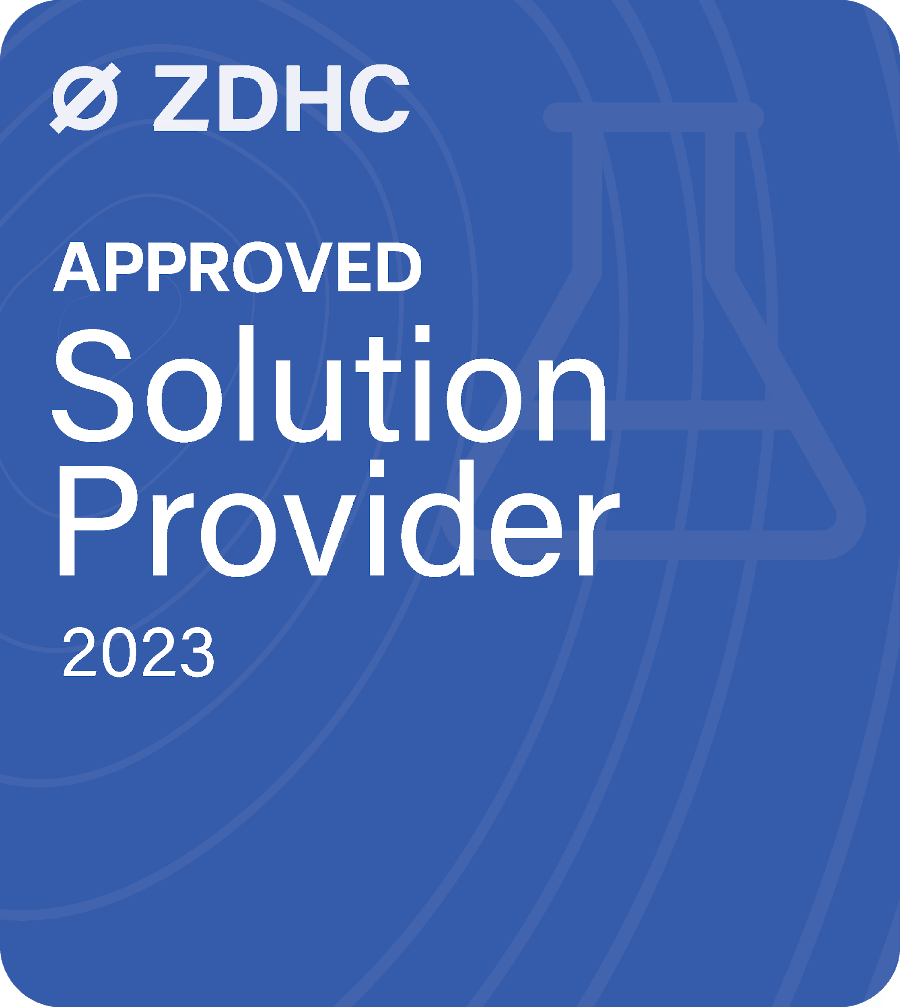
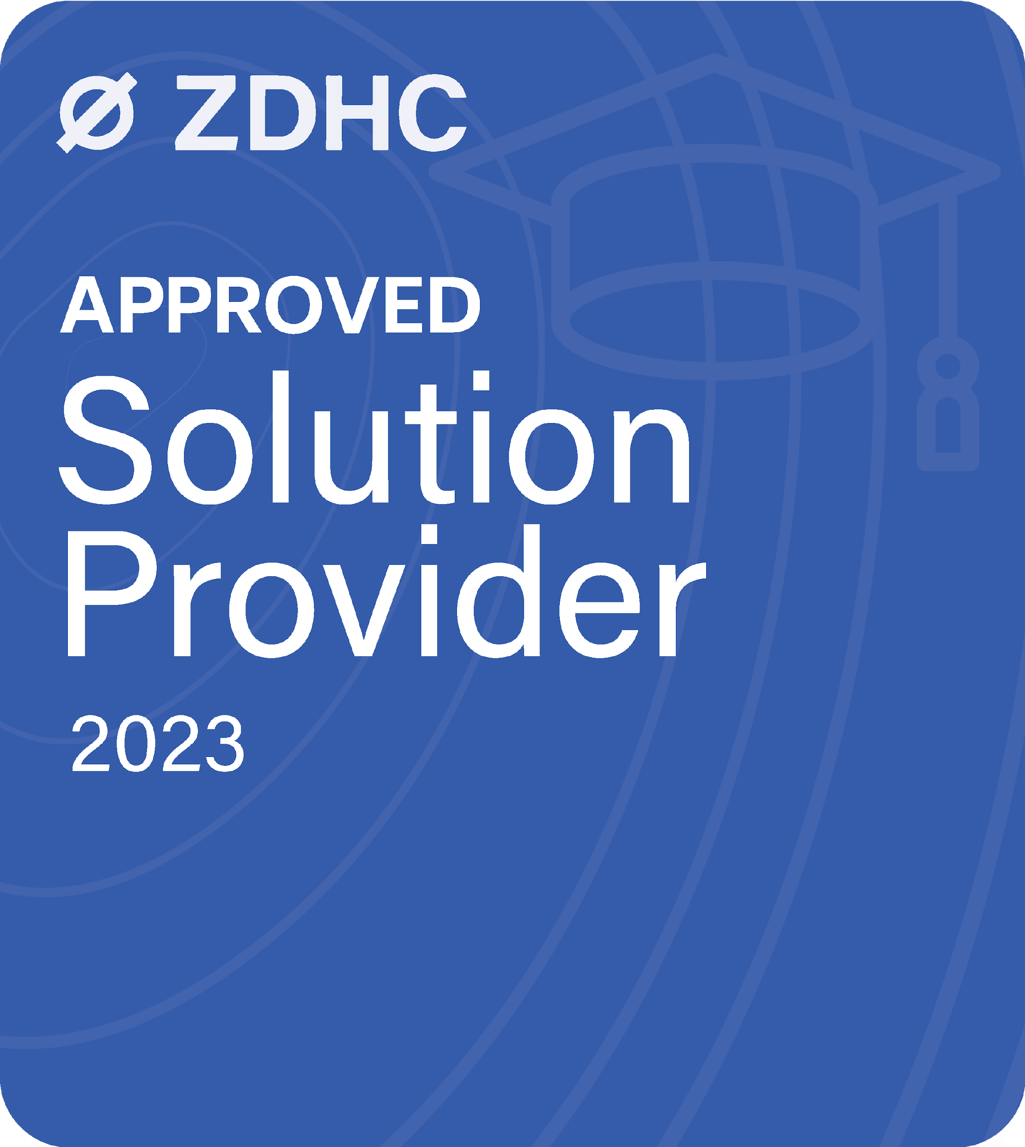
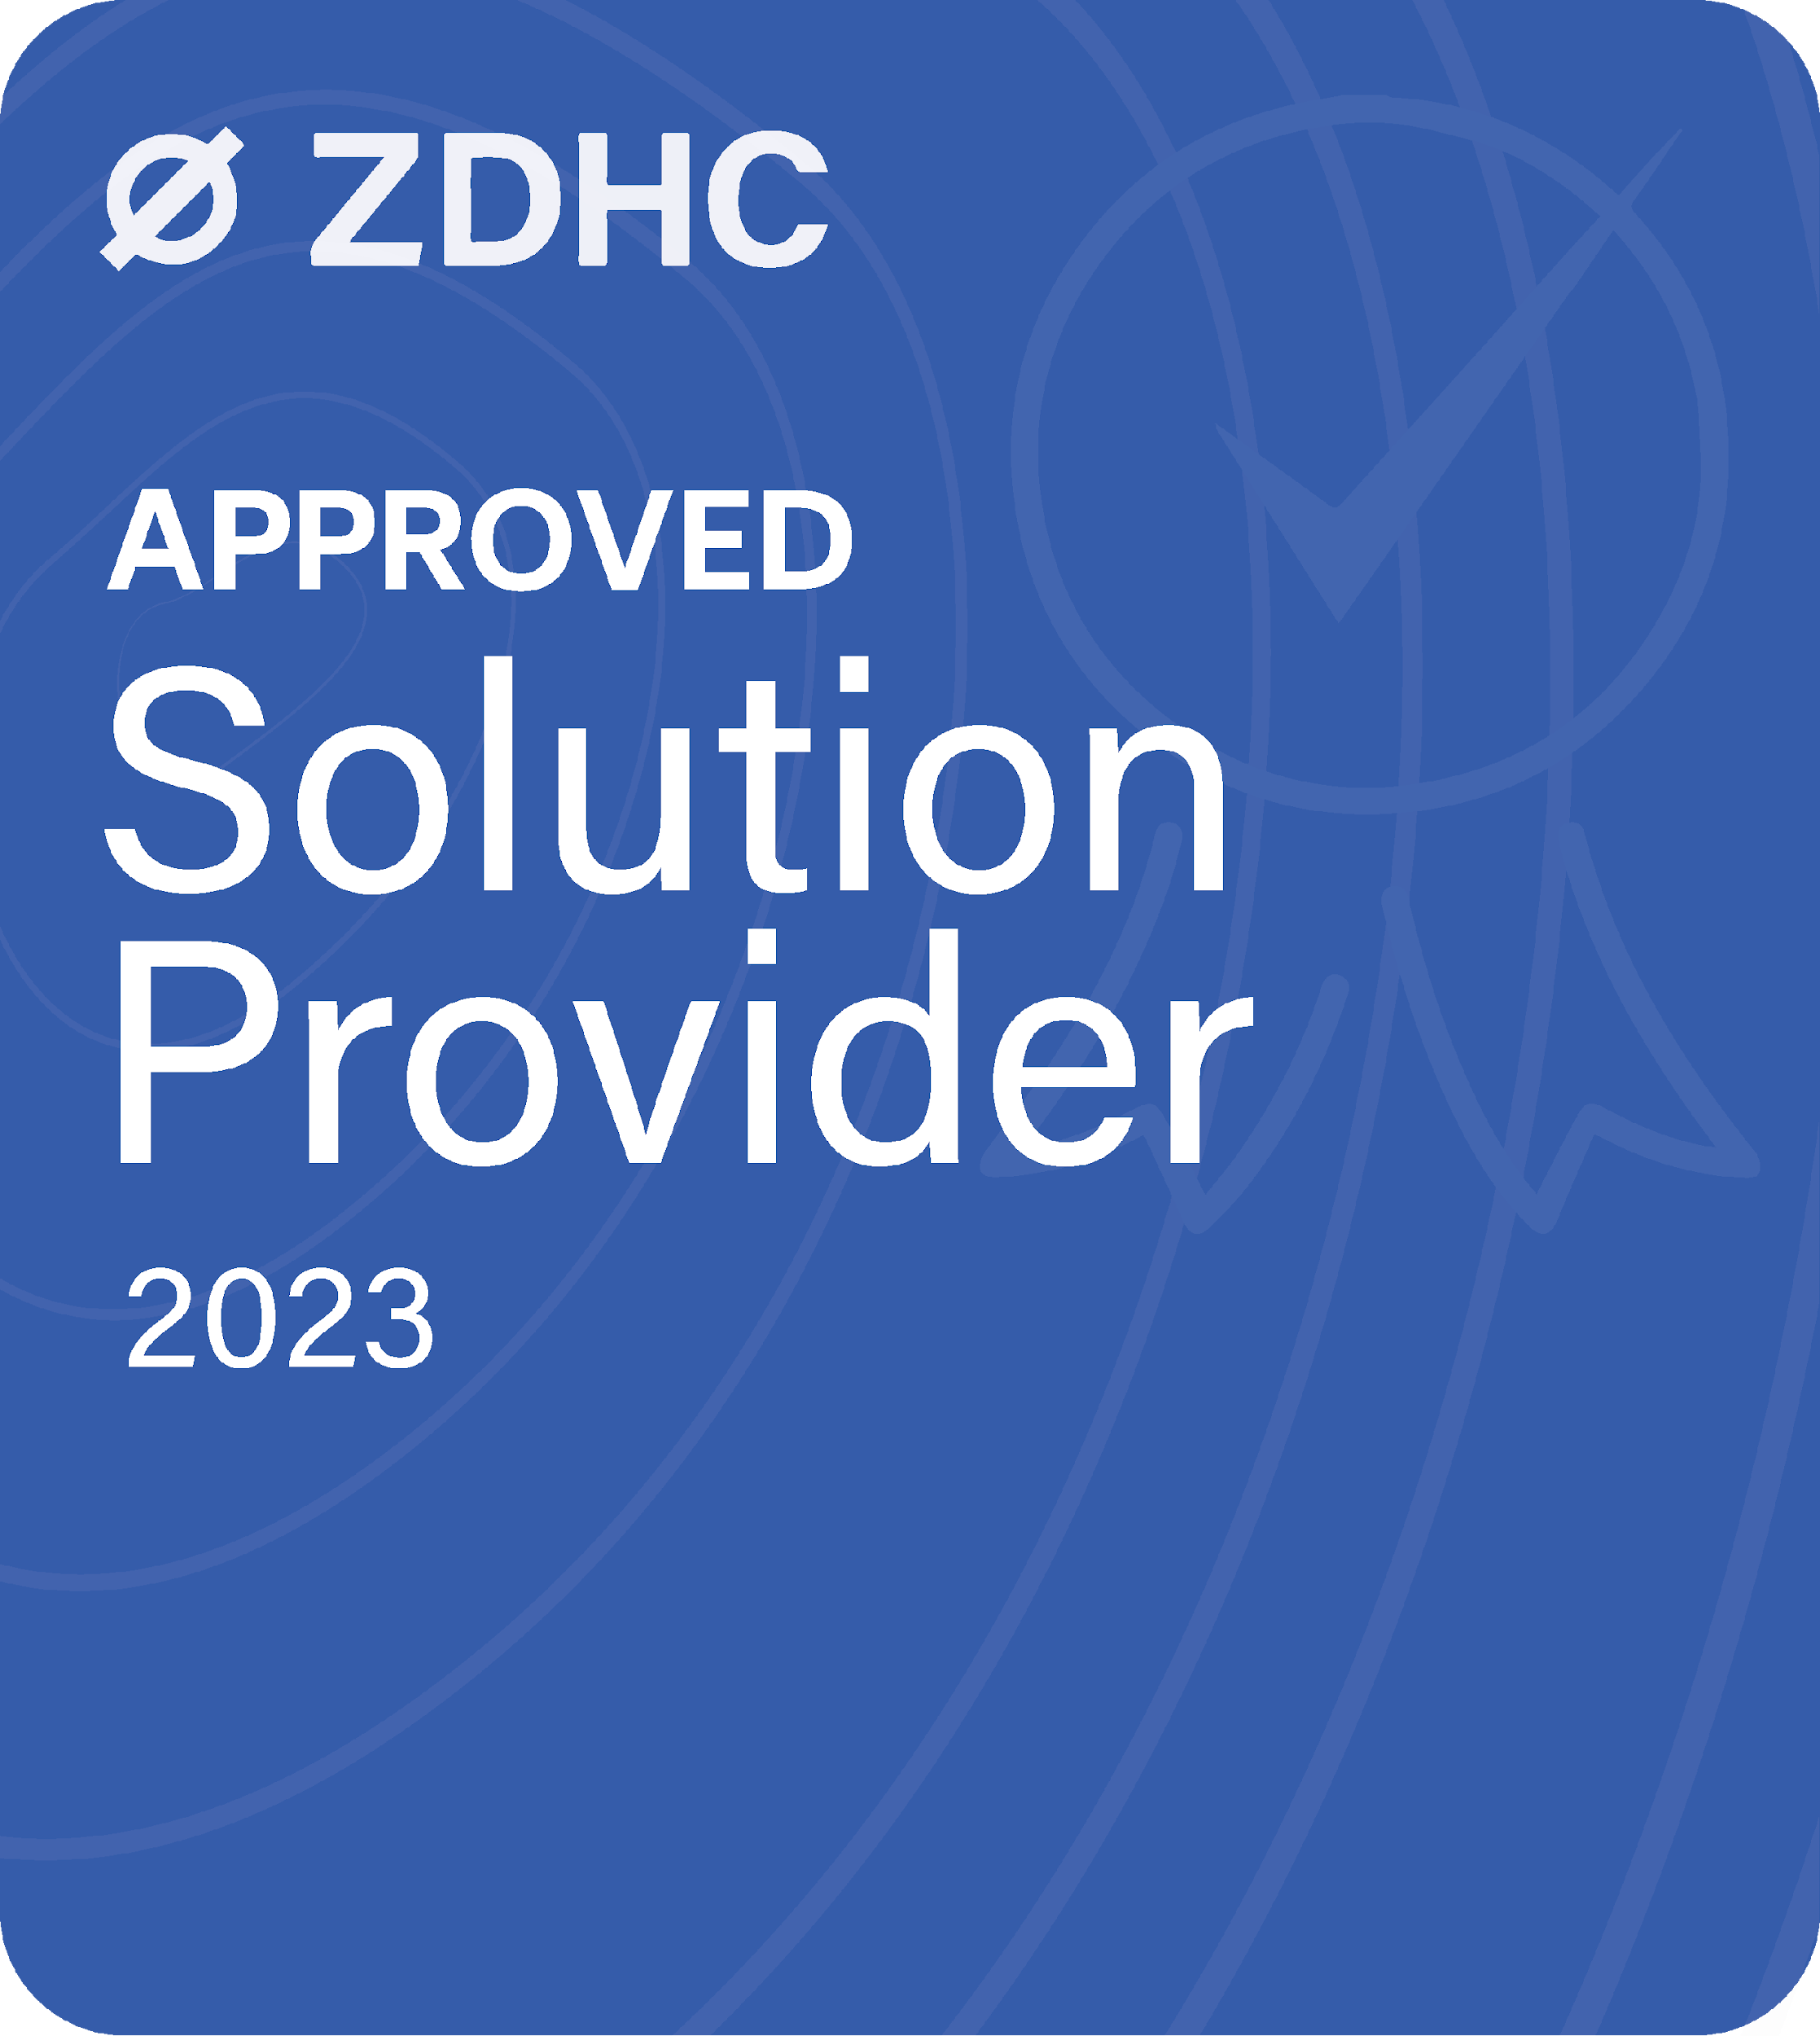
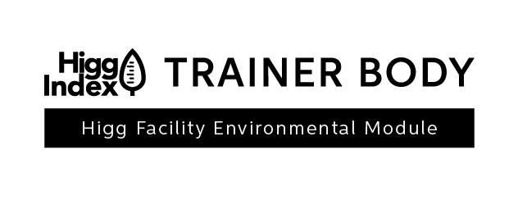
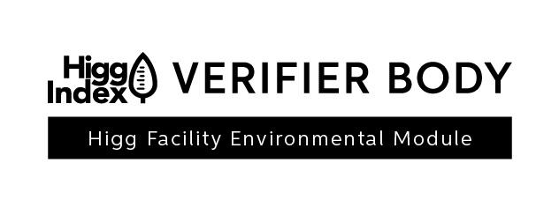


ABOUT BluWin
BluWin is the holding company of ‘’Sustainable Textile Solutions (established in 2012)’’ and ‘’BluWin academy’’ (established in 2020) and a high-impact climate solution provider whose mission is to contribute to a better world and better quality of life by providing solutions which reduce the adverse effects of the fashion, textile, and footwear industries on our planet and the climate.
BluWin Limited
35 Westgate, Huddersfield, HD1 1PA, United Kingdom
UK | Bangladesh | Brazil | China | India | Pakistan | Portugal | Spain | Sri Lanka | Turkey | US
Notes:
BluWin is the holding company of "Sustainable Textile Solutions" (established in 2012) and "BluWin Academy" (established in 2020) and a high-impact climate solution provider whose mission is to contribute to a better world and a better quality of life by providing solutions which reduce the adverse effects of the fashion, textile, and footwear industries on our planet and the climate.
With its head office in the UK, BluWin operates in Bangladesh, Brazil, China, India, Pakistan, Portugal, Spain, Turkey, and the US and offers services to more than 40 countries across the globe.

Slide 4

BLUWIN GLOBAL REACH
ASIA
Bangladesh, India, Indonesia, Cambodia, Vietnam, Sri Lanka, South Korea, Myanmar, Malaysia,, Pakistan, China, Taiwan, Thailand, Japan
EUROPE
Turkey, Germany, Poland, Spain, Portugal, Italy, Serbia, Croatia
AFRICA
UNITED KINGDOM
Egypt, Tunisia, Morocco, Madagascar, Kenya, Ethiopia
PORTUGAL
INDIA
CHINA
TURKEY
SRI LANKA
NORTH & SOUTH AMERICA
Guatemala, Argentina, Colombia, El Salvador, Honduras, Mexico, Nicaragua, Brazil, Dominican Republic
BANGLADESH
PAKISTAN
Notes:
A truly global team of interdisciplinary consultants places us in a unique position to derive innovative ideas and translate them into robust programmes that drive transformation. BluWin delivers a wide range of innovative and impactful solutions in line with the United Nations Sustainable Development Goals to help businesses transform towards sustainable production and a circular economy.

Slide 5







SCOPE OF OUR SERVICES
CLEAN CHEMISTRY
RESOURCE MANAGEMENT
REGENERATIVE BY DESIGN
Making products relevant for today and ahead of tomorrow by ensuring clean chemistry is part of the DNA of a product
From a re-active to pro–active approach in Resource management
Fashion without compromise. Building expertise and capabilities to-rethink and innovate beyond linear
PROCESS EXCELLENCE
CLIMATE POSITIVE
SUSTAINABLE FIBERS
Driving economic competitiveness through resource efficiency and meeting quality requirements by implementing Best Available Technologies
Achieving science-based targets through emission reduction and use of renewable energy resources
Accelerate sustainable practices in the apparel & footwear value chain through more sustainable material choices
Notes:
Our scope of services are divided into six segments-
Making products relevant for today and ahead of tomorrow by ensuring clean chemistry is part of the DNA of a product.
Clean Chemistry
Making products relevant for today and ahead of tomorrow by ensuring clean chemistry is part of the DNA of a product.
Process Excellence
Driving economic competitiveness through resource efficiency and meeting quality requirements by implementing Best Available Technologies.
Resource Management
From a re-active to pro–active approach in Resource management
Climate Positive
Achieving science-based targets through emission reduction and use of renewable energy resources.
Regenerative by Design
Fashion without compromise. Building expertise and capabilities to-rethink and innovate beyond linear.
Sustainable Fibers
Accelerate sustainable practices in the apparel & footwear value chain through more sustainable material choices.

Slide 6
About The Project

Slide 7


BLUWIN SCOPE OF WORK
TASK 01
Provide In-person training to facilities as well as the local taskforce who will provide future support to the facilities on ZDHC Technical Industry Guideline (TIG) and ZDHC Wastewater Management through ZDHC Academy
TASK 02
Provide on-site support at the facilities to prepare a CIL through training business units to enable them to create a Performance Incheck Report
TASK 03
Strengthen the capacity in the Southern Africa region through ZDHC approved laboratories through trainings.
Notes:
BluWin is the holding company of "Sustainable Textile Solutions" (established in 2012) and "BluWin Academy" (established in 2020) and a high-impact climate solution provider whose mission is to contribute to a better world and a better quality of life by providing solutions which reduce the adverse effects of the fashion, textile, and footwear industries on our planet and the climate.
With its head office in the UK, BluWin operates in Bangladesh, Brazil, China, India, Pakistan, Portugal, Spain, Turkey, and the US and offers services to more than 40 countries across the globe.

Slide 8
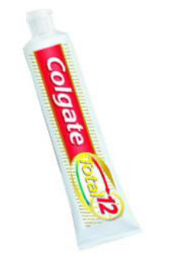
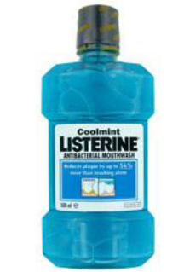


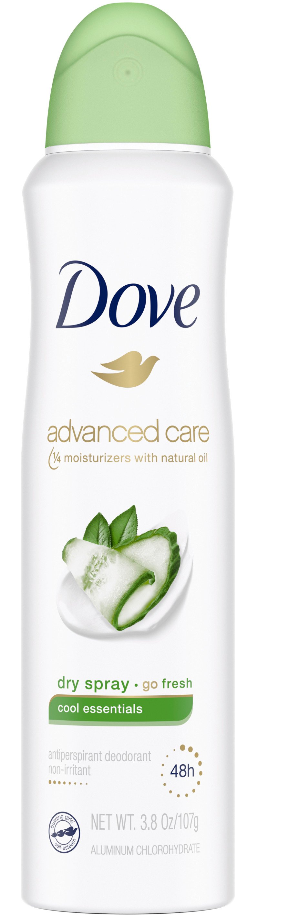
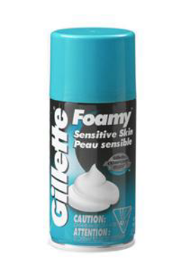




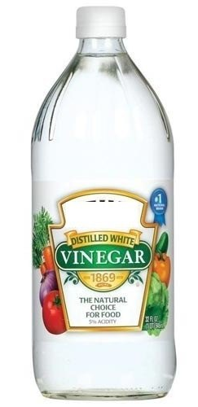
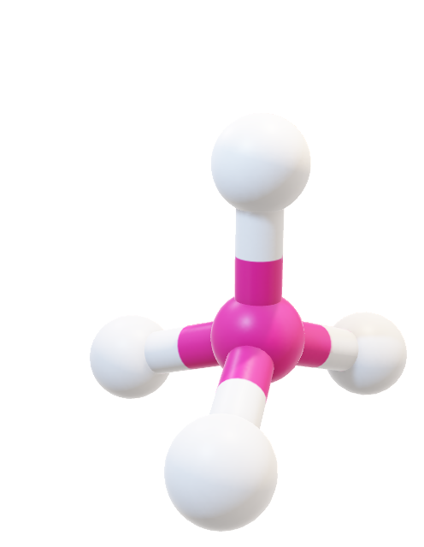
Chemistry in Day to Day life

Slide 9


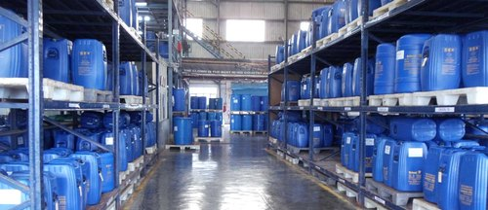
Textile Chemicals
Dyes, Pigments & Inks
Sizing agent
Coning oil
Desizing agent
Scouring agent
Bleaching agent
Wetting agent
Dispersing agent
Levelling agent
Fixer
Various finishing agent
Soaping agent
Binder
Thickener
And list goes on an on……..

Slide 10



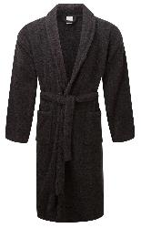






Textiles in day to day life
Home Textile
Apparel
Technical Textile
Footwear

Slide 11
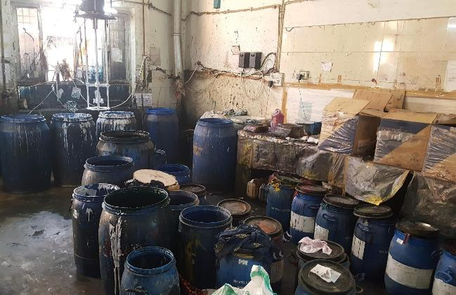
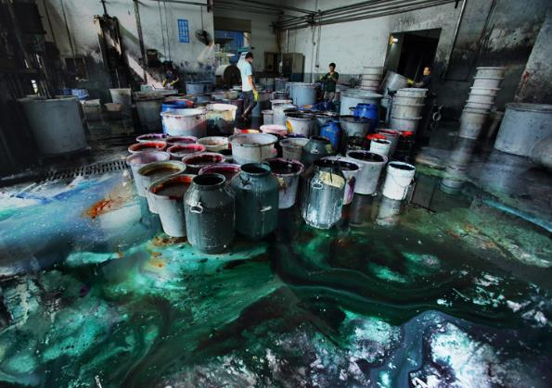
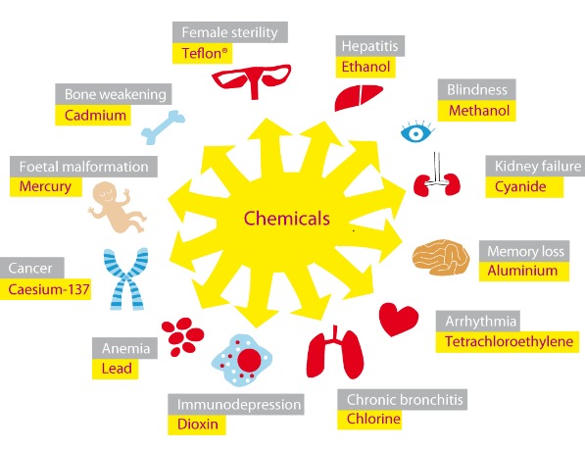
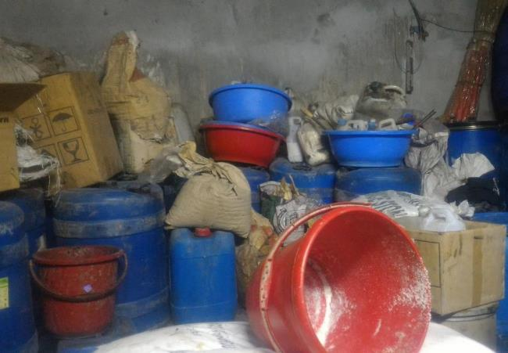
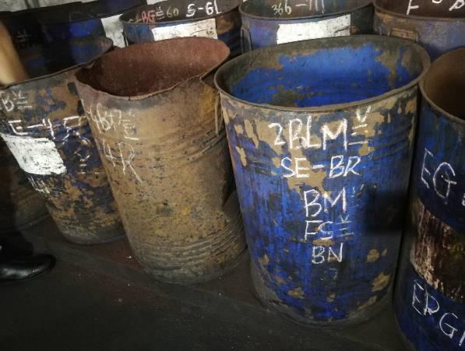
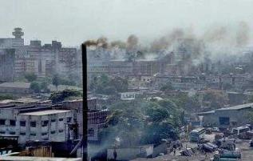
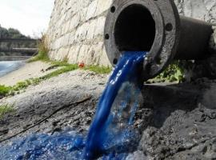
Bad Chemical Management
Health and Safety
Environmental

Slide 12
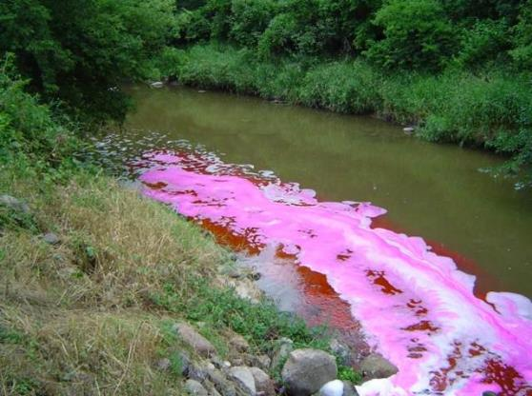

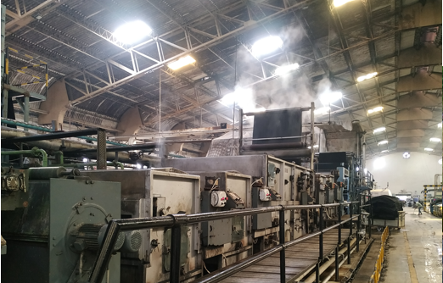
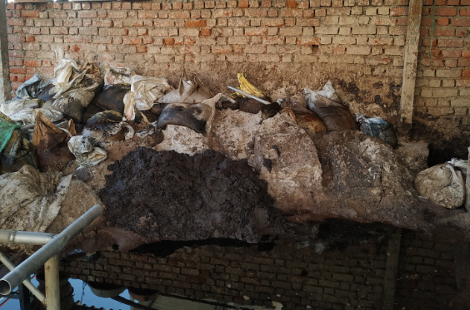
Bad Process Management – Increase pollution load
Water pollution
Air pollution
Soil pollution

Slide 13


Way Forward?
Chemical Management
Process Optimization

Slide 14
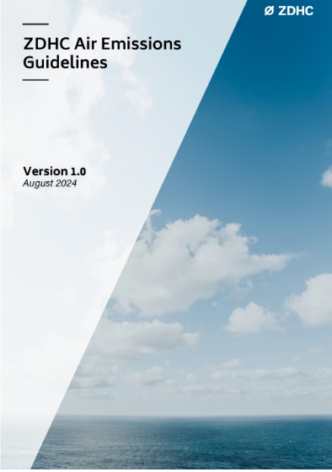
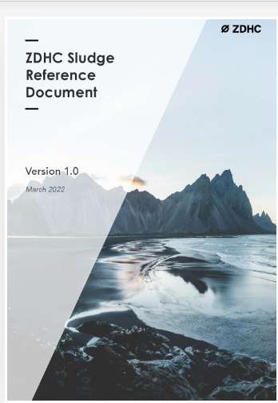

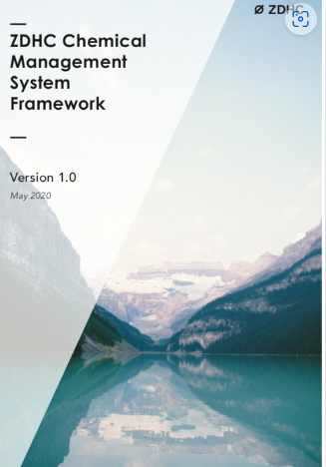
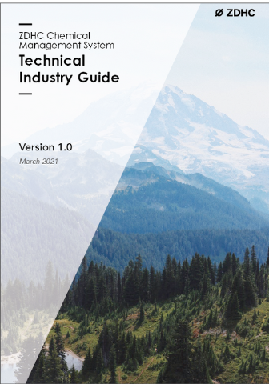
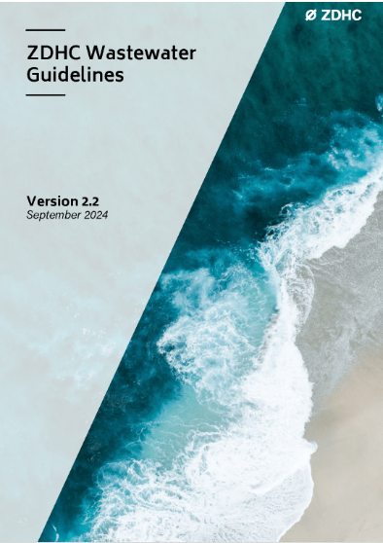
ZDHC PROGRAMME
Input Management
Process
Output Management

Slide 15
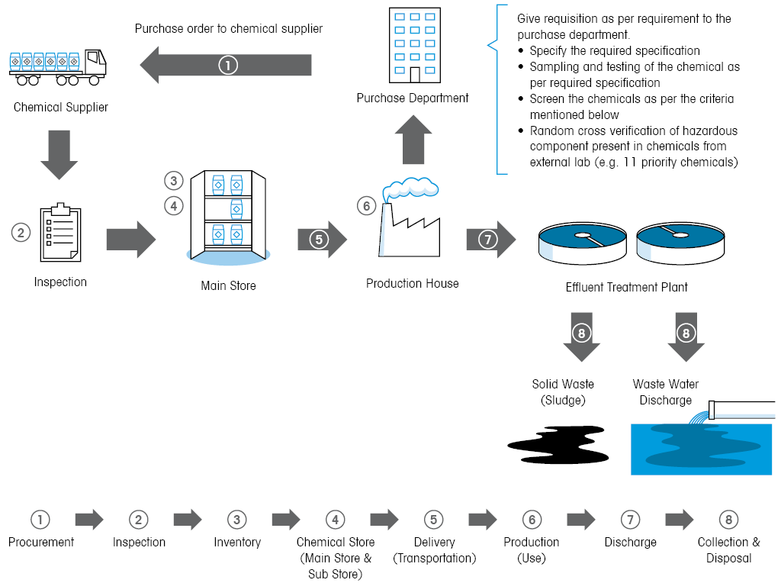
CHEMICAL MANAGEMENT SYSTEM
Notes:
Its important that you take full control of all operations and activities where chemicals are involved in the facility. You should be aware of the chemicals since the purchase to the disposal.
Chemical management is the systematic control, use, and disposal of all chemicals in a facility.
It includes traceability of formulations, both through a Safety Data Sheet or SDS and through the chemical manufacturer. It also includes a review of hazards to improve overall safety for workers.
A successful Chemical Management program includes establishing full control of the amount of chemicals ordered, used, discharged, and disposed.
Let us understand why we need to manage chemicals.
●The first reason is that we must all take a greater responsibility for the health and welfare of our planet for existing and future generations. There is no doubt that manufacturing operations cannot be sustained in the same manner that we are currently operating under. A conscious movement towards the use of safer chemicals and sustainable chemistry practices requires everyone’s involvement.
●Secondly, it is important for us to fully understand the various hazards associated with chemicals used in the manufacturing processes. This way we can implement proper risk control measures, not only protecting the safety of workers but minimizing chemical accidents.
●The third reason is to address growing concerns from buyers, consumers and other external stakeholders such as legislating bodies and NGOs. These concerns are mainly related to restricted chemicals that may remain as residues on the final product or chemicals that can negatively impact health and the environment. A comprehensive chemical management plan is the best way to ensure compliance to buyers and gain consumer trust.

Slide 16
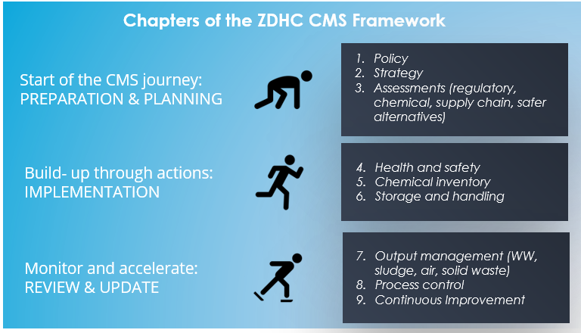
ZDHC CHEMICALMANAGEMENT SYSTEM

Slide 17

CHEMICAL MANAGEMENT POLICY
Write What you follow and follow what you write…..
Create policies to guide and manage.
  Purchasing Policy,
  Transparency Policy and
  Traceability Policy
  Waste Management Policy
  Wastewater Treatment and Management Policy
  Storage and Handling Policy
  Air Emission Policy
  Emergency Response Policy

Slide 18
SUPPLIER EVALUATION CRITERIA
QUALITY ASSURANCE
High quality product as per the facility requirement.
Inhouse quality control and quality assurance of all lots produced.
CONSISTENCY
Consistent supply from the first delivery onwards.
TRACEABILITY
Internal traceability of chemicals and ownership towards label traceability.
TRANSPARENCY
Sharing complete information about chemicals, including Safety Data Sheets as per GHS or other international norms and updated Technical Data Sheets.
PRODUCT STEWARDSHIP
Competency to supply ZDHC MRSL conform chemicals through an internal product stewardship system.
RSL/MRSL CONFORMANCE
Third- party verified certifications for finished products or self- declarations for Brand RSL and ZDHC MRSL requirements.
Third party test reports proofing conformance with MRSL/ RSL requirements and CoA.
TECHNICAL SUPPORT
Technical support team available to support new developments and resolving issues.
PRODUCT DELIVERY
Ontime delivery of chemicals.
Deadstock to be taken back under predefined terms and conditions.
PRICE
Competitive pricing without compromising quality.
Sustainable packaging
Green transport
Notes:
For each chemical used, ask the following questions:
− Can the supplier provide a Safety Data Sheet (SDS) in the local language containing the relevant sections on proper handling, hazards, transport and safe disposal?
− Can proper storage be provided for the chemical?
− Are the facilities appropriate for the use of this chemical?
− Will the chemical or its end products require disposal as hazardous waste?
− Is appropriate PPE available for safe use of the chemical or its end product?
− Have persons who will handle and use the chemical been trained in handling these chemicals? Are they aware of the hazards?
Answering these questions will help you to ensure that the procurement decisions you took are meeting MRSL/RSL as well as protecting the health and safety of your workers.
You can set the following criteria in your supplier evaluation policy to select your suppliers-
Quality assurance
Consistency of supply
Internal traceability of chemicals and ownership towards label traceability
Transparency
Product stewardship
RSL/MRSL conformance
Availability of technical support
Ontime delivery of chemicals
and
Competitive pricing without compromising quality.

Slide 19
EXAMPLE OF SUPPLIER EVALUATION
Based on the evaluation criteria we discussed in the previous slide, you can assess and classify the suppliers as preferred, approved or non-approved suppliers. Purchase only from your preferred and or approved suppliers.
Here is an example of a supplier evaluation using a set of criteria with a scoring system.
Notes:
Based on the evaluation criteria we discussed in the previous slide, you can assess and classify the suppliers as preferred, approved or non-approved suppliers. Purchase only from your preferred and or approved suppliers.
Here is an example of a supplier evaluation using a set of criteria with a scoring system.
We have scored 2 suppliers in 9 different categories.
Which supplier are you going to choose based on their scores?
In the following slides, we will dig deeper and discuss a little more about some of the criteria.

Slide 20



MANAGEMENT STRATEGY
Define the scope of the facility for Chemical Management System (CMS)
Decide the infrastructure & resources required for implementing the CMS
Finalize an action plan with details of the goals as well as the tools and methodology, timeline, resources, budget and staff responsible and accountable for each defined goal

Slide 21
ASSESSMENT
What should you consider when you conduct a chemical hazard & risk assessment?
Validation that purchased chemicals meet the ZDHC MRSL requirements by checking conformance via the ZDHC Gateway.
Validation that all chemicals have a proper SDS in local language.
Assessment of health and safety risks of employees:
Identify to what chemicals employees may be exposed to
Which harm may cause the exposure to chemicals
What activities may increase exposure to risk
Chemical products and their compatibility with other chemicals during storage, transportation and handling

Slide 22
ASSESSMENT
What should you consider when you conduct a chemical hazard & risk assessment?
Identify which risks need to be controlled that may affect property, human health and the environment:
  Frequency of exposure
  Concentration of substances involved
Identify other operational risks during the assessment (i.e. leak, fire, flood, waste storage).

Slide 23

HEALTH AND SAFETY
Chemical hazards using control hierarchy
PPEs and how to select them
Emergency Response Plan and Emergency Response Team
Fire hazards and control procedures
minimum requirements of exposure must be reviewed:
Ingestion
Touch (i.e. Dermal)
Inhalation
Environmental
Community

Slide 24
CHEMICAL INVENTORY
Comprehensive chemical inventory
Track chemical use and identify discrepancies between recipes and actual usages
Match equipment size/capacity to sizes of orders
Avoid dead stock or surplus stock
Recover and recycle inputs where possible
Purchase Compliant chemicals
Track ZDHC MRSL Conformance
Demonstrate compliance with existing regulations
Assess chemical hazards and implement control measures
Correct storage of hazardous chemicals
Improved access to safety information
Selection of appropriate personal protective equipment (PPE) for workers
Basis to define training content
Identify root-causes in case of any product or wastewater failures
Notes:
So, What is a CIL?
A Chemical Inventory list or CIL is a list of all chemical formulations kept or used in a facility.
A chemical inventory should :
Be comprehensive
Track chemical use and identify discrepancies between recipes and actual usages
Match equipment size or capacity to sizes of orders and use low liquor ratio machines to the maximum extent possible
Avoid dead stock or surplus stock
Recover and recycle inputs where possible
purchase sustainable chemicals
Track ZDHC MRSL Conformance
Demonstrate compliance with existing legal and brands’ regulations
Assess chemical hazards and implement control measures
Indicate Correct storage of hazardous chemicals
Provide improved access to safety information
Provide information on selection of appropriate personal protective equipment or PPE for workers
Incorporate basis to define training content
Identify root-causes in case of any product or wastewater failures
This will not only empower you to decrease costs, but also help you meet legal and client requirements and achieve sustainable chemical management practices.

Slide 25
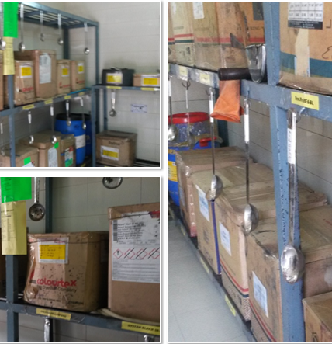
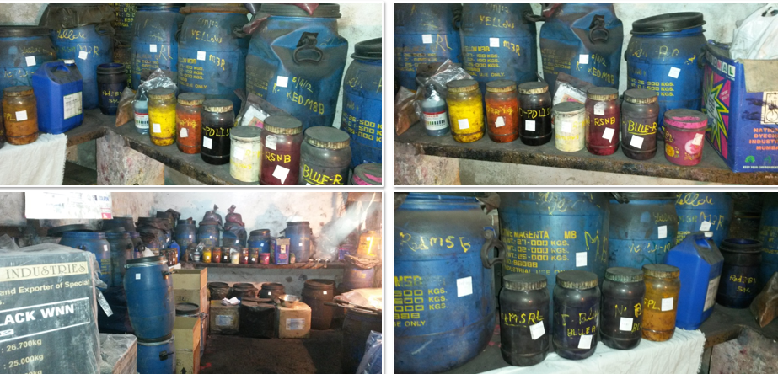
STORAGE & HANDLING OF CHEMICALS

Slide 26



OUTPUT MANAGEMENT
Wastewater
From a chemical and environmental management standpoint, it is important to define all output streams as identified during your assessments, including but not limited to those stated in the grey box.
You need to consider how to:
Control quality of discharged wastewater
Properly manage and dispose the sludge
Control air emissions
Minimise hazardous solid waste and its management
Sludge
Concerns your chemical & environmental policy directly
Air Emission
Solid Waste
(Hazardous & non-hazardous)
concerns RSL and product safety compliance
Final products

Slide 27

OUTPUT MANAGEMENT
ZDHC Wastewater Guideline
ETP operations for conventional parameters
Conduct Root Cause Analysis for nonconformities
Identify sources of air pollutants and control air emission
Classify and label hazardous waste
Disposal pathways to dispose hazardous waste

Slide 28
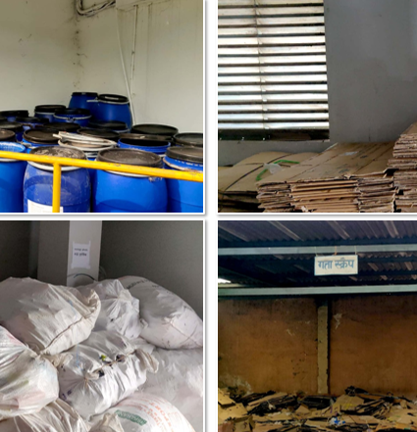
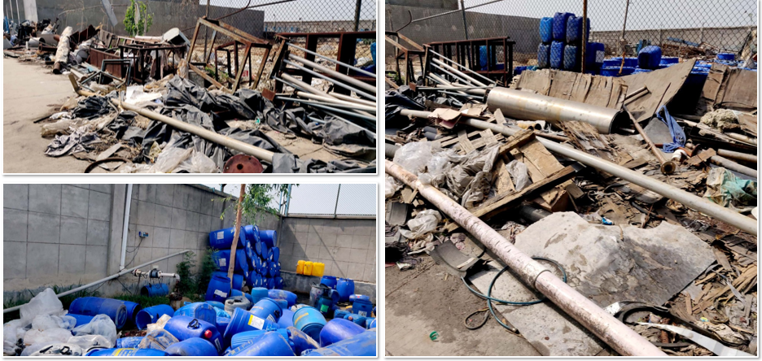
WASTE MANAGEMENT

Slide 29
PROCESS CONTROL
Controlling the processes and documentation at a Supplier helps to ensure a proper implementation of CMS and monitoring of traceability, transparency and continuous improvement.
The three main elements of process control for a successful CMS are:
  Document and Record control
  Incident and non-compliance management
  General maintenance and housekeeping

Slide 30
CONTINUOUS IMPROVEMENT
1. Periodic internal/external audits
2. Identify areas of improvements or change requirements
3. Make improvements and changes
4. Revised CMS established/ implemented
Once the CMS elements are set, continuous improvements can be implemented through the following steps :
Review of CMS policy and strategy at specified time periods by Chemical Responsible Team or by external experts through periodic internal or external audits, followed by a review by the leadership
Identify areas of improvements or pending actions or inconsistencies with new requirements in the existing CMS
Revise the CMS to include changes and improvements in action plans, strategy, procedures, policies, documents, tools, personnel, compliance and training requirements and priorities
Implement the updated and revised CMS
Notes:
Once the CMS elements are set, continuous improvements can be implemented through the
following steps (as shown in figure):
1. Review of CMS policy and strategy at specified time periods by Chemical
Responsible Team or by external experts through periodic internal or external audits,
followed by a review by the leadership
2. Identify areas of improvements or pending actions or inconsistencies with new
requirements in the existing CMS
3. Revise the CMS to include changes and improvements in action plans, strategy,
procedures, policies, documents, tools, personnel, compliance and training
requirements and priorities
4. Implement the updated and revised CMS

Slide 31
Company Assessments

Slide 32
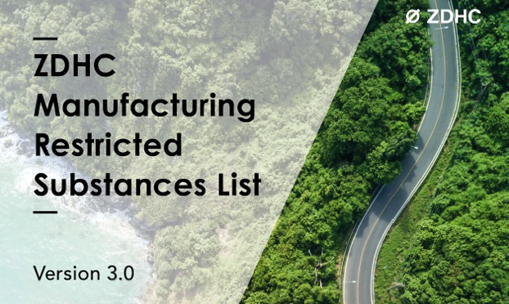

COMPANY ASSESSMENTS
KEY ACTIVITIES INITIATED
Assessed current CMS system and chemicals currently in use
Understand the chemistry, hazards and restrictions of the chemicals
Create action plan for phase out and manage the application for safer out put
Establish ZDHC CMS in place through CIL.

Slide 33
COMPANY ASSESSMENTS
KEY FINDINGS
Production facilities with adequate infrastructure and skilled man power towards production and quality requirements.
Positive attitude towards implementing systems to improve the Health and Safety conditions.

Slide 34
COMPANY ASSESSMENTS
KEY FINDINGS
Only chemical stock data was available in most cases
Complete CIL was not available
SDS for most chemicals are present but not compliant as per GHS or other directive
Chemical management system and Policies with full transparency and traceability were not present
Chemicals selection with hazard assessment and chemical load and treatability assessment was found missing

Slide 35

COMPANY ASSESSMENTS
KEY FINDINGS
System to conduct Risk assessment of the chemicals with reference to RSL or MRSL is absent
Awareness on the RSL risks and CMS attributes among the chemical supply chain partners needs improvement
Process of conducting walkthrough, Hot Spot identification and Incident Registry System need improvement.

Slide 36
COMPANY ASSESSMENTS
Way Forward…
Establish full CMS
Engage and upskill chemical suppliers
Create Policies and CIL and complete the gaps
Incidents registry through walk-trough assessments
Hotspots analysis and create action plans to remediate
Critical Thinking and Root cause assessments
Monitor continuous improvement

Slide 37
Thank You!

Slide 38
Any questions?

