Slide 1

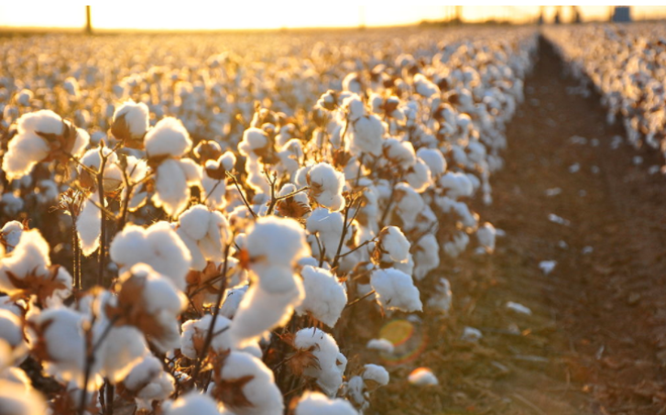



IFC Support to the Textile Industry
November, 2024

Slide 2

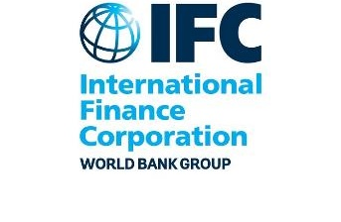


IFC: A Member of the World Bank Group
Advancing economic development and improving the lives of people by encouraging the growth of the private sector in developing countries
The World Bank Group
IFC: Quick Facts
Founded in 1956
Over 60-year history in emerging markets
Owned by 186 member countries
$43.7bn in investment commitments (LT & ST) in FY23
IBRD
International Bank for Reconstruc-tion and Development
IDA
International Development Association
IFC
International Finance Corporation
MIGA
Multilateral Investment and Guarantee Agency
ICSID
International Center for Settlement of Investment Disputes
$390+
billion invested in
emerging markets since 1956
~4,400
staff in 100+ offices
in 95+ countries.
AAA/Aaa
S&P/Moody’s Rating
In working to end extreme poverty and boost shared prosperity, IFC collaborates closely with other members of the World Bank Group
Loans to middle-income and credit-worthy low-income country governments
Interest-free loans and grants to governments
of poorest
Countries
Solutions in
private sector development
Guarantees of private sector investments’ non-commercial risks
Conciliation and arbitration of investment disputes
$69.5bn
Committed Portfolio
$31.7bn
LT Commitments in FY23
$16.7bn IFC Own Account
$15.0bn Mobilized

Slide 3
IFC invested Over $200 billion in Emerging Markets over 10 Years
FY23 is a year of record results for IFC with total commitments around the world achieving $43.7 billion
FY23 Financial Highlights¹
$69.5 billion Active Portfolio² Breakdown as of FY23
$43.7 billion
total commitments around the world
$31.7 billion
long-term investment commitments
$11.0 billion
short-term finance – outpacing the previous annual high of $9.7 billion in FY22
$7.6 billion
climate financing for our own account
6%
3%
Long-Term Investment Commitments by Year ($ billion)
31.7
Including both loan-type and equity-type products
Portfolio exposure is defined as the sum of the (i) committed exposure for IFC’s debt investments, (ii) fair market value of IFC’s equity investments, and (iii) total undisbursed equity commitments

Slide 4




Industry divisions
Our Products and Services
A one stop-shop from debt to equity
Investment
Infrastructure & Natural Resources
Loans | Equity | Trade & Commodity Finance | Derivative & Structured Finance | Blended Finance
Corporate and project financing On-lending through intermediary institutions Sustainable and climate finance linked loans and bonds | Direct equity investments Private equity funds | Guarantee of trade-related payment obligations of approved financial institutions | Derivative products to hedge interest rate, currency, or commodity-price exposures of IFC clients | Using donor funds to crowd in private financing
Manufacturing, Agriculture & Services
Advisory
Financial Institutions
Creating Markets | Firm level | Project Development
Expertise in creating enabling business environment in specific industries Track record on working with governments on implementing reforms Deep relationships across WBG help to improve coordination and delivery | Strengthen clients’ performance and impact Strengthen capacity of suppliers (e.g. farmers) and distributors (SMEs) Sector-specific advisory including PPP Transaction Advisory | Co-develop early-stage projects Help pilot new markets Unlock investment opportunities Improve ESG standards
Private Equity & Venture Capital
Mobilization
Over 80 co-financiers: banks, funds, development finance institutions

Slide 5
IFC’S UPSTREAM – FROM SCOPING TO INVESTMENT
IFC early-stage project development takes a comprehensive lens starting from market scoping to project preparation and culminating in investment making. The clear goal is to generate a bankable deal.
Predevelopment
Development
Financing
IFC supports early-stage generation by leading or supporting funding for feasibility studies, market scoping, diagnostics, market/company surveys.
IFC supports development of projects following confirmation of their feasibility by contributing resources and/or funding for the execution of development activities. IFC’s value-add is in ensuring that projects are bankable.
IFC provides debt and/or equity financing and helps mobilize third-party capital required to fund and execute the project.
Project preparation
Market Scoping
  Technical assessment, engineering, design, FEED
Legal & Regulatory
  Project structuring and planning
Feasibility
  Economic assessment (and alternatives)
  Legal and regulatory assessment and engagement
  Environmental and social-impact assessment, etc.
Business Model/Financial Structuring
Proof of Concept/Piloting
Financing & Mobilization of Capital
IFC provides technical assistance and capacity building throughout the project-development cycle

Slide 6



IFC’S UPSTREAM – PRE-INVESTMENT SUPPORT
IFC has developed specialized tools to crystalize investments
Co-Development
IFC acts and invests as a co-sponsor of a specific and well-defined project or pilot of a project that would be scaled if successful and as such can secure certain rights for the mainstream financing. IFC typically enters a Joint Development Agreement (JDA).
Collaboration
Lighter touch approach to enable IFC to cost-share specific limited scope studies/activities in coordination with other prospective investors to assess potential project(s) in return for certain future co-investment rights. IFC typically uses a Collaboration or Letter Agreement.
Notes:
Deleted:
Advice
Over 800 projects of $1.2 billion (FY 22)
No info in FY 23
Mobilization
$10.1 billion under management at IFC AMC (FY 22)
No info in FY 23

Slide 7
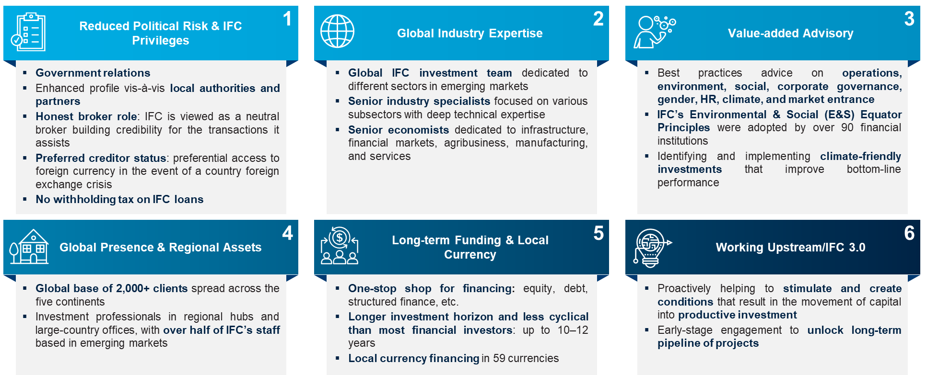
IFC’S VALUE ADD
A strong, long-term strategic partner supporting companies’ expansion in emerging markets

Slide 8
What We Do: Financing Alternatives
Financing options may be pursued individually or in any combination
Senior Debt Financing with Mobilization
Sustainability-Linked Financing
Structuring a Green Loan/ Bond
Anchor Investment in Bond Offering
Advisory Offerings
  Senior debt with a tenor of 6-8 years and grace period of 1-2 years
  IFC to commit to the financing package post due diligence and internal processing
  IFC to syndicate/mobilize from other investors including other IFI and DFIs in its network, providing access to a diversified lender base
  The IFC Tranche and potentially other IFI / DFI funds may have a longer maturity than the traditional commercial lenders (up to 1-2 years)
  Corporate loans / bonds which incentivize achievement of beyond-compliance sustainability KPIs
  As the Sustainability Coordinator, IFC will help determine the most appropriate KPIs for the financing, including threshold and timing (for example GHG emissions reduction)
  IFC will help to develop the Sustainability-Linked Financing Framework (“SLFF”) describing the KPIs
  IFC will also coordinate the review of the SLFF by Second Opinion Providers1
  The use of proceeds is not prescribed, however, IFC would require some of the proceeds to be used towards new capex; some instruments use SDG KPI’s or ESG KPIs or third-party sustainability ratings
  Green Loan / Bond with proceeds earmarked for activities that promote climate purpose
  The Company to work with IFC to identify activities for which the proceeds from the bond will be used for greening assets.
  IFC to help with the green bond process, including provision of technical support such as tools to measure and report impact and necessary training.
  The issuance can be via private placement or a public bond. In case of a public issuance, the minimum issue size would be US$300m and the issuer would need to undergo a ratings process.
  IFC has in-depth knowledge of impact investors who participate in Green Bonds and can catalyze such investors along with it
  Direct financing via purchase of a substantial portion of the bond issuance*
  IFC to commit to subscribing to a bond issuance, which can be communicated to prospective investors during the roadshow.
  Like a partial underwriting, an IFC anchor investment ensures a successful issuance
  IFC’s public endorsement may help to boost subscription levels and contribute to pricing tension
  The issuance can be via private placement or a public bond. In case of a public issuance, the minimum issue size would be US$300m and the issuer would need to undergo a ratings process.
  Potential IFC Advisory Services engagements
  IFC financing can be complemented by IFC Advisory Services offerings to support sustainability efforts and develop decarbonization roadmaps
  IFC and the company may determine the scope of the engagements on key sustainability efforts of the Group
For loans, external verification is recommended. For bonds, pre-issuance Second Party opinion is recommended; but external verification of performance against KPIs is required
Depending on capex requirements, part of the financing can be structured in the form of green loan/bond and/ or sustainability linked loan/bond. IFC financing to be exclusively used in in emerging markets and at least partially for capital expenditure towards investment in machinery, process improvements, and maintenance capex.

Slide 9
IFC’s focus and Approach in Textiles and Apparel
Textiles and apparel value chain is key to economic transformation and creation of jobs in developing countries
Why Textiles and Apparel
Transformational Priorities for Fundamental Change
Creating and Connecting to Markets: as a key source of exports for developing countries, the textiles and apparel value chain allows local factories / suppliers to connect to global markets through integration into GVCs
Building Capabilities and Connecting Workers to Jobs: as an early industrialization sector, the textiles and apparel value chain absorbs large numbers of low skilled workers, providing them with access to their first formal jobs and an opportunity to build their skills and capabilities
Supply Chain Traceability
Combating Climate Change
Efficient Use of Resources
Respectful, Secure Work Environment
To build systems that help trace and measure sustainability in supply chains in manufacturing companies both directly connected to them and further up the value chain
To work with value chain partners to implement programs that reduce greenhouse gas emissions (e.g., by switching to renewable energy resources)
To work with supply chain partners to identify and track water, energy and chemicals consumption and pollution in the processing stage to create a baseline
To implement policies to enhance respect of human rights, including safe working conditions, no discrimination, and no forced labor for all people employed directly or indirectly
Jobs and Sustainable, Inclusive Growth
Job Creating Private Investments
Economic Transformation
More Productive Workers and Entrepreneurs
Creating and Connecting to Markets
Building Capabilities and Connecting Workers to Jobs
Sustainable Material Mix
Circular Fashion System
Promotion of Better Wage Systems
Fourth Industrial Revolution
Total Active Portfolio of $276 million in 26 Different Projects
To trace and evaluate E&S impact of the materials they use and to shift the mix towards low-impact materials (e.g., by using organic instead of conventional cotton)
To create products made for durability, disassembly, and recycling, and to increase the share of recycled fibers in productions. To increase efforts to collect used garments
To pay at least minimum wage without undue delay and unlawful deduction and to not impose other unfair or unreasonable impediments
To start preparing for the effects of technological innovation by analyzing potential impact on value chains (collective effort by the whole industry)
5%
Note: Including IFC’s own account and B loans, as of FY22

Slide 10
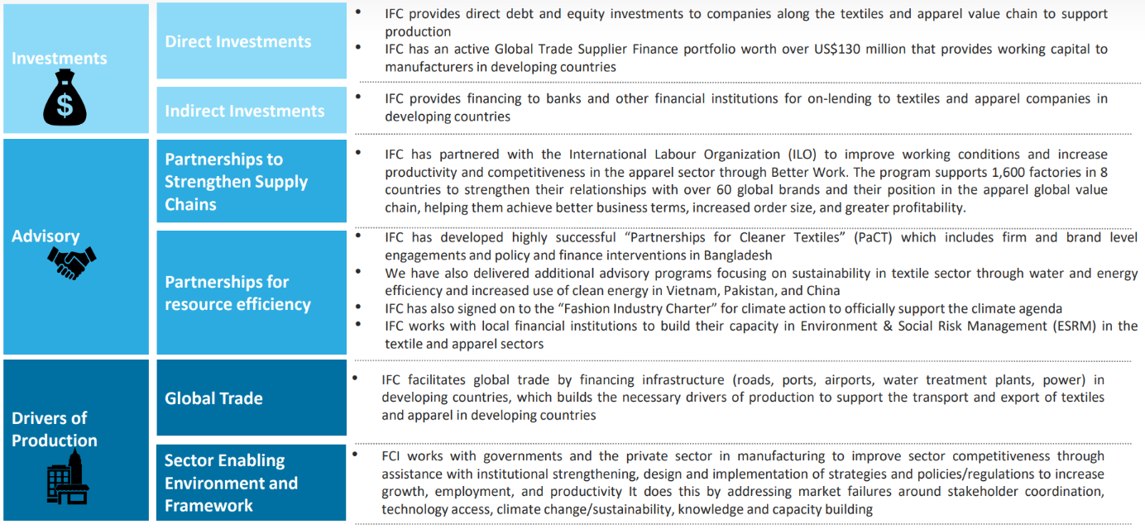
IFC’s engagements in the textiles and apparel Sector
Engagement cuts across IFC’s product portfolio
10

Slide 11





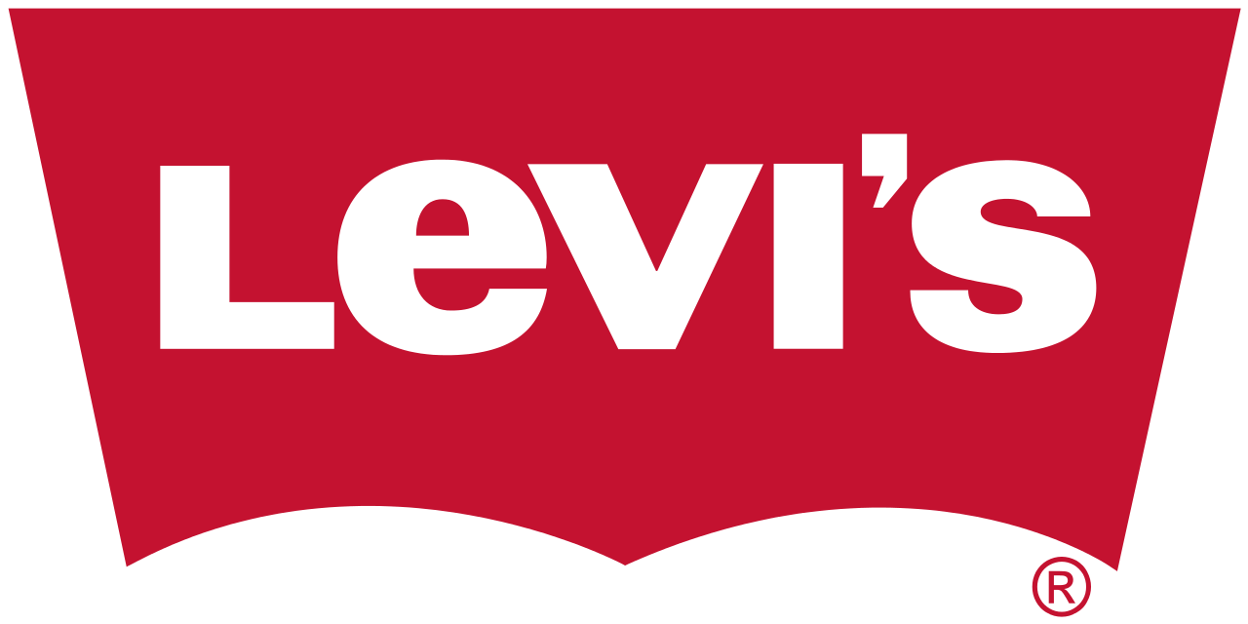
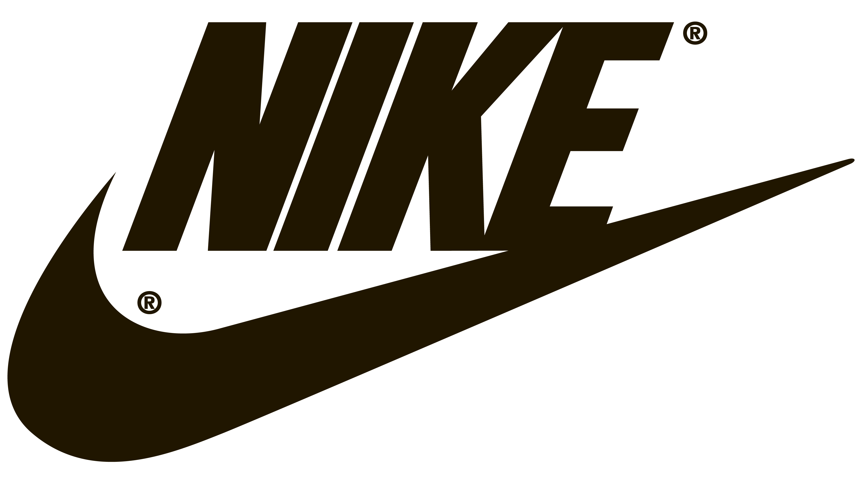
Case study – GTSF
Global
IFC Project description
Under the Global Trade Supplier Finance (GTSF) Program, IFC provides short-term financing to suppliers in emerging markets selling to large companies on open account terms. Under this project, IFC will provide financing to Tier 1 International brands’s Suppliers based in different emerging market countries. The GTSF facility disbursed around US$1.5 billion in FY2020 to more than 300 different suppliers of PUMA, Levi’s, Nike, Columbia, Polo RL, etc..
IFC Added Value
GTSF will reach suppliers in emerging markets and focus on IDA countries. Commercial supplier finance today is mainly reaching suppliers only in OECD markets.
GTSF will reach small and medium size suppliers. Today only the largest suppliers are being covered. GTSF can reach these smaller suppliers in part by leveraging IFC's Advisory Services resources and partnerships in the regions.
Development Impact
Directly increasing direct access to finance exports from emerging markets and supplementing the availability of credit through the local banks that has been the primary focus for economic development.
Reducing the cost of financing the supply chain that enables a better competitive position for the exporter as well as improving the transparency and risk profile of the transaction as the payment risk is transferred to the buyer
Increasing the suppliers' sales to both large buyers in the program as well as to other companies, in turn increasing employment levels for the suppliers.

Slide 12



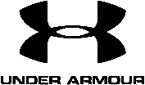








IFC INVESTMENTS IN THE TEXTILES AND APPAREL SECTOR GLOBALLY
Selected transactions in the textiles and apparel sector
Sri Lanka
Sri Lanka
Bangladesh
World
Jordan
Bangladesh
Brandix
MAS Capital
Hamza Textile
Under Armour
Classic Fashion
EKWL
US$50mn Loan
Working capital requirements and capital expenditure existing operations
US$58mn Loan
Working capital requirements and capital expenditure existing operations
US$11mn Loan
Investments for resource efficiencies
US$34.5mn Loan
GTSF Program to support Under Armour’s suppliers
In Latin America & Caribbean regions
US$25mn Loan
Expansion of manufacturing capacity
US$14.4mn Loan
Expansion of manufacturing capacity
2021
2014, 2021
2021
2021
2020
2019
Bangladesh
Bangladesh
Haiti
Uzbekistan
Dominican Republic, Haiti
India
Ananta Apparels
Esquire Knit
Hansae Haiti
Indorama Kokand
Grupo M
Flexituff
US$14mn Loan
Upgrading its existing facility and expansion of tire manufacturing capacity
US$22mn Loan
Expansion of tire manufacturing capacity
US$2mn Loan
Greenfield cutting and sewing plant
US$40mn Loan
Expansion of tire manufacturing capacity
US$33mn Loan
Expansion of tire manufacturing capacity, long term working capital needs and refinancing existing obligations
US$7mn Equity
US$9mn CB
Replacing obsolete equipment with more efficient machinery
2013, 2017
2018
2017
2016
2004, 2010, 2014
2013
12

Slide 13
IFC has supported a diverse range of private companies in the textiles and apparel sector globally and in Africa
Global clients in the textiles and apparel sector
LaInternacional, Ecuador
ECCASA, Honduras
SIFAS, Turkey
Enka Colombia SA, Colombia
Arewa Textiles, Nigeria
Fabritex, Nicaragua
Honam Silk, Korea
SIFAS, Tukrey
India-Malaysia, Malaysia
Pearl Textile, Sri Lanka
Far Eastern, Taiwan
Filitex, Lebanon
Primatexco, Indonesia
Unitex, Indonesia
Sherkate Aliaf, Iran
CELMEX, Mexico
Bata Shoe ZA, Zambia
Daralon, Indonesia
Bata Shoe ZA, Zambia
FILSYN, Philippines
Primatexco, Indonesia
Tatuape, Brazil
Kamaltex, Indonesia
Aksa Akrilik, Turkey
Libtex, Lebanon
Kartaltepe, Turkey
PPIC, Philippines
Tong Yang, Korea
RIVATEX, Kenya
CTM, Sudan
David Whitehead, Malawi
Tecanor, Brazil
SITENE, Brazil
Gonfreville, Ivory Coast
Alpargatas, Argentina
SOTEMA, Madagascar
Kamaltex, Indonesia
Rio Lindo, Honduras
Nile Clothing, Egypt
GEMATEX, Sudan
CYNTEX, Sri Lanka
NTM, Nigeria
Hering, Brazil
MENSA, Tukrey
Kafue Textile, Zambia
Bata Malgache, Madagascar
LIK, Kenya
Kafue Textile, Zambia
Natex, Eswatini
SOTEXKI, DR Congo
COTONA, Magascar
CICAM, Cameroon
SITEX, Tunisia
Guney, Turkey
SOTIBA, Senegal
Socota Textile, Mauritius
Pan Atlantic, Togo
SETAFIL, Morocco
SITER, Tunisia
Tong Yang, Korea
Utexafrica, DR Congo
SANSER, Brazil
Brasital, Brazil
Tatuape, Brazil
Moinho Santista, Brazil
Shams Textile, Pakistan
Sapphire Textile Mills Ltd, Pakistan
Toalia, Brazil
Kewalram, Philippines
Coats Iplik, Turkey
Hala Spinning, Pakistan
Isko, Turkey
Edirne, Turkey
COTONA, Madagascar
Rupali, Pakistan
Spintex, Eswatini
EXB-KH Shoes, India
ROB-INTA, Argentina
AEF NTM, Botswana
Arewa Textiles, Nigeria
Togotex, Togo
SOMOTEX, Tunisia
National Blanket, Zimbabwe
Spinweave, Zimbabwe
PT Indo-Rama, Indonesia
PT Argo Pantes, Indonesia
Avantex Mill, Philippines
Kula, Turkey
Coltejer, Colombia
TIL, Mauritius
Dynamic Textile, Bangladesh
AEF Vicoda, Nigeria
PT Indaci, Indonesia
Crescent Bahuman, Pakistan
NASCO, Turkey
Arvind Mills, India
RUPAFIL, Pakistan
KDIC-Daemyung, Korea
IPS(K)-Novaskins, Kenya
TFB-CIAB, Thailand
CEBRACTEX, Brazil
AEF Growela, Cape Verde
Ghim Li Fashion, Fiji
SETAFIL, Morocco
SCB-Thai Baroda, Thailand
Sarah Textiles, Pakistan
ROB-Guilford, Argentina
Regent Knitwear, Pakistan
BUB-Csini, Hungary
Rupafab, Pakistan
Dupont Suzhou, China
Derivados, Mexico
BOA-Wing Fat, Thailand
Mohib, Pakistan
AEF Aura, Kenya
Liteksas, Lithania
AEF Moshi Lthr, Tanzania
AEF Tan Leather, Tanzania
Yalova Acrylic, Turkey
Texicodi, Ivory Coast
FTG, Ivory Coast
Bradesco-Hering, Brazil
AEF Notacam, Cameroon
Teteks, North Macedonia
Coteminas, Brazil
AEF Lowveld Lthr, Zimbabwe
El-Zay, Jordan
SEF G&M Leather, Mongolia
AEF Isfar Ltd., Zimbabwe
AEF Deras Ltd., Kenya
Coteminas, Brazil
Soktas, Turkey
Zhen Jing, China
SEF SENTA, Senegal
Settavex, Morocco
Wembley, Brazil
Dauteks, Latvia
Vulcabras, Brazil
MFL Vinh Phat, Vietnam
AEF Deraswiss, Zimbabwe
Gumussuyu Kap, Turkey
AEF Global Fabri, Nigeria
Krenholm, Estonia
Kordsa, Turkey
Drobe Wool, Lithuania
Ciluluk Village, Indonesia
Sunson, Indonesia
Boscan Jordan, Jordan
Giavoni, Tajikistan
Cottonline, Madagascar
Alok, India
Babei, China
Grupo M, Dominican Republic
SRF India Limited, India
Dewan Salman, Pakistan
Babei Necktie, China
Unitim, Turkey
Kucukcalik, Turkey
Atateks, Turkey
Nile Suez, Egypt
Encorpar, Brazil
Willbes Haiti, Haiti
Color City, Bangaldesh
Ananta Apparels, Bangladesh
Sanko Tekstil, Turkey
Flexituff, India
ALDO Group HQ, World
EKWL, Bangladesh
Hansae Haiti, Haiti
Esquire Knit, Bangladesh
Classic Fashion, Jordan
Under Armour, World
MAS Capital, Sri Lanka
Brandix, Sri Lanka
Wolverine Worldwide, World
13

Slide 14
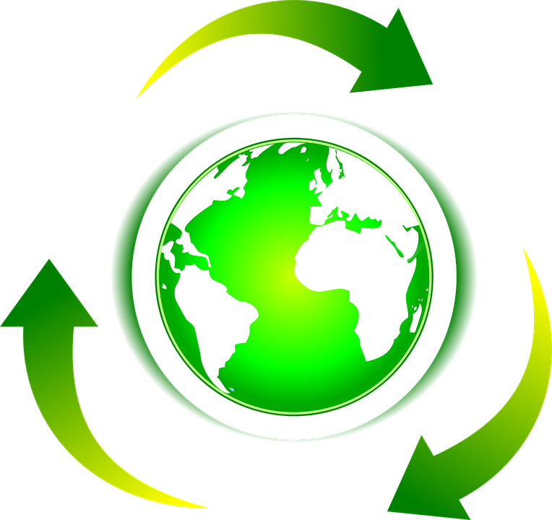
IFC’S EXPERIENCE / FOCUS IN SUSTAINABILITY AND CLIMATE

Slide 15
IFC is a leader in sustainable financing
Market Pioneer
Setting Standards
Mobilizing Investors
IFC issued its first green bond in 2010 and is one of the largest global issuers
172 green bonds issued for around US$10 billion in 20 currencies.
IFC chairs ICMA’s Sustainable Finance Committee - published Sustainability-Linked Bond (SLB) Principles
IFC sits on Sustainable Finance Committees at LMA and APLMA - published the Green Loan and Sustainable-Linked Loan (SLL) Principles
In 2018, IFC and Amundi launched the $2 billion Amundi Planet Emerging Green One - world’s largest targeted EM green bond fund
In 2020, IFC and HSBC closed the third HSBC Real Economy Green Investment Opportunity GEM Bond Fund (REGIO) - raised $474 million of new financing to support climate mitigation investments across EMs

Slide 16
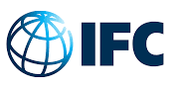
Types of products and instruments
Sustainable Finance products
Green Loans/ Bonds
Blue Loans
Sustainability Linked Loans/ Bonds
“Use of Proceeds” - Green / Blue / ESG / Social
  A loan or bond that exclusively finances “Eligible Green Projects” as defined in the issuer’s independently verified Green Finance Framework
  Follows the internationally recognized Green Loan/Bond Principles
  Issuers must report annually on use of proceeds and the impact achieved
  Additional transition finance theme may be applicable
  A loan that exclusively finances investments that protect oceans & water, supporting SDGs 6 and 14
  Follows the IFC “Blue” taxonomy that specifies activities that address: (i) protection of marine ecosystems and (ii) water management
  Issuers report on use of proceeds and the impact achieved
“Target Driven” - Sustainability-Linked Financings
  General purpose loan linked to defined KPI targets during tenor of the loan/bond
  Borrowers/issuers reports annually on progress using agreed KPIs
  Pricing structure may include incentives or penalties
  Transition finance theme may be applicable

Slide 17










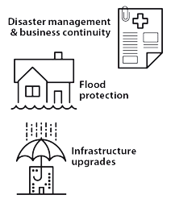

Green instruments: examples of uses of proceeds
Certified Green Buildings that meet IFC standards, e.g. IFC’s Excellence in Design for Greater Efficiencies (EDGE) or other recognized certification (e.g. LEED)
Renewable Energy equipment, systems or services that enable production of wind, solar hydro, biomass to power, biogas,..; or the use of clean sources of power by companies
Energy Efficiency equipment, systems or services that result in energy savings, e.g., waste heat recovery, cogeneration, capacity upgrades, carbon capture and utilization.
Pollution prevention and control such as reduction of air emissions, soil remediation, waste prevention / reduction, and emissions-efficient waste to energy.
Climate-Smart Agri activities such as
Increasing productivity without increasing GHGs (e.g., precision farming)
Avoiding crop losses, reducing food losses
Reducing N20 emissions from fertilizer use
Climate resilient crops
Activities that help clients to Adapt to Climate Change e.g.
Flood-proof infrastructure.
Climate resilient ports
Heat and water stress resilient agriculture
Circular Economy type measures, in products or manufacturing processes that support product redesign, waste recycling & reuse
Climate Smart Forestry and Wood Products afforestation, reforestation, sustainable forest management that increases carbon stock
Water Efficiency & Management
water saving / reuse / recycling, especially in water stressed areas. Waste-water treatment, methane capture, anaerobic digestion
Low emission transport products, services and infrastructure such as electric vehicles, charging stations; and their value chains. Energy storage
Biodiversity Conservation
both terrestrial and aquatic, including protection of coastal, marine and watershed environments

Slide 18
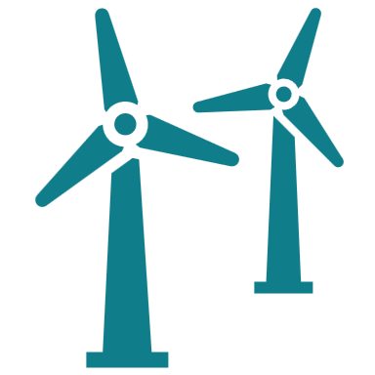




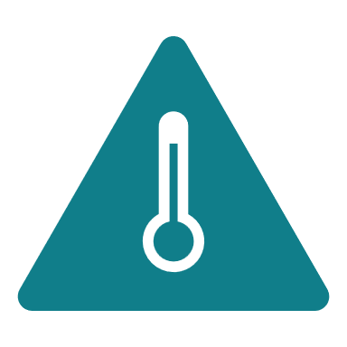






Sustainability-linked instruments: examples of KPIs
Alternative Energies
Circular Economy
GHG Emissions
Energy Efficiency
Water
Climate Smart Agri
Wind and solar capacity
Hydrogen capacity
RE share in power consumption
Share or absolute amount of recycling, reuse of materials, waste reduction
Reduced GHG emissions
(Scope 1 + 2)
Share of New and Refurbished Green Buildings
Energy storage
Efficient HVAC
Reduced system losses
Freshwater use
Wastewater treated
Reduce food losses
Reduce input use
Add crop sustainability certifications
Gender
Community
Health & Safety
Biodiversity Conservation
Governance
Forestry
Share of Female staff
Share of Women in management
Community investment
Youth employment
Education
Reduced accidents
Share or absolute amount for protection of marine ecosystems
Biodiversity KPIs
Improved governance reporting / transparency
Reforestation, Sustainable forest management that increases carbon stock

Slide 19
Structuring and issuing sustainable finance instruments
Obtaining an external verification from a reputable ESG agency to confirm alignment of the framework with the internationally recognized principles applicable to the selected instrument and type of financing. Additional features may include a sustainability / ESG rating or a score, private or public opinion issuance. An SPO is considered critical to maintain integrity of the instrument and issuer reputation
Assignment of net proceeds to eligible projects and reporting on the funding allocation and impact of the financed projects (in case of use of proceeds instruments), reporting on the performance of the company vis-à-vis the KPIs linked to the instrument (in case of targets-driven instruments). Can be done on a standalone basis and/or as part of an annual report
Framework development
Issuance of instruments
Second-party opinion
Allocation of proceeds and reporting
A Green/Blue/Social/Sustainability-linked framework sets forth the key parameters of sustainable financing instruments in accordance with the internationally recognized principles for corresponding types of instruments (loans, bonds) and financing (use of proceeds or targets-driven)
Identification of the pool of investors, negotiation of the key parameters of instruments with lenders and/or subscribers with the boundaries identified in the framework, issuance of the instruments with an options for subsequent listing. Listing platforms may have dedicated guidelines for sustainable financing instruments

Slide 20
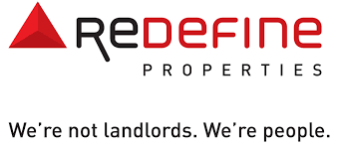

IFC’s Participation in dmtc issuances in South Africa
Growthpoint and Redefine Green Bond - Case Studies
SA’s 2nd Largest REIT with a market cap of $1.4bn (R25.8bn) and AUM of $4.9bn (R94.1bn) as of Feb 2023
Redefine’s local property asset platform is valued at R59bn as at 28 February 202. The offshore real estate investments are valued at R35bn representing 36.9% of the group’s total property asset platform, which provides geographic diversification through retail and logistics property assets in Poland.
Rated Ba2 stable by Moody Ratings (April 2023)
In Sept 2022, IFC invested in R750m ($44m) in an unsecured use of proceeds green bond by Redefine which is listed on JSE. IFC investment was in 7- and 10-year tranches of the bond and secured mobilization of additional R750m ($44m)
SA’s largest REIT with total assets of $9.5bn (R179.8bn) as at 30 June 2023 and a market cap of US$2bn (R37.7bn) and existing IFC client Large portfolio of high-quality commercial property assets across retail, office, industrial and specialized segments in 3 continents.
Rated Ba2 stable by Moody Ratings and BB+ by Fitch.
Board approved client envelope of ZAR2.0bn ($118m) to support investments by IFC into senior unsecured green bonds to be issued over the next 12 months.
The initial use of the client envelope was to support IFC investment as the sole investor into a R1bn ($59m) privately placed green bond (the “Green Bond”) on Dec 2022. The R1.0 bn Green Bond is listed on the JSE

Slide 21











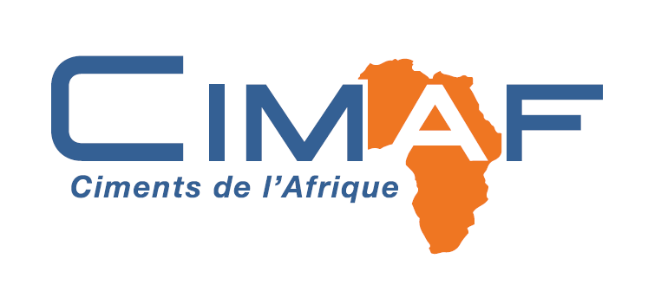



IFC Select Sustainable Finance Transactions
Asia / Multi-country
Africa : Senegal
Africa: South Africa
LAC: Brazil
IVL
Sococim Low Carbon Cement (Vicat)
Redefine Properties
Votorantim Cimentos
Blue Loan Package: $150M A Loan,
$150M B Loan
Bottle-to-bottle recycled PET, resource efficiency and renewable energy
Green Loan Package: EUR120M A Loan, EUR120M B Loan
For the replacement of part of current clinker lines with a new fuel-efficient one, using up to 70% of alternative fuels and boosting energy efficiency
Green Bond: $44M
The first green bond of a leading property development and management company to support long-term decarbonization of their building portfolio, including through green building certification
Sustainability-linked loan: $150M
Support to the company’s decarbonization roadmap and investment plan implementation, including co-processing and efficiency upgrades
2021
2023
2022
2023
LAC: Brazil
Indonesia and Philippines
Africa: South Africa
Africa: Morocco / West Africa
Suzano
Ascott SLB
Growthpoint Properties
CIMAT / CIMAF
Sustainability-Linked loan: total of $1.25B incl. $250M A loan, $350M B loan
Construction of a greenfield pulp mill and development of eucalyptus plantations in Ribas do Rio Pardo, state of Mato Grosso do Sul.
Sustainability-Linked Bond: $115M A loan
Decarbonize 3 serviced residences in Southeast Asia, in Indonesia and in the Philippines to achieve 40.5% reduction in electricity consumption by 31 December 2028
Green Bond: $118M A loan
Participation in a sustainable debt program of a leading real estate developer and operator in South Africa, with all assets certified under Green Star standard
Green Loan: $50M A loan
Funding of the long-term decarbonization program of one of the leading cement manufacturers in North and West Africa
2022
2022
2023
2023
Key
Manufacturing
Green building / Tourism, Retail and Property
Agribusiness and Forestry

Slide 22
CONTACT
Christoph Kausch
Southern Africa Hub Co-Lead,
Manufacturing & Services
ckausch@ifc.org
+1 (202) 956-9875
Kemal Aksoy
Senior Investment Officer
Manufacturing, Agribusiness & Services
kaksoy@ifc.org
+27 (83) 781-5432

