Slide 1
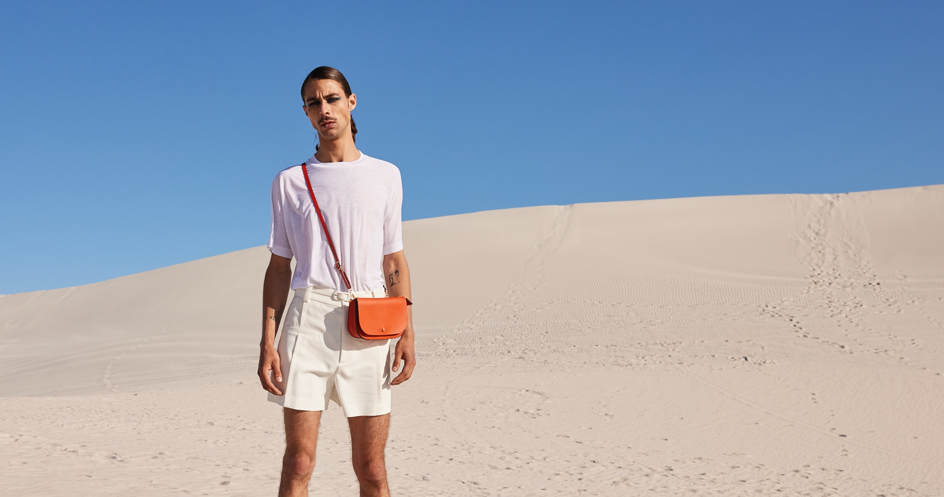


Tropic Mad SA
SUSTAINABILITY
At a Glance
Notes:
Add note to this slide

Slide 2

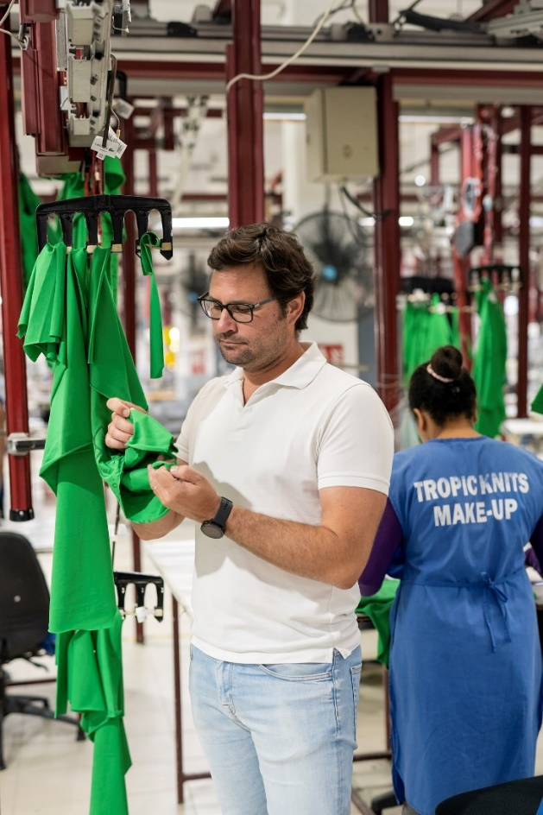



WORD FROM OUR CHIEF
EXECUTIVE
OFFICER
There is no issue today that connects everyone on the planet more than the issues around climate change.
Sustainability is still a useful term however the definition has expanded to cover all aspects of an organization: social, environmental and governance. Increasing regulations in the fashion industry are ensuring that sustainability is taken as a serious term, especially when used in the context of product marketing and corporate sustainability reporting.
Sustainability actions and become more determined than ever. Be aware: you are our best judges. Please challenge us, ask questions, and dare us to improve how we do things. Partner with us to find new ways of developing products that will continue to be useful and meaningful for many years to come.
Join us in pursuing our mission: Improve Fashion Every Day!
Jerome Couve CEO
Notes:
Change to Jerome photo and wording. Waiting for Jerome approval.

Slide 3
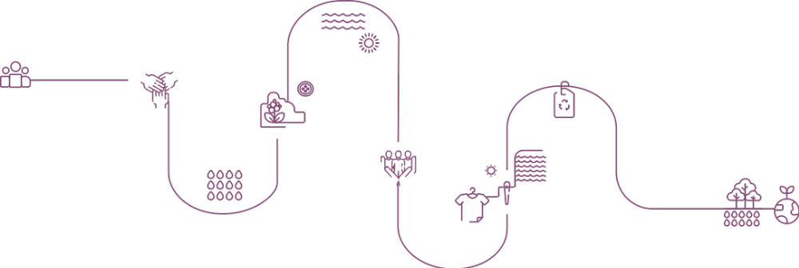
2017 - 2019
SAC Membership -Adoption of HIGG
Index tools in 100% of
our manufacturing
sites
Contributor of ZDHC
Implementation of Sustainability training for employees
OUR
JOURNEY
2023 AND BEYOND
Enhancement of Sustainable finance journey
Increase in renewable energy usage
Implementation of product traceability
Commit to SBTi.
Promotion of collaboration and partnerships with stakeholders
Monitoring of Carbon footprint – Scope 1 & 2
2020 - 2022
Implementation
of UL, a
Sustainability
Reporting
software
Development
of internal
Eco Index
tool
Compliance with ZDHC standards
Sign with UNFCCC and report CDP.

Slide 4

OUR SUSTAINABILITY STRATEGY
PROSPERITY
Responsible product offering
Sustainable value chain
'Act For' initiatives
Strategic partnerships
PURPOSE
“For a world we can all feel proud of”
FOSTER
A VIBRANT WORKFORCE
CHAMPION
INCLUSIVE
GROWTH
PEOPLE
Learning &
Development
Ethics & Diversity
Inclusion
Fair & Safe Work Environment
ACTIVATE CLIMATE RESPONSE
PLANET
Renewable energy
Carbon footprint
Water & Effluents
Waste management & Circularity
Notes:
Type your notes

Slide 5
Our commitments
Champion Inclusive Growth | Act for Initiatives | Advocate maximum employee engagement in our CSR intiatives - target is 50% employee engagement
 |  | To create high impact initiatives focusing on long term projects - 50% intiatives related to long term projects
 | Sustainable value chain | Value chain compliance : 80% of Suppliers using the Higg FEM & FSLM and doing verification by 2030
 |  | No value chain partner should be in zero tolerance & Ground zero category by end 2024
 | Responsible product offering | Target to reach 50% certified raw materials by 2025 and 80% by 2030
 |  | Target to reach 10% reccyle raw materials by 2025
 | Strategic partnership | Partner with stakeholders across the value chain to define the future of the textile and apparel industry
Activate Climate Response | Energy | Increase the renewable energy mix at | 60% by 2025
 |  |  | 80% by 2030
 | Carbon footprint | Decrease by 50& our scope 1 & 2 carbon intensity by 2030
 |  | Adopt CDP & SBTIs methodology by 2024
 |  | Continue our efforts in conservation and regeneration of natural ecosystems
 | Water & Effluents | 20% of water consummed to be recycled and reused by 2025
 |  | Equip all factories with rainwater harvesting system by 2025
 |  | Sustain ZERO non conformty to ZDHC
 | Waste management & Circularity | Wastes diverted from landfill | 90% by 2025
 |  |  | 100% by 2030
Foster a Vibrant Workforce | Diversity and Ethics | Women to hold 35% of management level roles by 2030
 | Inclusion | target to onboard 5% employee with disabilities by 2030
 | Fair & Safe work environment | 90% verified score on FSLM in all CT factories
 | Learning & Development | 100% employee trained on Ethics and Sustainability by 2025
Notes:
Type your notes

Slide 6
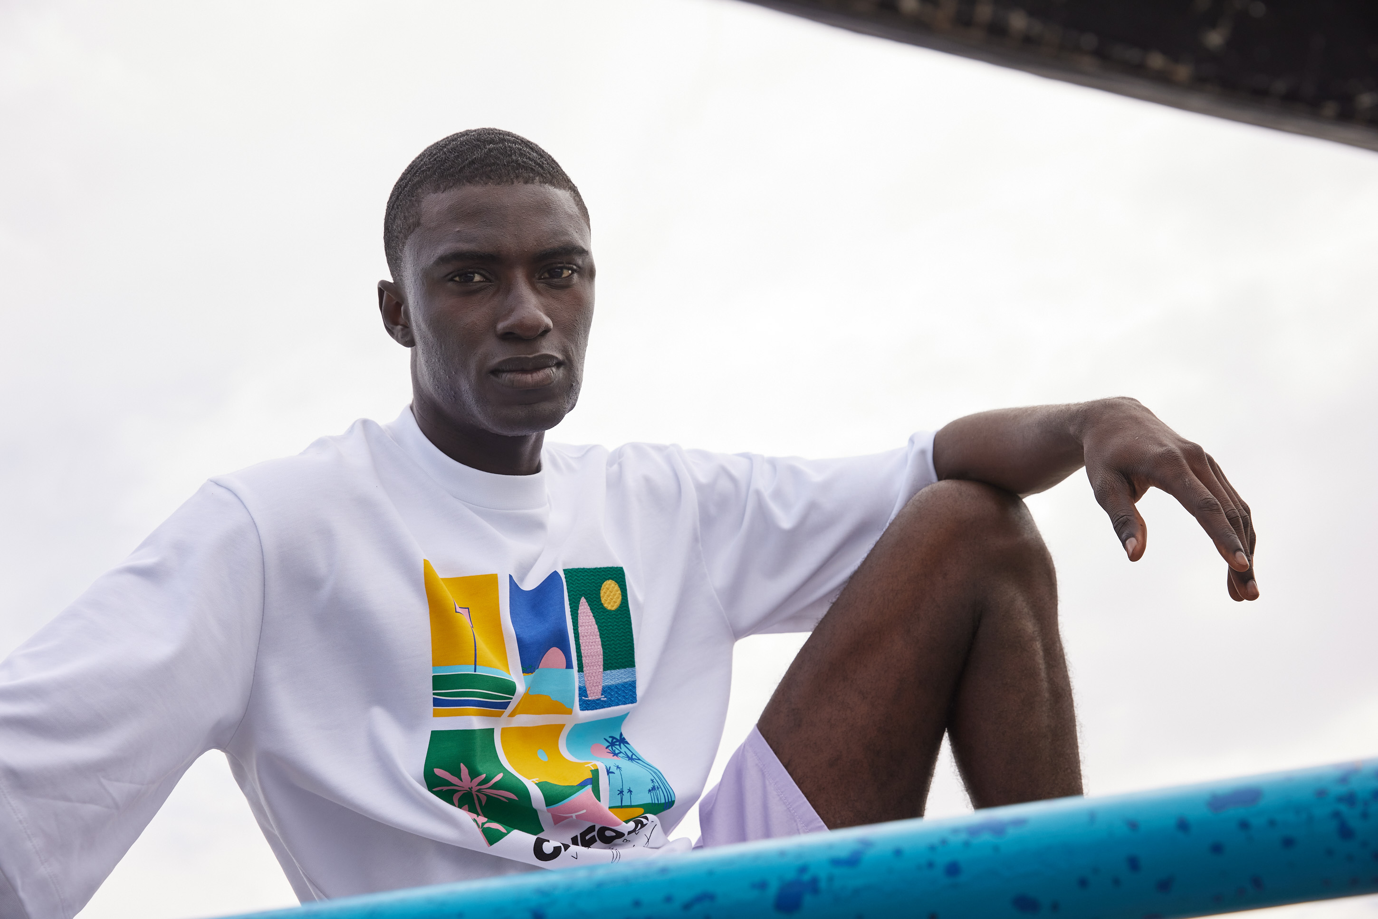
PROSPERITY
Notes:
Add note to this slide

Slide 7




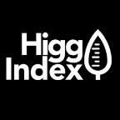






RESPONSIBLE Product Offering
Social
Environment
Material
Notes:
Type your notes

Slide 8

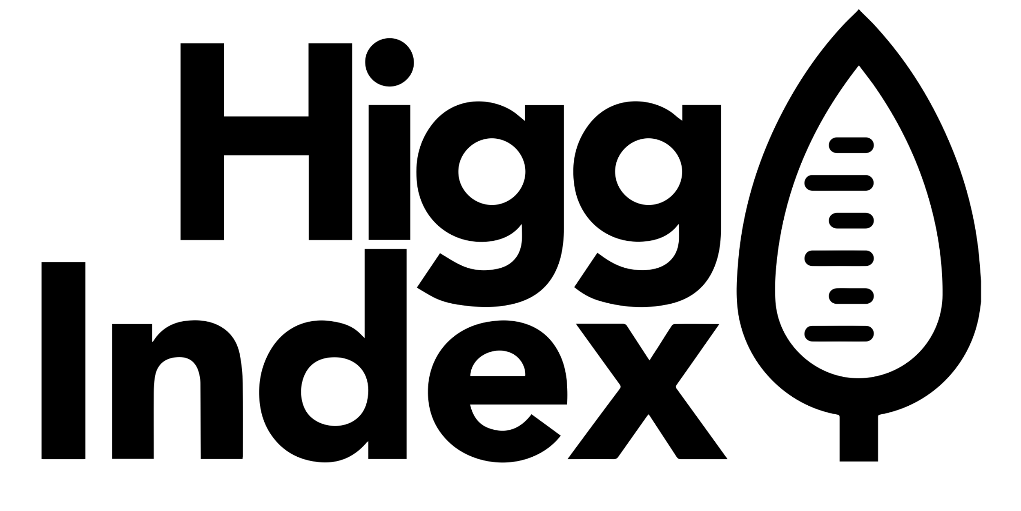



STRATEGIC Partnerships
Since 2017
Since 2018
Since 2018
Since 2018
Since 2017
Notes:
Type your notes

Slide 9
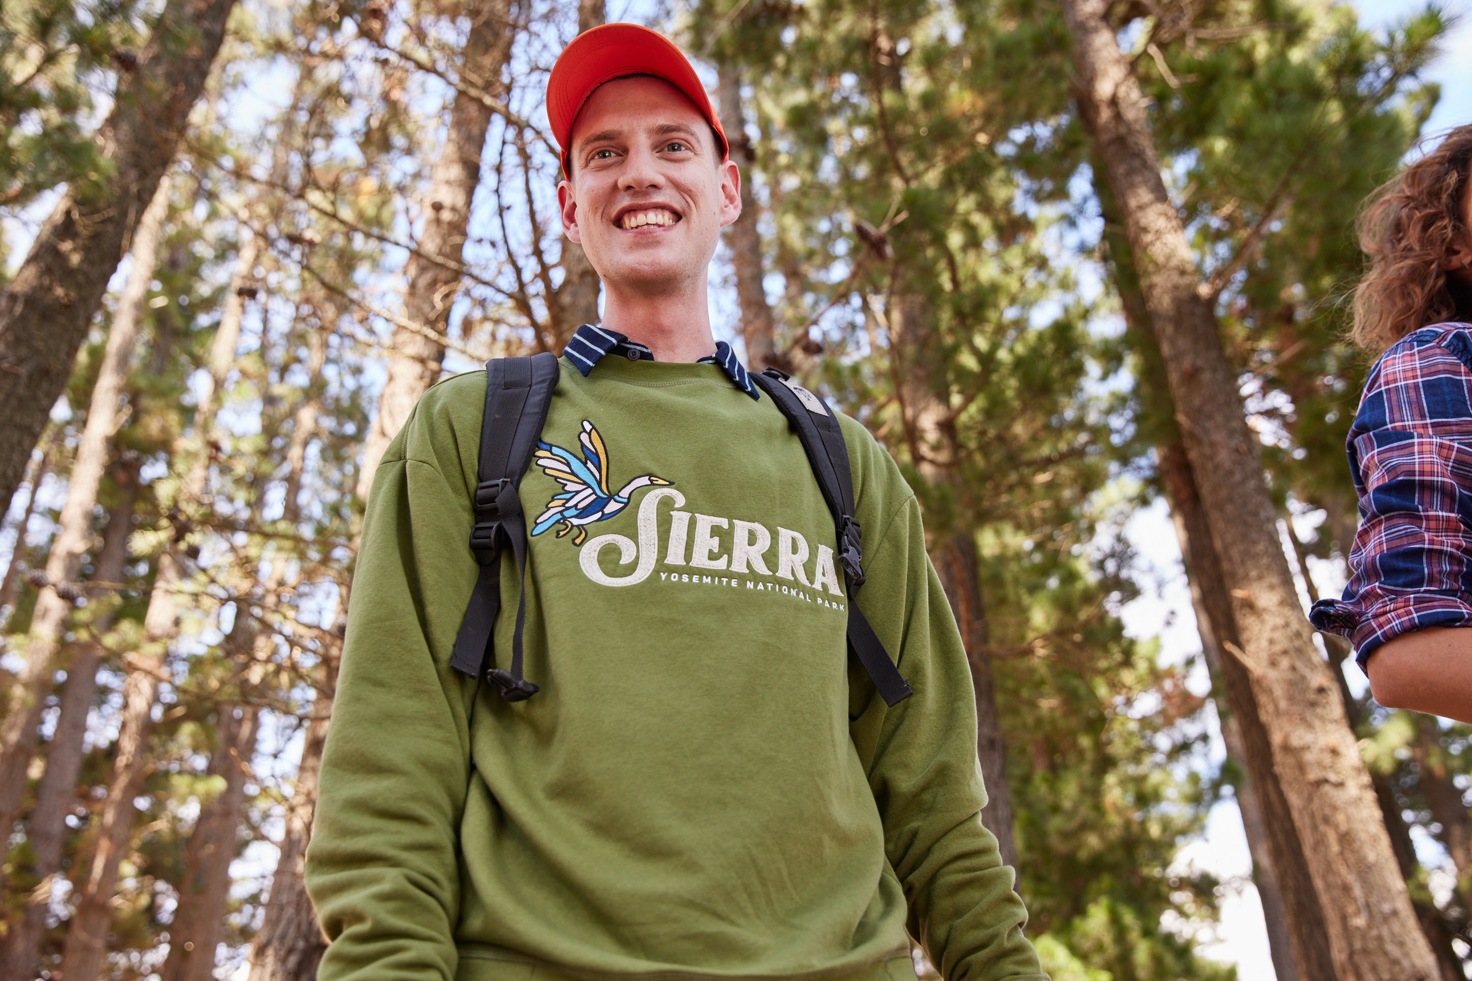

PLANET
Notes:
Add note to this slide

Slide 10

Environment Audit
Benchmarking year | 2021 | 2022 | 2023
Top Score | 98.25 | 98.63 | 98.33
Bottom Quartile | 27.87 | 28.53 | 25.23
Median | 55.75 | 57.06 | 50.66
Top Quartile | 77.19 | 77.84 | 74.5
Total Number of Facility verified | 4505 | 6000 | 6110
 | TKL MADA
HIGG Vfem 2019 | 83
HIGG Vfem 2020 | 88
HIGG Vfem 2021 | 91
HIGG Vfem 2022 | 88
HIGG Fem 2023 | 91
Notes:
Type your notes

Slide 11
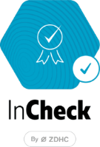


CHEMICAL MANAGEMENT
Conformity
Chemical Sourcing Policy.
Supplier SAQ.
Responsibility
Monthly InCheck/Intelex upload of chemicals.
Yearly on site audit for chemicals. (97% Pass)
Management
CMS Implementation.
Digitalisation of chemical inventory/usage.
CIL/MSDS Request.
Quarterly testing of wastewater against GOTS/Legal standards.
Bi annual ZDHC testing of wastewater.
Above and Beyond
Yearly screened chemistry.
Increased sourcing of ZDHC chemicals. (80%+ for 2024, 90%+ for 2025)

Slide 12




SUSTAINABLE
WASTE MANAGEMENT
At TROPIC, we generate 2 distinct categories of waste :
Hazardous
Non-Hazardous
In 2025
80% waste Diversion form Landfills
100% Recyced
Used oil.
Sludge.
Chemical Containers.
Contaminated wastes.
Electronic wastes.
Fabric
Plastics
Paper/Carton
Food waste
General waste.
75% Recyced
Notes:
En terme de gestion de dechets,
On categorise nos dechets,
100 produits dnageurexu sont traite et recycle
75 recycle par des ONG, PME
Notre target dest de 80

Slide 13
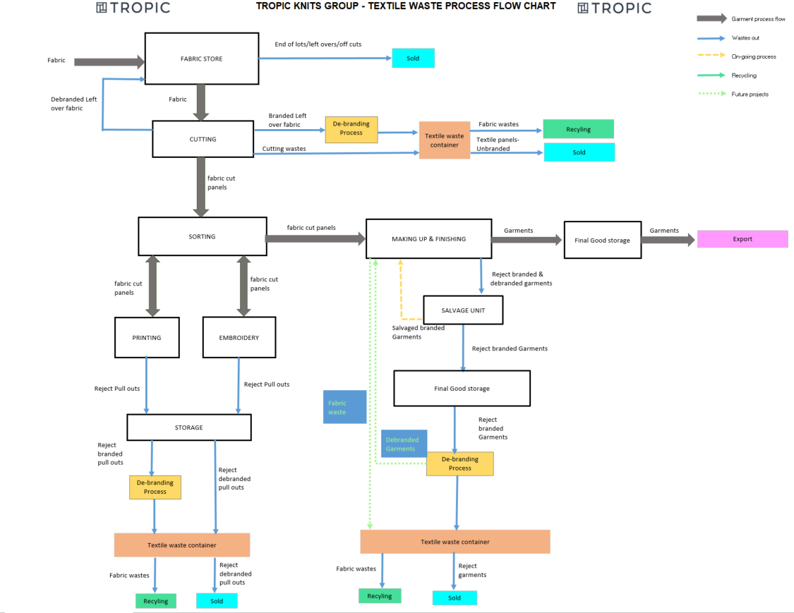
Waste route
Notes:
Pour les dechets on a un flow chat, qui nous permet d’identifier les flux de matiere premiere dans chaque dept, qu’on mesure par la suite et qu’on recycle

Slide 14
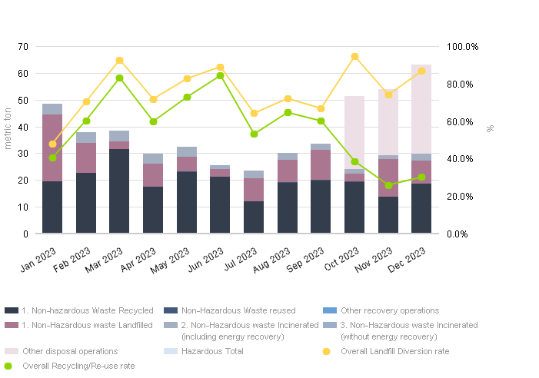
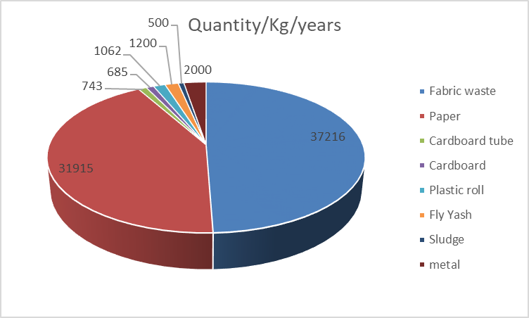
SUSTAINABLE
WASTE MANAGEMENT
Notes:
Voici en general un rapport de l’annee derriere,
La plus grande partie de nos déchets en termes de quantité est constituée de chutes de tissus et papier

Slide 15

PEOPLE
Notes:
Add note to this slide

Slide 16
FAIR & Safe Work Environment
Benchmarking year | 2021 | 2022 | 2023
Top Score | 96 | 95.3 | 96.8
Bottom Quartile | 34 | 34,2 | 34.84
Median | 67.8 | 68.3 | 69.69
Top Quartile | 82 | 81.8 | 83.24
Total Number of Facility verified | 2143 | 3579 | 4466
 | TKL MADA
HIGG vFslm 2021 | 88
HIGG vFslm 2022 | 88
HIGG vFslm 2023 | 90
Notes:
Type your notes

Slide 17
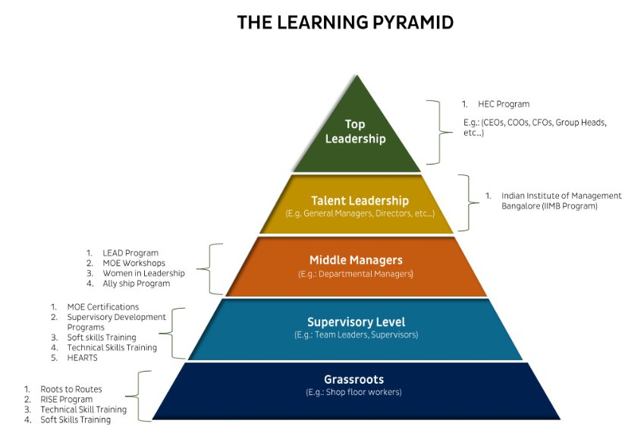
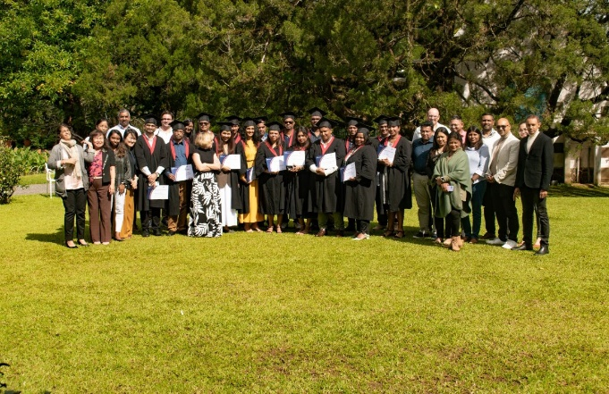
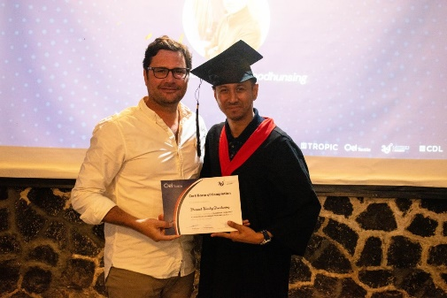
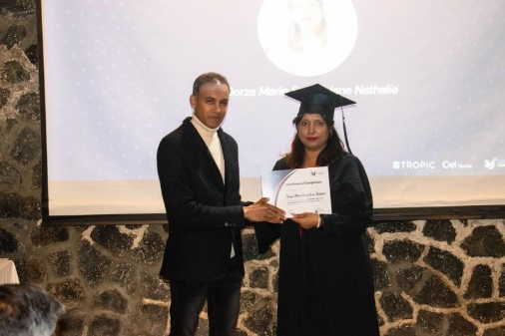
LEARNING & Development
At Tropic Knits, our Learning and Development (L&D) initiatives are designed to empower our workforce at all levels, from entry-level employees to top leadership, by utilizing a holistic approach based on the Learning Pyramid model.
Notes:
Type your notes

Slide 18
DIVERSITY, Ethics & Inclusion
Women Empowerment program :
Key actions :
Training & Awareness
Policies and procedures development
Recruitment of talented women
45%
of Women in leadership position
Notes:
Type your notes

Slide 19
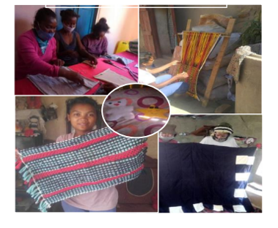
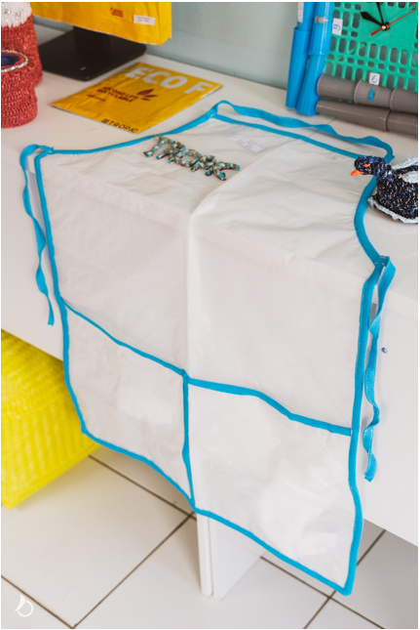
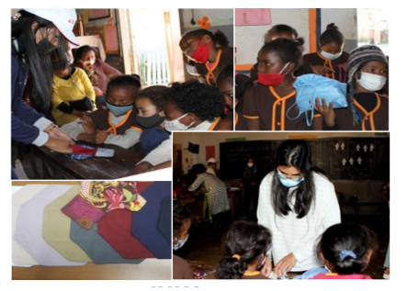
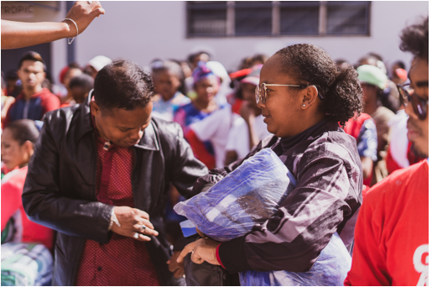
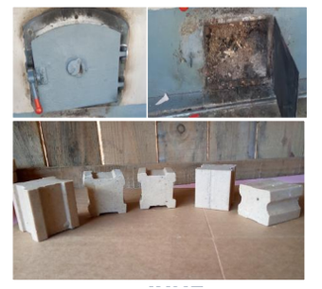
RECYCLING
PROJECT
Notes:
Alors voici qlq illustrations des recyclages au’on a fait
A noter nos beneficiaiires sont nos collaborateur employes et aussi la communite

Slide 20




LET’S
IMPROVE FASHION
TOGETHER
Get in touch,now

