Slide 1




PROMOTION OF CIRCULAR ECONOMY IN THE TEXTILE AND GARMENT SECTOR THROUGH THE SUSTAINABLE MANAGEMENT OF CHEMICALS AND WASTE IN LESOTHO, MADAGASCAR, SOUTH AFRICA AND ETHIOPIA.
Presentation by: Miss Lefulesele Georgina Motlomelo
Ministry of Environment and Forestry

Slide 2
CONTENT
Background – Textile & Garment Sector in Lesotho
Delays
Procurement of Project Assistant
Engagement with service providers
Project Components
National Inception Workshop
Next steps

Slide 3
BACKGROUND – TEXTILE & GARMENT SECTOR IN LESOTHO
  A vital economic sector comprising approximately 66 companies,
    Employs more than 46,500 people,
    Accounts for around 20% of the country’s GDP.
  Responsible for the production of approximately 90 million knitted garments annually, consuming an estimated 22,000 to 26,000 metric tons of knitted fabric per year (2017).

Slide 4
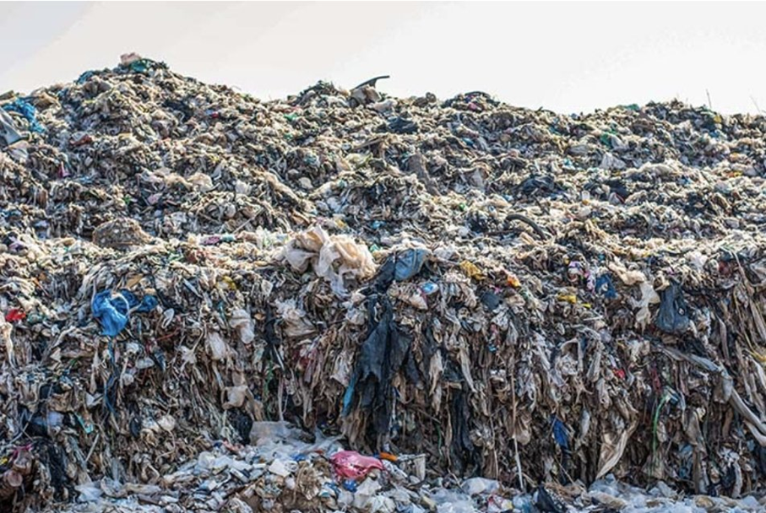
BACKGROUND…
The sector generates a substantial amount of textile offcuts ≈ 16,800 tonnes.
  20% of these textile offcuts are recycled locally
  80% of textile offcuts are burned, incinerated, or taken to dumpsites
Leading to adverse environmental and health impacts.

Slide 5
DELAYS
Amendment No. 1 of the UNIDO Implementing Partner Agreement No. 3000116560:
This amendment governs the change of name of the Ministry of Environment and Forestry, previously known as the Ministry of Defence, National Security, and Environment.
The amendment was countersigned and couriered back to UNIDO.
Approval of Kickoff report before release of funds

Slide 6
PROGRESS OF PROJECT

Slide 7
PROCUREMENT OF PROJECT ASSISTANT
The position was successfully advertised in local newspapers.
Three candidates were shortlisted and interviewed.
Miss Lefulesele Motlomelo was selected and began her work on July 1, 2024.

Slide 8
ENGAGEMENT WITH SERVICE PROVIDERS
Introductory virtual meeting with International Council for Local Environmental Initiatives (ICLEI) on 10th July 2024.
Introductory virtual meeting with Zero Hazardous Discharge of Chemicals (ZHDC) was on 11th July 2024.
The meetings were facilitated by the Africa Institute
Bi-weekly meetings with ICLEI

Slide 9
1. Strengthening of regulatory and institutional capacities for adoption and promotion of Circular Economy in the textile and garment (TG) sector.
Output 1.1. - Legal and institutional framework for life cycle management of the TG supply/value chains. (Y1 – Y2) (ICLEI)
Output 1.2 - Regulations and incentive scheme for promotion and sustainability of circular economy in the TG sector. (Y2 – Y3)
Output 1.3 - Technical Committee for Circular Economy in the TG sector (Y2 ->)

Slide 10
2. Recyclability of textile and garment wastes is enhanced through POPs-free textile manufacturing process and the implementation of BAT/BEP and RECP investments
Output 2.1 - Chemical inventories for POPs and technical guidelines for environmental sound management of POPs chemicals and wastes (Y1-Y3) (ZDHC)
Output 2.2 - Standard operating procedures (SOPs) and checklists concerning POPs pollution prevention and control (Y2)
Output 2.3 - Techno-economic feasibility of BAT (Best Available Techniques)/BEP (Best Environmental Practices) and RECP (Resource Efficiency and Cleaner Production) options (Y2)
Output 2.4 - Training and Capacity building in BAT/BEP, RECP and Circular Economy (Throughout)
Output 2.5 - BAT/BEP and RECP options identified and implemented in at least two facility for the country (Y2 ->)

Slide 11
3. Introduction of Circular Economy concept for UPOPs emission reductions through ESM of textile and garment wastes and pilot demonstration of textiles/garment wastes recycling and reuse
Output 3.1 - Environmentally sound management (ESM) plan for textile/garment wastes (Y1 –Y3)
Output 3.2 - Training and capacity building in ISWM and BAT/BEP for ESM of textile and garment wastes (Y2 – Y4)
Output 3.3 - Financing mechanisms and business models for circular economy (Y2 – Y4)
Output 3.4 - Techno-economic feasibility study of BAT/BEP options for recycling/reuse of textile and garment wastes (Y2)

Slide 12
CONT.
Output 3.5 - Socioeconomic impact assessment of project intervention (Throughout the project)
Output 3.6 - Partnership and cooperation mechanism supply chain management (Throughout)
Output 3.7 - BAT/BEP demonstration for ESM of POPs chemicals and textile/garment wastes (Y2 ->)

Slide 13
4. Knowledge management for scaling up. (throughout)
National capacity and awareness programs developed and implemented to increase ability of textile sector and policy makers to control POPs and CoCs
Regional and Global Knowledge Exchange and Management tools produced and accessed by users globally
Gender and Social Action Plan implemented, and benefits accrued to women workers

Slide 14
5. NATIONAL INCEPTION WORKSHOP
Hosted the National Inception Workshop on the 30th October 2024.
The Minister of Environment and Forestry – Hon. Letsema Adontši gave the keynote address
Remarks by UNIDO and Lesotho National Development Corporation (LNDC).
Presentation by: UNIDO, Africa Institute, ICLEI and ZDHC

Slide 15
5. NATIONAL INCEPTION WORKSHOP
Stakeholders present:
- LNDC
- Lesotho Textile Exporters Association
- Department of Industry
- National University of Lesotho – Chemistry department
- Lesotho Council of Non-Governmental Organisations
- Chemicals Management Committee (CHEMAC)
- Beneficiary Companies

Slide 16
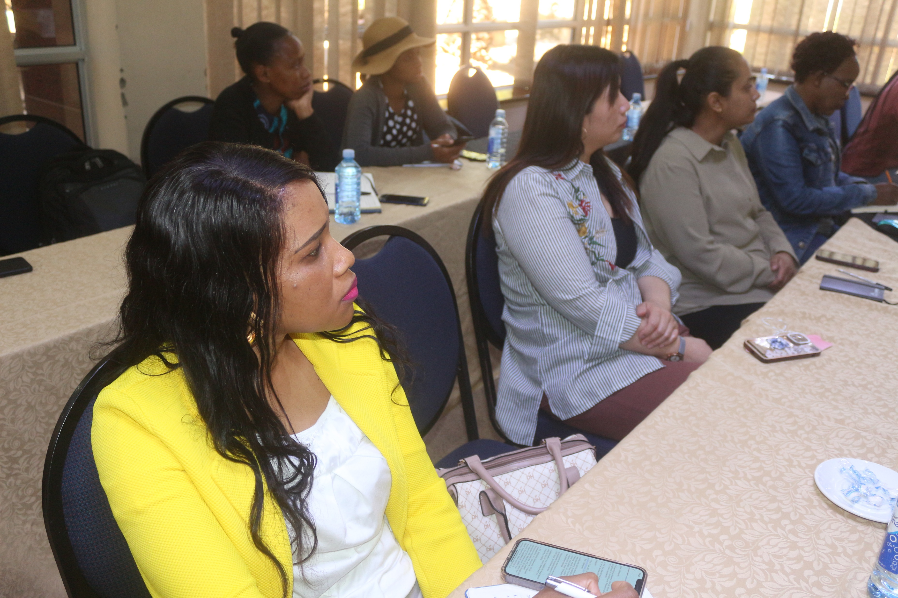
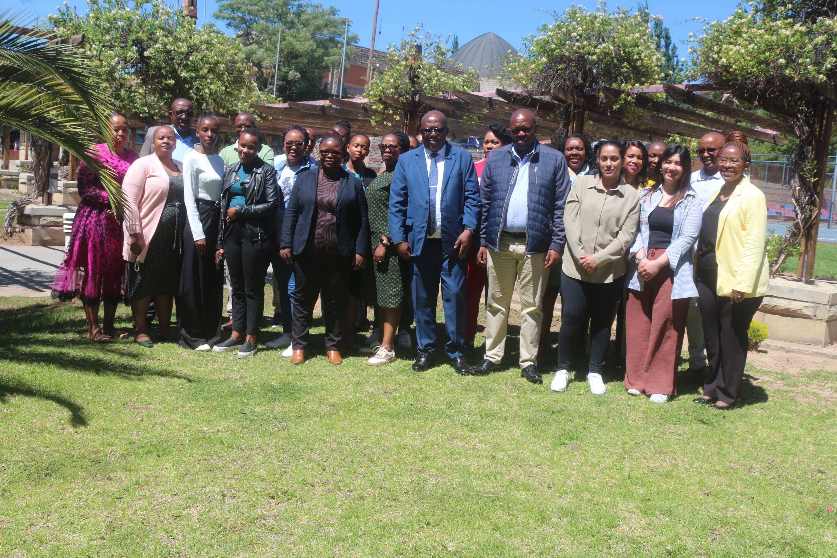
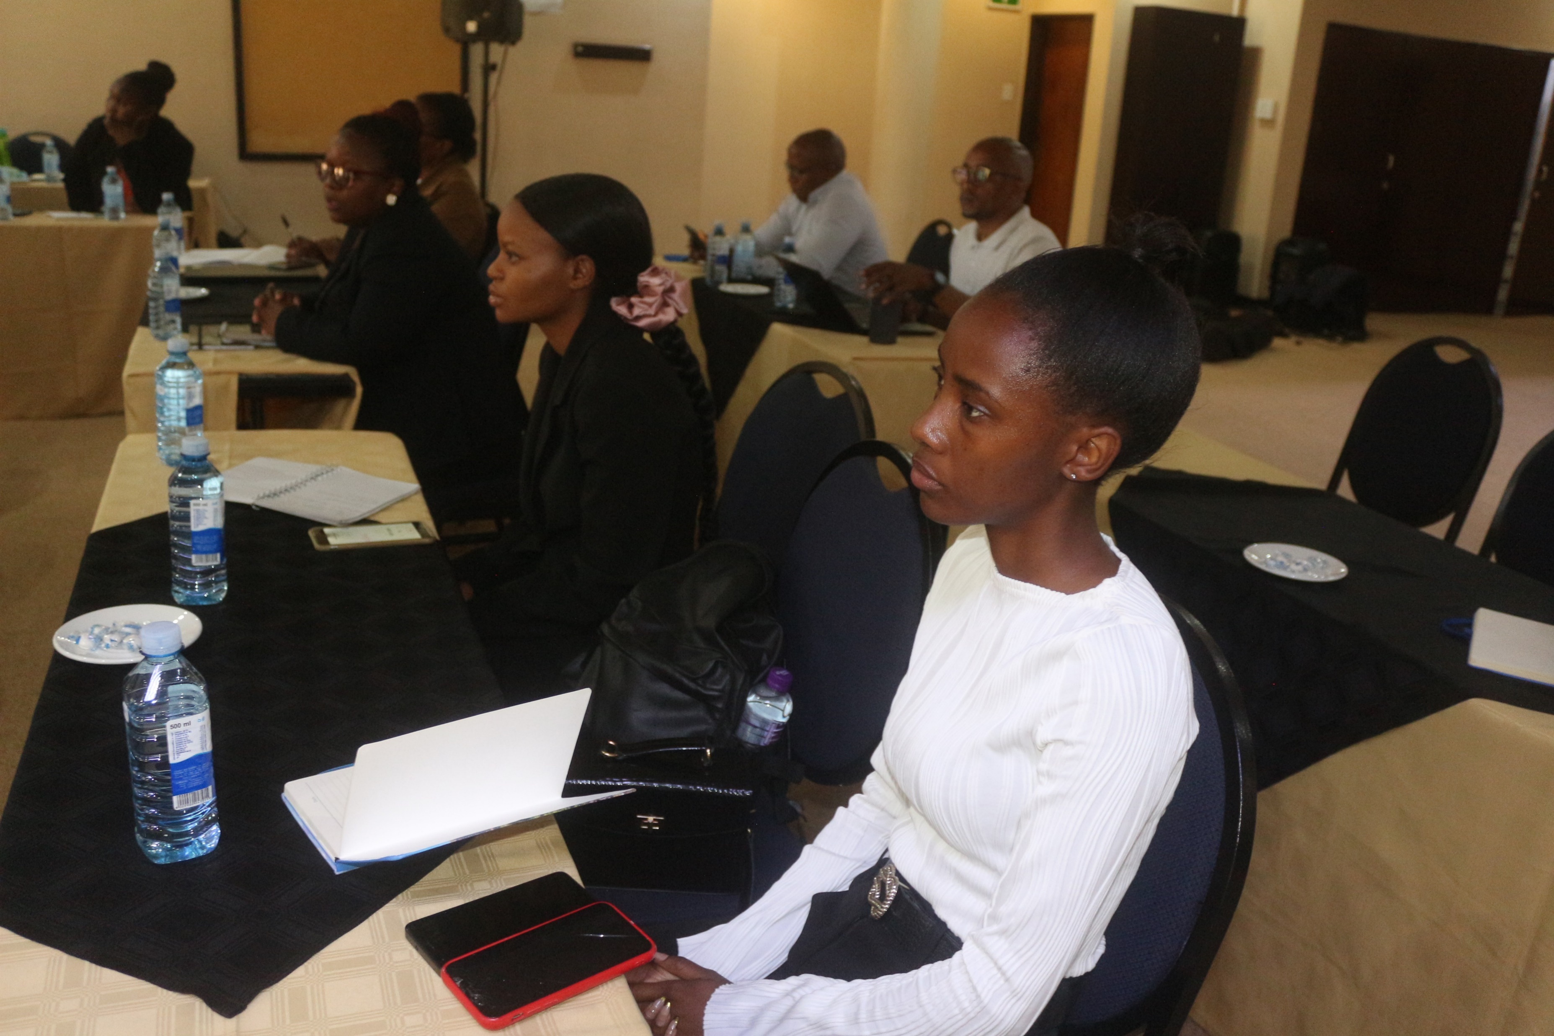

Slide 17
6. NEXT STEPS
Procurement of office supplies
Advertisement of consultants (output 3.1 and output 3.5)
Online and in person training with BluWin and ZDHC
Needs assessment

Slide 18
THANK YOU
KEA LEBOHA

