Slide 1



InTex Project
Eco-innovative Business Practices and Economic Models in the Textile Value chain
Regional Inception Workshop
Circular Economy Project- Textile and Garment Sector
14 November 2024
Zubeida Zwavel – CARES
Maggie Mashau NPC-SA

Slide 2
Presentation Outline
About the Project
Project Outputs and Highlights
Project Milestone
Phase II of the Project

Slide 3
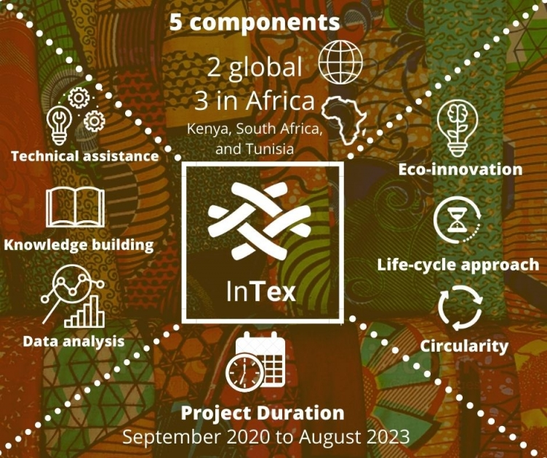

About InTex Project
The project "Innovative Business Practices and Economic Models in the Textile Value Chain" (InTex).
Three-year UNEP project funded by the European Union (EU).
Global time frame – Sep 2021 to Nov 2024
The InTex project has five components.
  2 components have global reach,
  3 components focus on national implementation in three countries in Africa: Kenya, South Africa, and Tunisia
https://www.unep.org/intex

Slide 4




InTex Partners
International implementor:
UN Environment Programme (UNEP)
International funder:
European Union (EU)
SA National Project Coordinators (PC)
National Cleaner Production Centre, South Africa (NCPC-SA)
SA Technical Intermediary (TI)
Centre For African Resource Efficiency and Sustainability (CARES)

Slide 5
InTex key concepts
Main text goes here
Eco-innovation | Product Environmental Footprint (PEF) | Circularity
UNEP's Eco-innovation approach guides SMEs in incorporating circularity and resilience into every aspect of their business strategy and underlying business models, operations, products, and processes to reduce the environmental and social impact of human activity. This results in an agile, reactive, and competitive company. http://unep.ecoinnovation.org/ | The European Commission’s Product Environmental Footprint (PEF) measures the environmental performance of a good or service throughout its life cycle (from extraction of raw materials, through production and use, to final waste management). As it is a standardized methodology, SMEs can gain competitive advantage and credibility by using PEF, providing a robust way for consumers to compare the environmental footprint of their products | Circularity provides a model to transform the current economic system towards a sustainable future. As outlined in the UNEP circularity platform. (www.unep.org/circularity) circularity’s underlying objective is that materials should be kept at their highest possible value as they move and are retained within the value chain. Circularity builds on a guiding principle: ‘’Reduce by design’’, as well as value-retention processes: Refuse, Reduce, Reuse, Repair, Refurbish, Remanufacture, Repurpose and Recycle.

Slide 6



Project Output I: Policy Analysis And Recommendation
Outputs | Deliverables | Outcome
D I.1 Establish Project Steering Committee (PSC) |  | PSC was established and meet twice a year Made up of government department, Private sector (DTIC, DSI, DFFE, TIPS and TexFED)
D I.2 Policy training & skills dev |  | Training workshop was held 29 Sept 2022 Facilitated by UNEP internation Expert on Mainstreaming Eco-innovation and circularity in the textile policy instrument
D I.3 Policy analysis and recommendations |  | Policy quick scan final completed, available on NCPC-SA website Policy recommendation were presented to DTIC, DFFE and DSI for validation
Regular Dialogue between PSC and SMEs |  | To ensure SMEs experience and needs are considered in policy recommendations Two Roadshows were conducted in CT and DBN

Slide 7
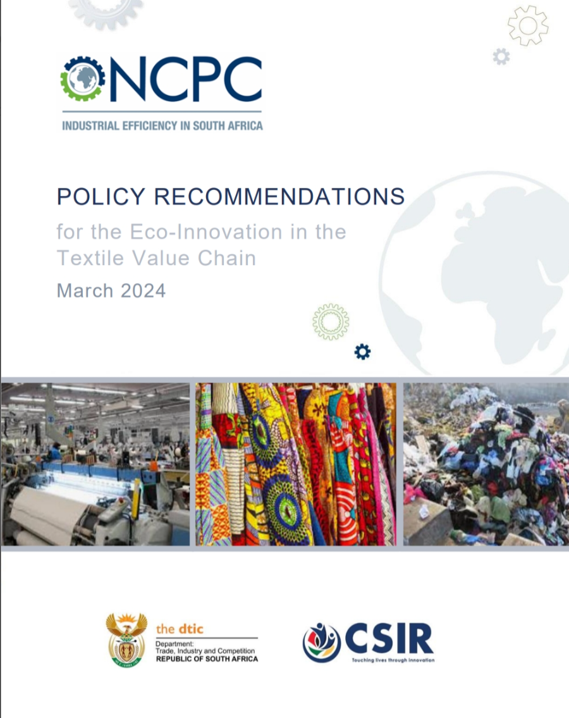
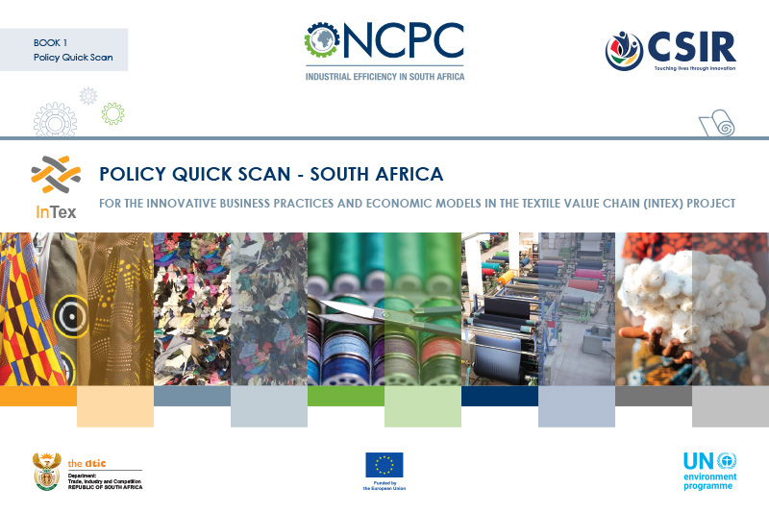
Policy Quick Scan and Recommendation Reports
Policy Gap
No reference to circularity/ in Textiles Master Plan and
Lack of online policy knowledge Hub for ease access to SMEs that provide all textile policy actions and initiatives
Recommendation on actionable path to integrate sustainability (Circularity) in Master Plan

Slide 8

Highlights from Dialogue between PSC and SMEs
Dialogue with SMEs highlighted
Need for more incentives and Financing circular economy projects, eco/environmentally friendly material or fabric
Need for solutions to dealing with waste disposal of synthetic fibre waste.
Support from Municipality on bylaws
Eco-labelling
Need for awareness among retailers and manufacturers regarding circular textile manufacturing knowledge and information.
Training in sustainable sourcing.
Need for vocational machinery learning centres
Increased funding opportunities for machinery use in textile industries as this skill is scarce

Slide 9

Proposed Governance Structure
Chair:
Ilze Baron (DTIC)
Members:
Mahendra Shunmoogam (DTIC)
Gaylor Montmasson-Clair (TIPS)
Brian Brink (TexFed)
Jenitha Badul (DFFE)
Henry Roman (DSI)
Project Team:
Lee-Hendor Ruiters (NCPC-SA)
Maggie Mashau(NCPC-SA)
Zubeida Zwavel (CARES)
Sira Williams(CARES)
Bettina Heller (UNEP)
Claudia Giacovelli (UNEP)
PSC
Project Steering Committee
DTIC
DSI
DFFE
TexFED
TIPS (NPC)

Slide 10
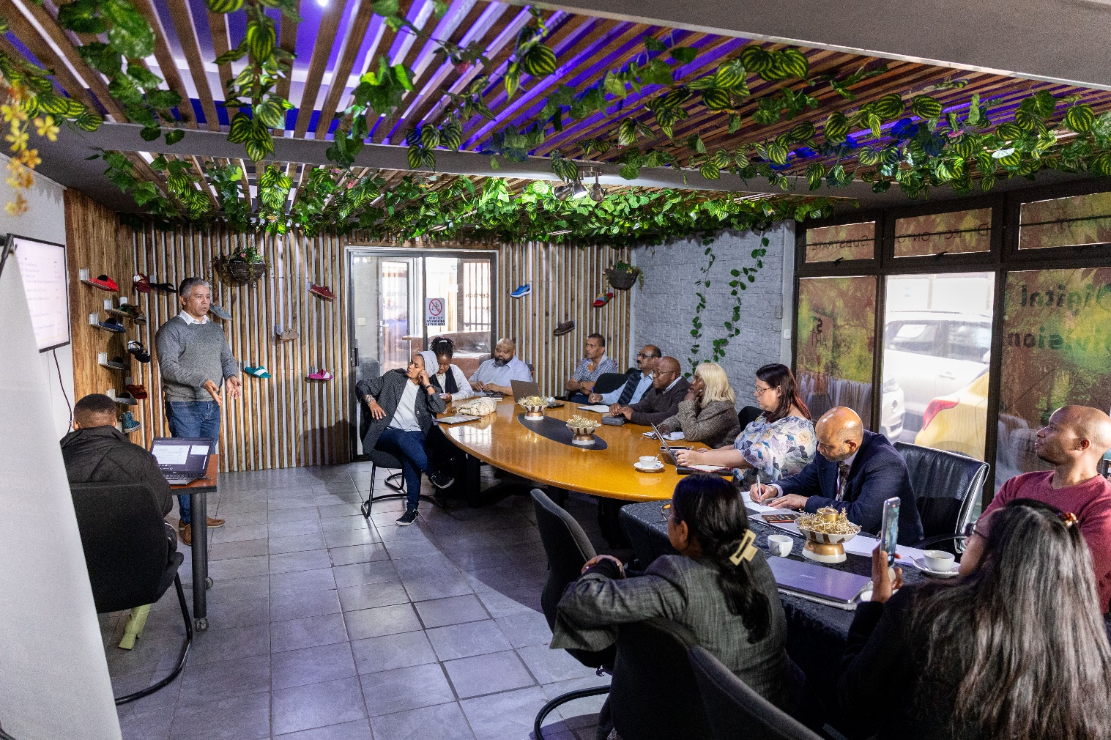
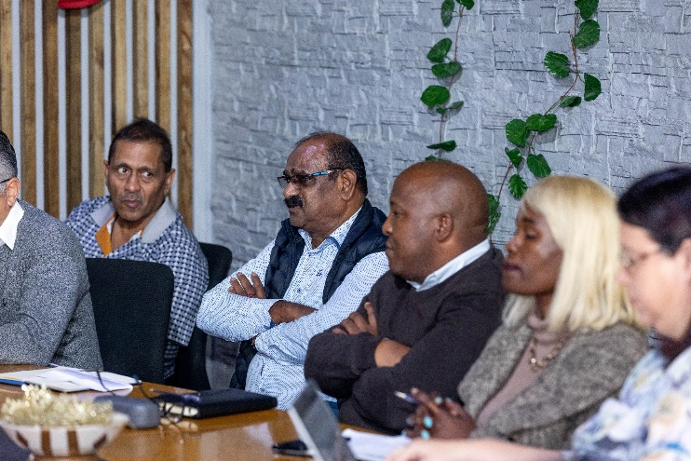
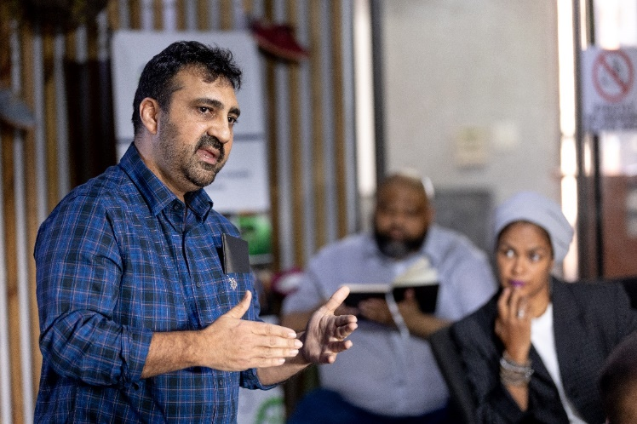
Roadshows in Durban- June 2023
SMEs sharing challenges at the Durban roadshow

Slide 11
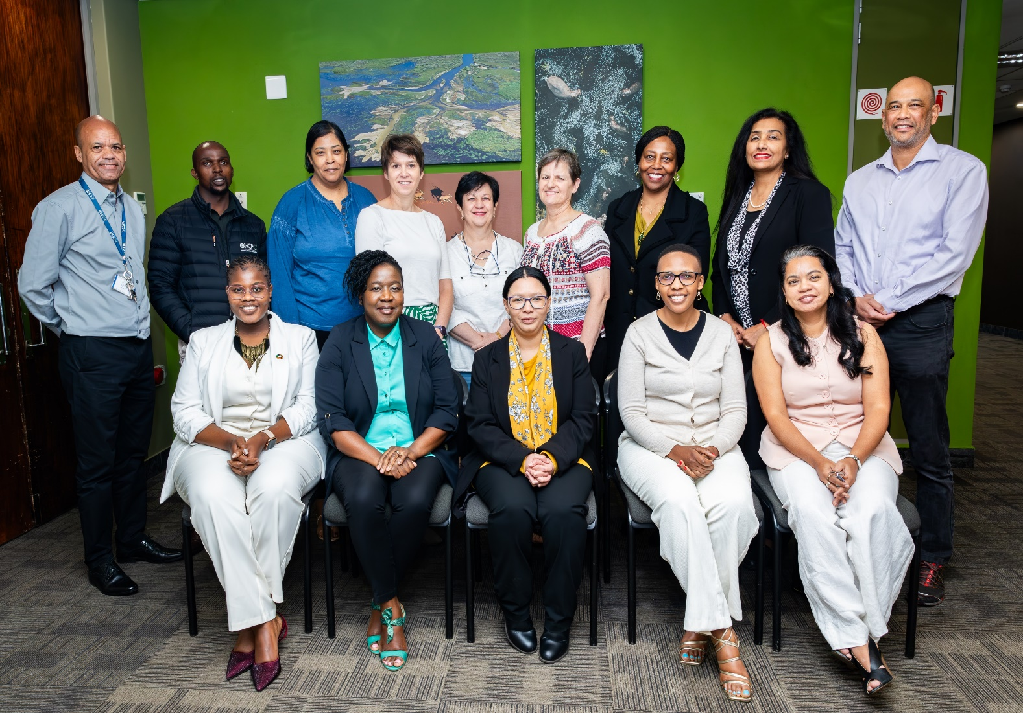
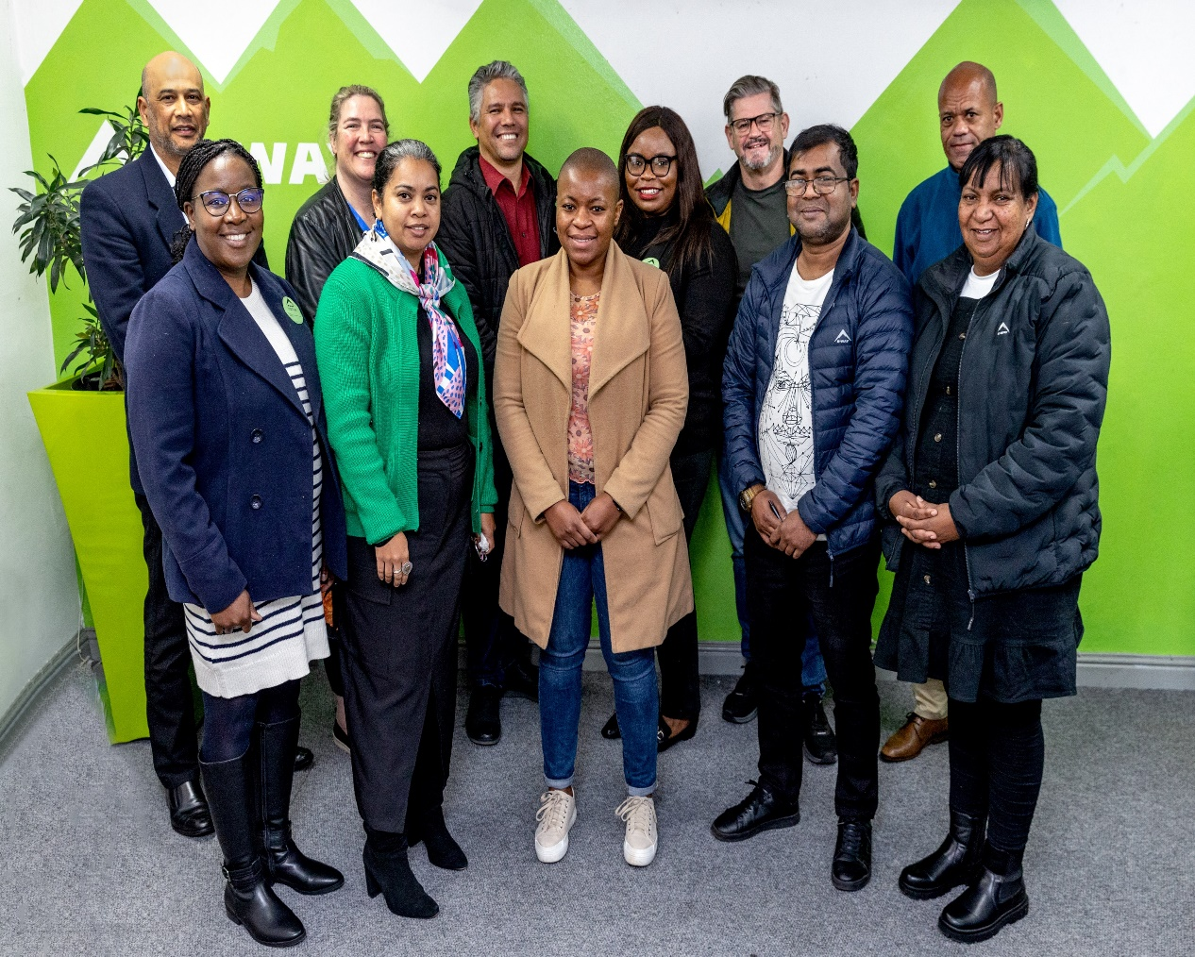
Project Outputs Activities Events
Output I : Policy Analysis and Recommendations
  Validation workshop – September 2024 Roadshow in Cape Town- August 2023

Slide 12
Project Output 2: Implementation of Circularity and Eco-innovation
Outputs | Deliverables | Outcome
D II.1 Eco-innovation Training workshop. |  | Training was conducted In Durban and CT November 2022 with UNEP Experts and 3 big retailers participated – and their suppliers, PnP, Cape Union Mart, MrP
Eco-innovation market assessment |  | Market assessment complete and published
Preliminary assessment studies for each SME |  | 2nd round of walkthroughs Few prelims submitted, working on rest to complete
Outreach to finance Sector |  | Two Green Finance Workshops we held with finance sector and SMEs to raise awareness on business cases for circularity and eco-innovation and SMEs financing needs
New Business Strategy and Models

Slide 13
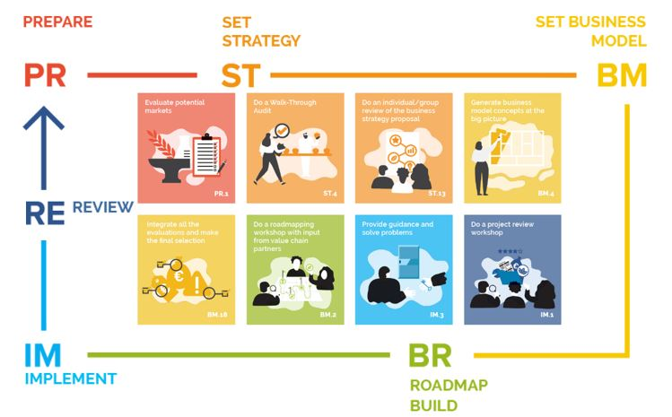
Output 2: Eco-innovation

Slide 14
Project Participating Companies
Company Name | Manufacturing Process | Outcome
Winelands Textiles | (CMT) Garment manufacturing | Garments | Garment manufacturer Brand owner | 100% female ownership
Imraan Textiles | Spinning, weaving, dyeing | Textiles for schooling, blazers etc. | Textiles manufacturer | Family ownership no females
Cape Union Mart- Kway | CMT (Garment manufacturing) | Jackets, T-shirts | Garment manufacturer | None
Cape Union Mart-Keedo | CMT (Garment manufacturing) | Ladies and kids apparel | Garment manufacturer | None
Finlam Textiles | Manufacturer of: woven polyester fabrics, | Specilaised fabrics for apparal and other | Textiles manufacturer | None
Rossatex CC | Textile Weavers on Jacquard and dobby looms. | Table Runners and Scatter Cushions for MrPH | Textiles manufacturer | 50% Female owned
Mozimax (Pty) Ltd | Manufacturing of home textiles. | Home textiles | Textiles manufacturer | None
Maytex Carding CC | Manufacturing of inner for duverts pillows | Fill Products i.e. Pillows , Duvet inners and Mattress protectors. | Textiles manufacturer | Family Trust (Trust does include female beneficiaries)
Republic Umbrella Manufacturers (Pty) Ltd | Manufacturer of textile homeware products | Home textiles | Textiles manufacturer | Afropulse (Pty) Ltd which is a womens’ empowerment trust co; & Jessica Sassen
Planet events | Manufacturers of Footwear Components , Completed Sandals ( Pool Sliders ), | Soles for school shoes | Shoe manufacturer | None

Slide 15
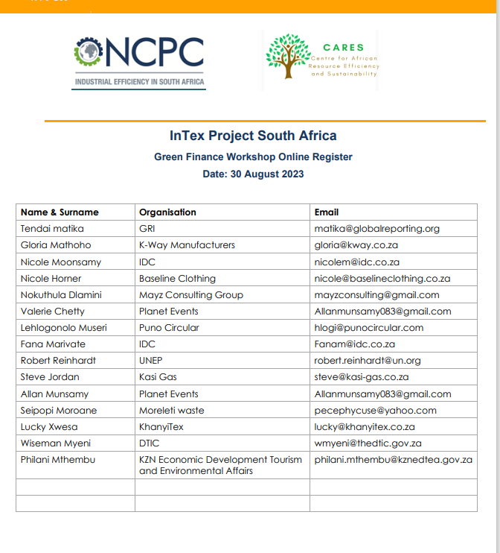
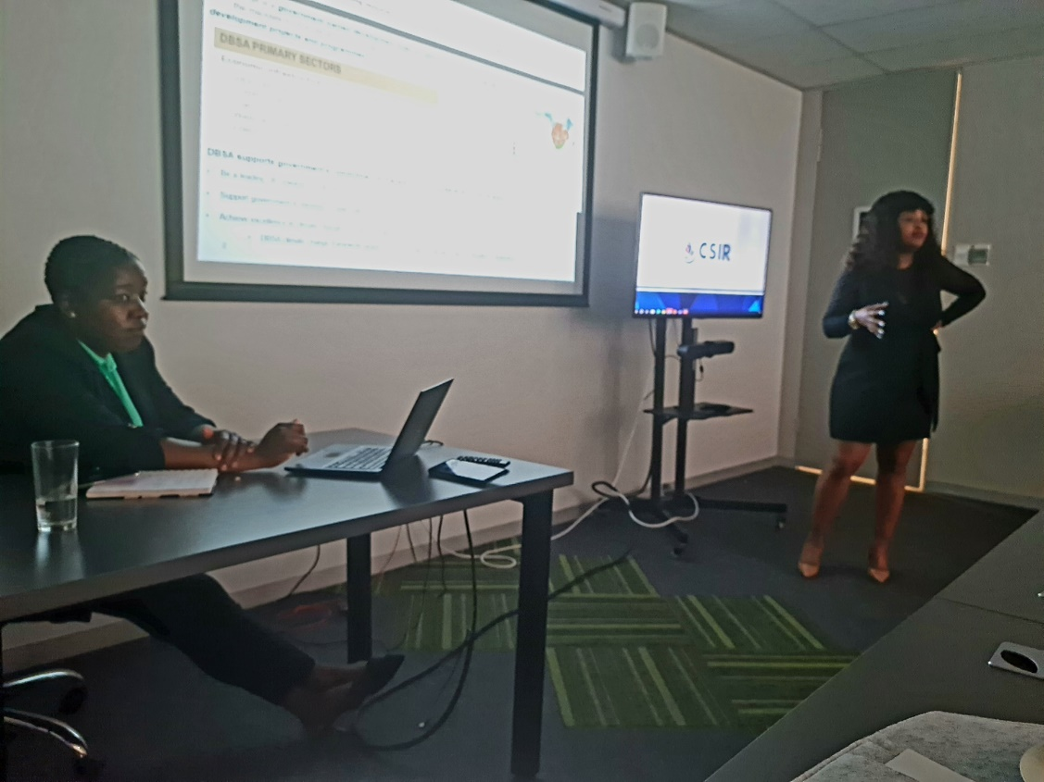
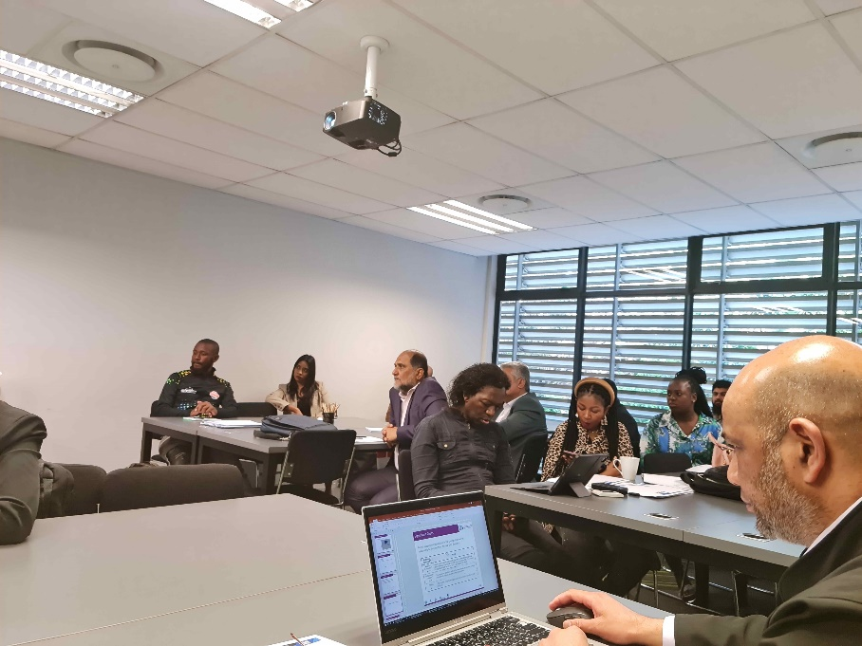
Project Outputs and Activities
Output II:
  Finance workshops: 1st in person, 2nd online

Slide 16
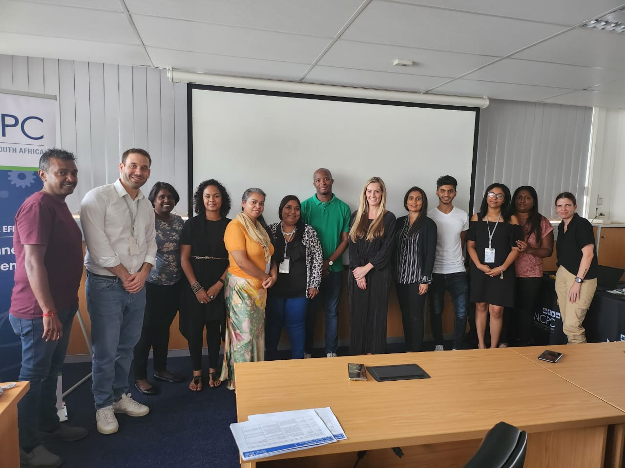
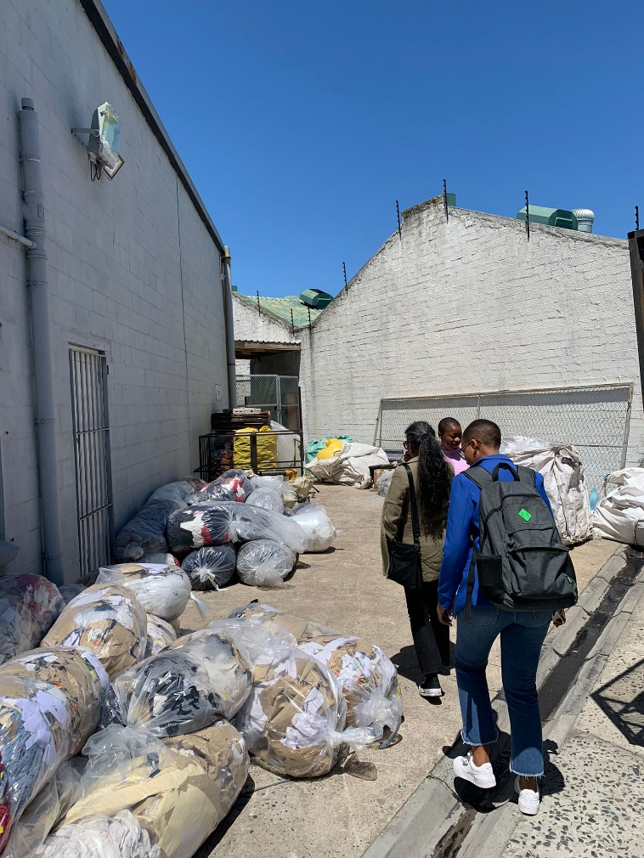
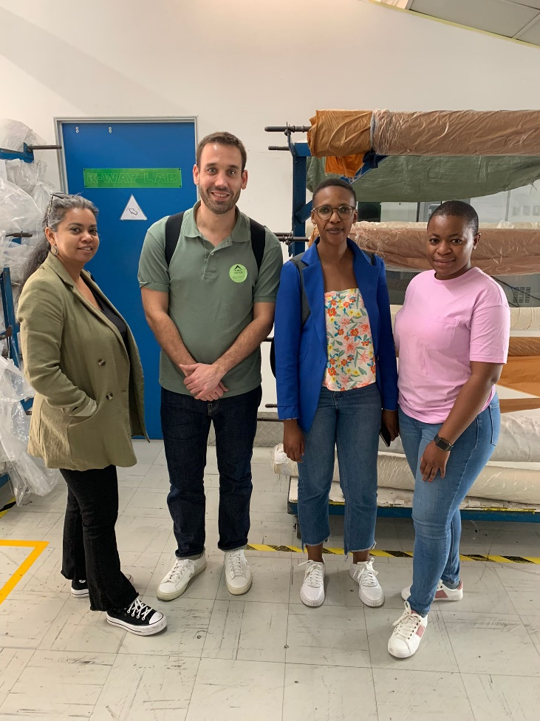
South Africa Intex Project Update
Training & Site walkthroughs November 2023

Slide 17
Project Output 3: Implementation of LCA
Outputs | Deliverables | Progress
Output III | PEF data gathering | In Progress all companies submitted data. Follow up on data gaps
 | PEF training | Training on LCI calculator from Juan
Output IV | Progress meetings and report, financial reporting | Ongoing

Slide 18
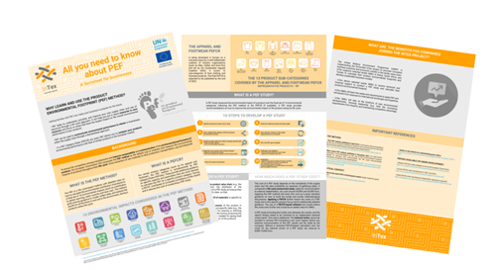
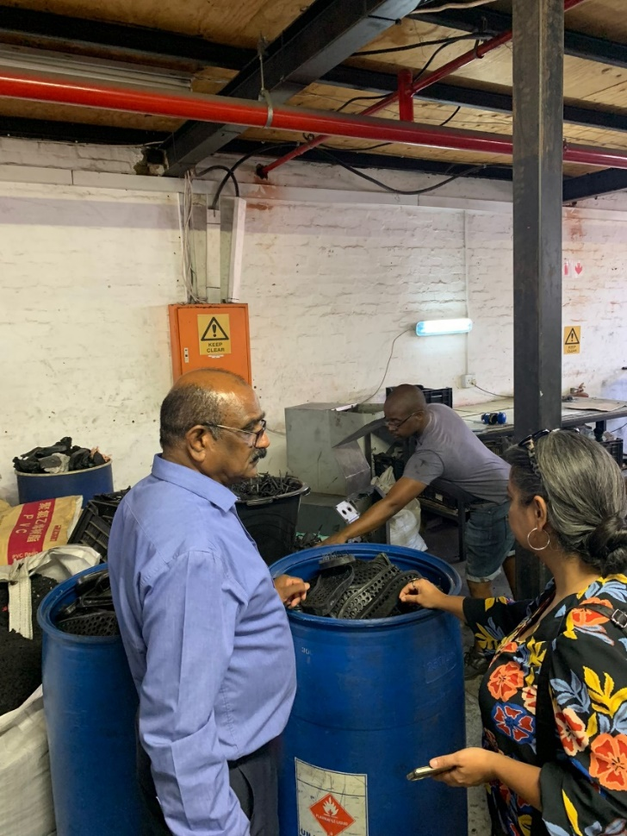
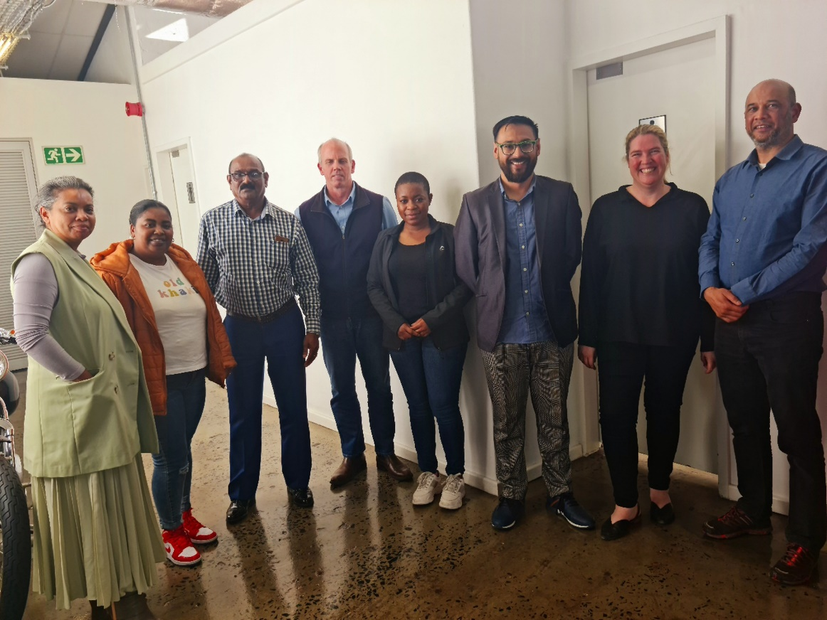
Project Outputs and Activities-PEF training June 2022
Feedback meetings of hotspots
PEF guidance document
PEF training
Another site visit and awareness raising on PEF

Slide 19
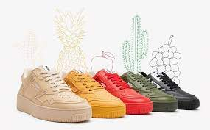
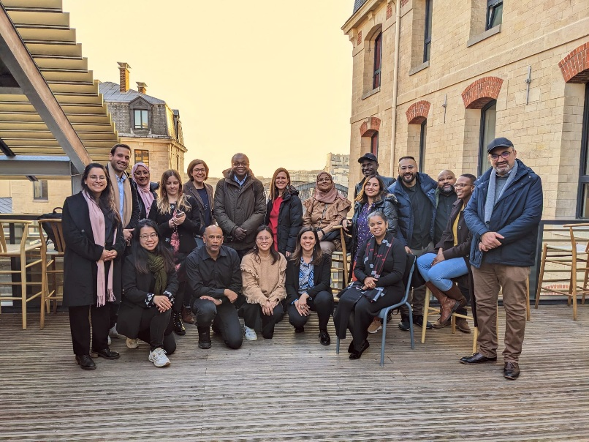
Project Outputs and Activities
Output IV : Progress meetings and report
Meetings with UNEP Paris Feb 2023
Partner’s meetings

Slide 20
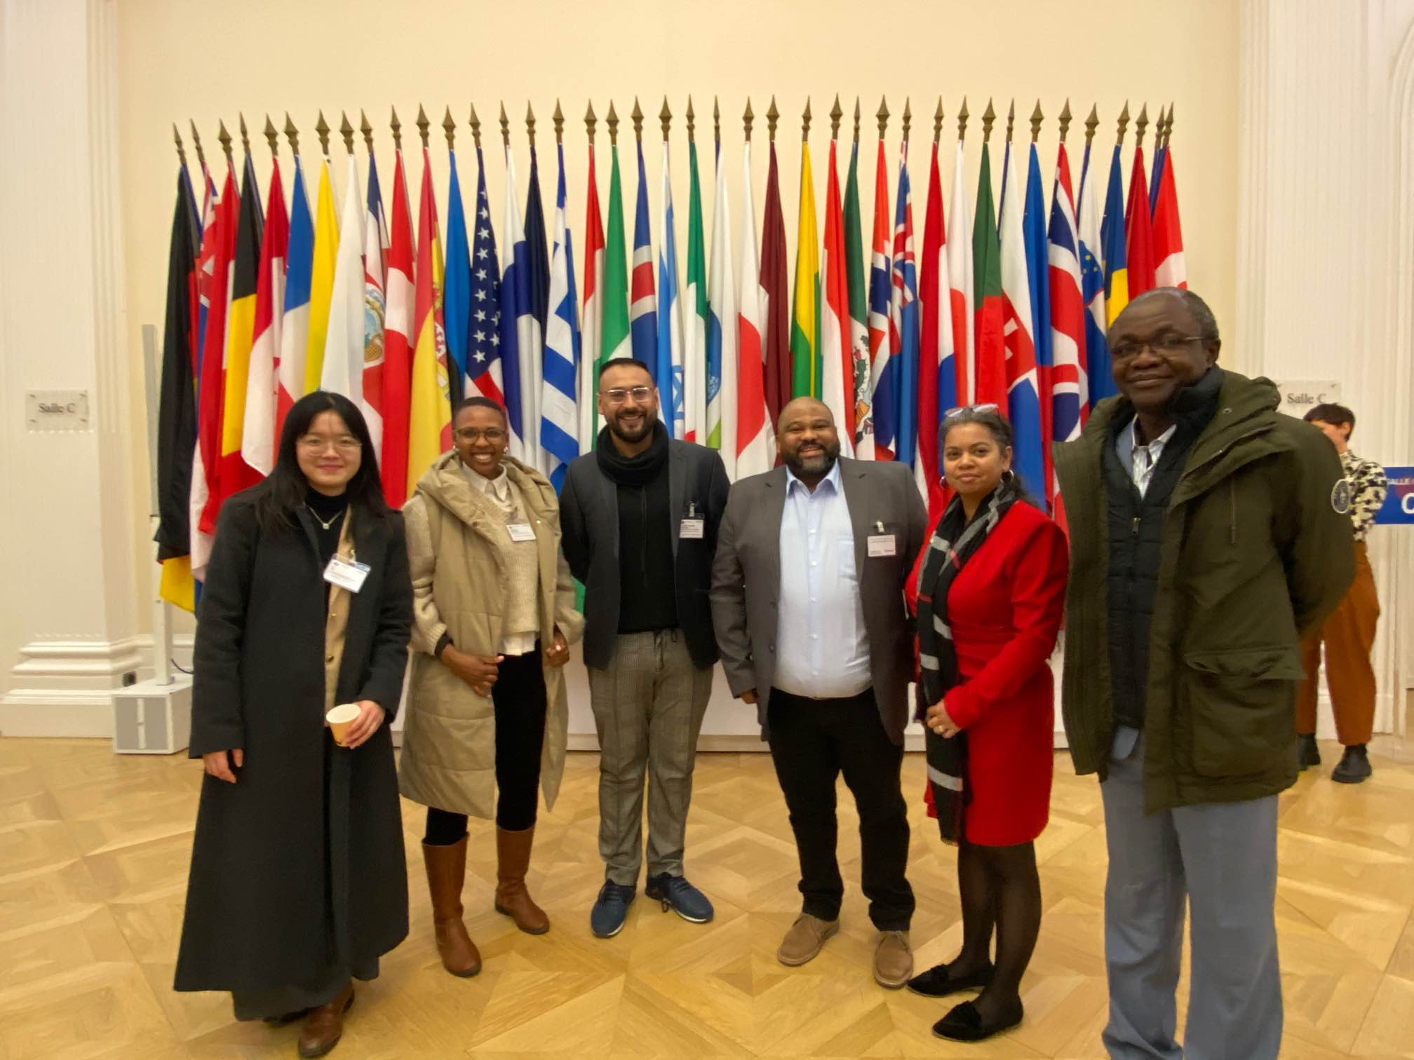
Partners Meeting February 2023
Access to international experts
Learnings regionally and globally
Possibility for export (future proofing companies)
Access to finance
SUSTAINABILITY IS OVERARCHING AND LINKS ALL ASPECTS

Slide 21
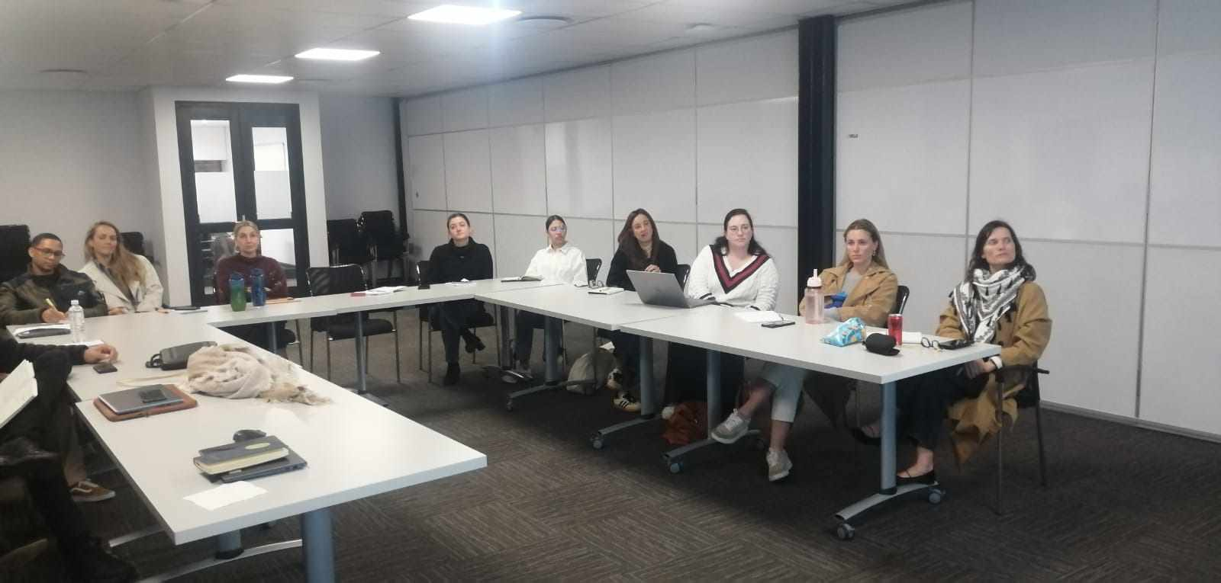
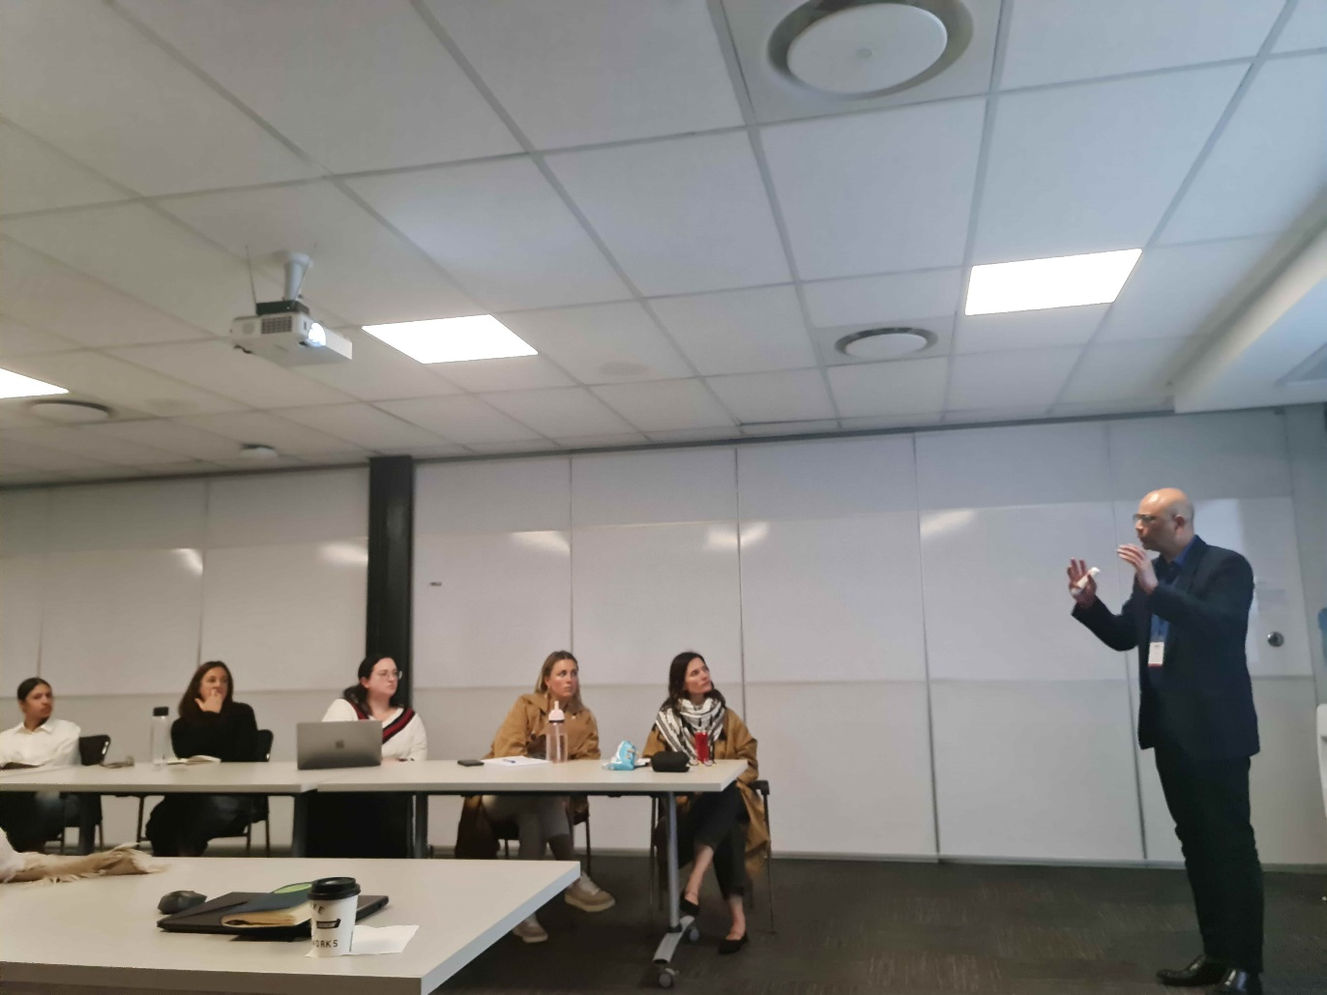
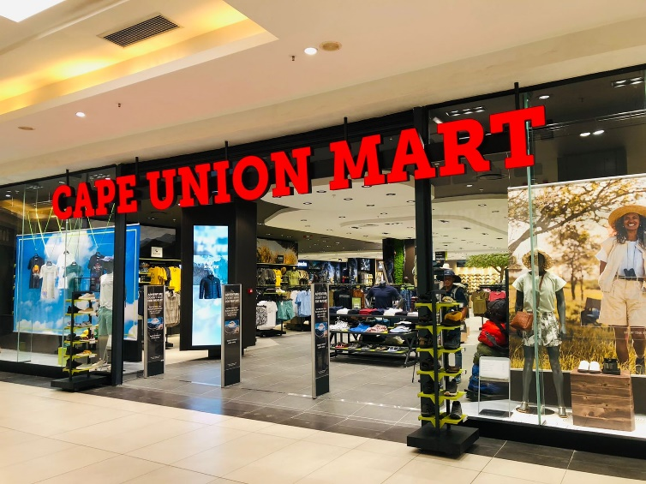
Project Outputs and Activities
Output II: Eco-innovation
  Supply chain workshop for Cape Union Mart- focusing on ecolabelling and export readiness

Slide 22

Selected Project Milestones
Participating companies gained access to multistakeholder sectoral partnerships Imran Textiles (Textiles Exchange + Event in Milan) UNICA, Hextex, Republic Umbrella access to NCPC who offered further assistance with REPC assessment following the EI training
Participating companies have taken initial steps to implement innovative sustainable business models
SMEs were supported to adopted sustainable and circular practices through application of life cycle thinking Hextex (Women owned,) Green-Thread (Women run)
SMEs were supported to start take action on improving chemicals management in adopting more circular practices SA: Green Thread (waterless dyeing plant)

Slide 23
Future Phase 2: Focus Areas
Integrate Sustainability in the Master Plan (they started to create a Task team)
Knowledge Hub (?) + Road shows for specific topics, along with industry associations
How to make companies export ready? (towards African markets). Including awareness, data and standardisation
Transport infrastructure
Expand on circular business models
Partnerships for skills development / educational authorities (SETAs)
Accelerate Green Finance
Support implementation
Include more retailers and large manufacturers

Slide 24




THANK YOU YOU!
Stay in touch! Visit:
www.unep.org/intex
www.ncpc.co.za

