Slide 1



Strategic framework: Alignment with Regional Project

Slide 2


Contents
03 Our business
06 Strategic sustainability framework
09 Climate Change Process
11 Plastic waste to products
14 Our partners
Image
goes here
if needed

Slide 3
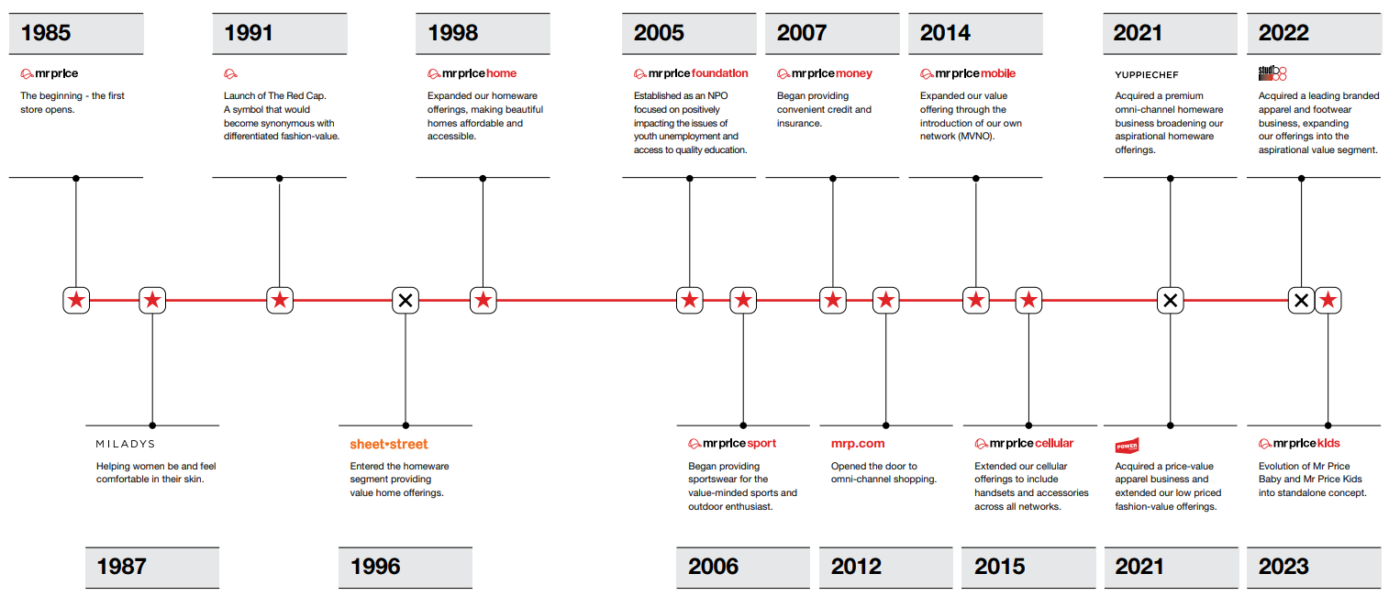
Our Business
03 | Our Business

Slide 4
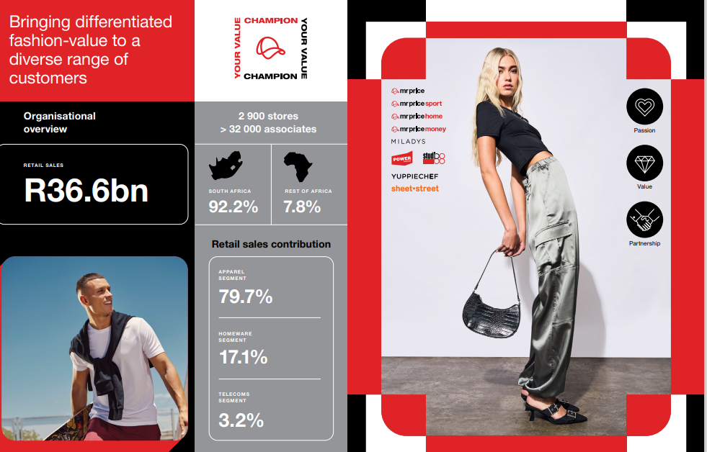

Slide 5
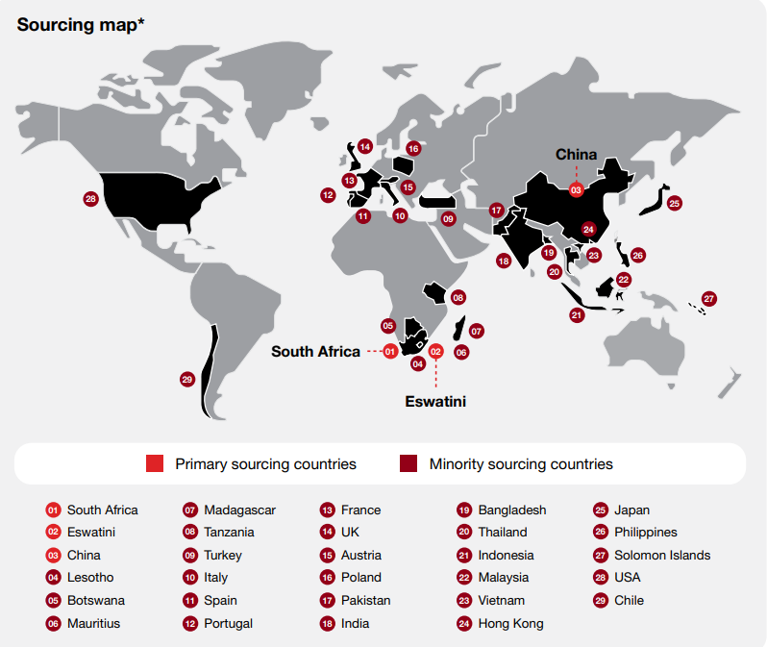
05 | Sourcing Countries

Slide 6
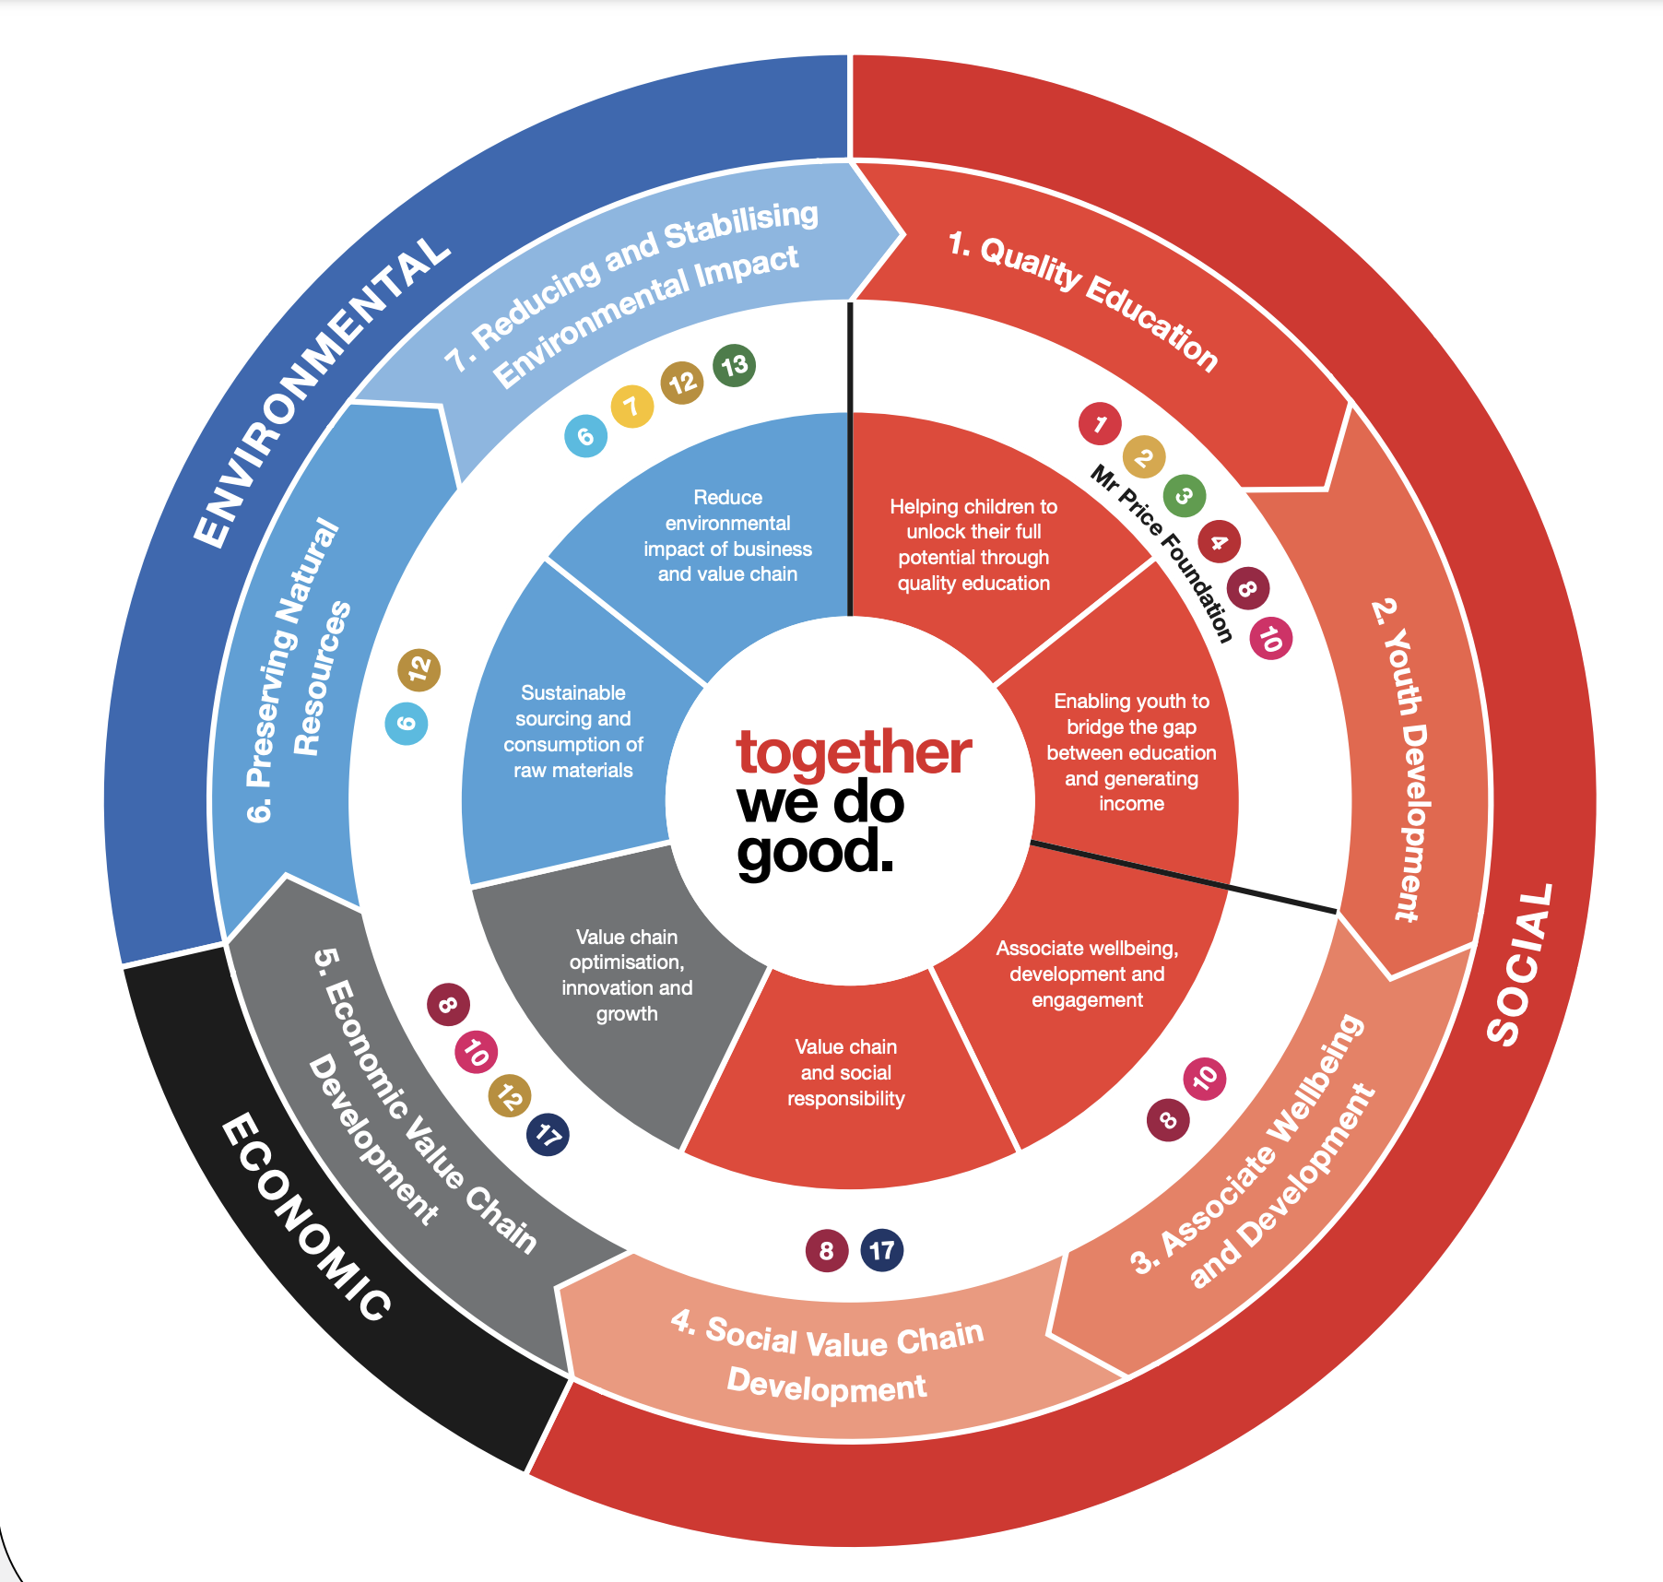





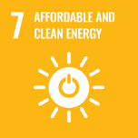

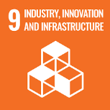
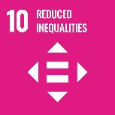
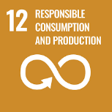
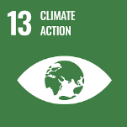
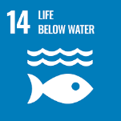

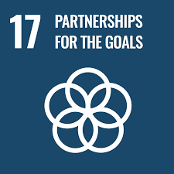
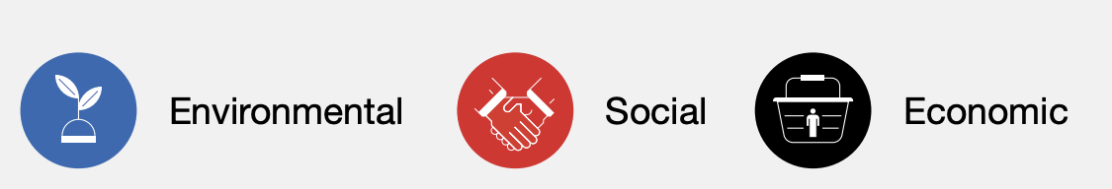
Strategic Sustainability Framework
Framework Pillars
Strategic
Framework
06 | Strategic Sustainability Framework

Slide 7
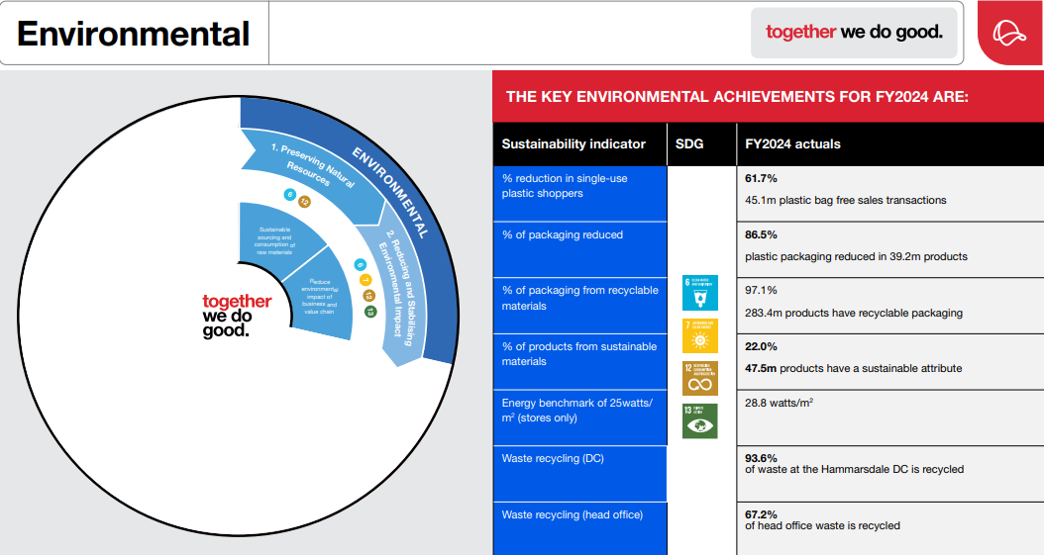
07 | Environmental

Slide 8
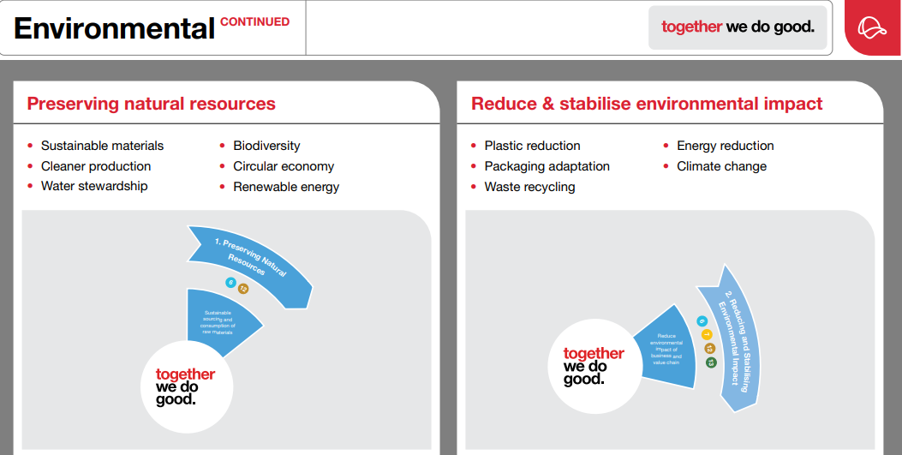
08 | Environmental

Slide 9
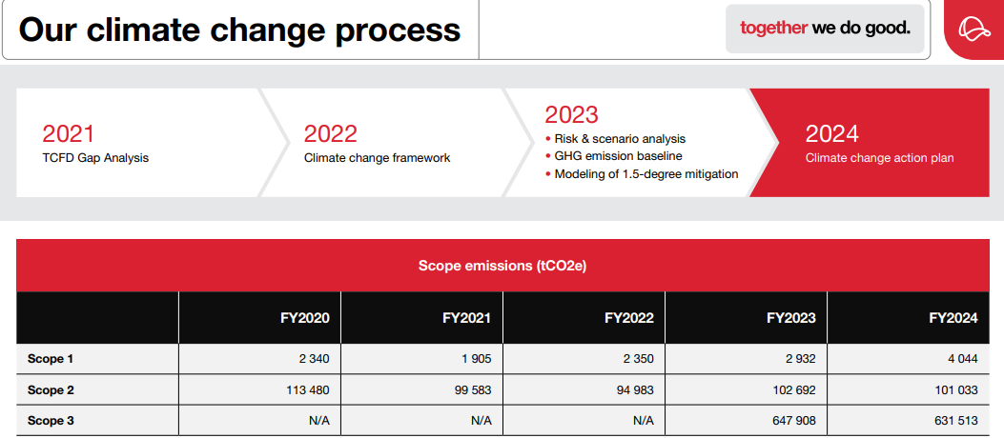
09 | Climate Change Process

Slide 10
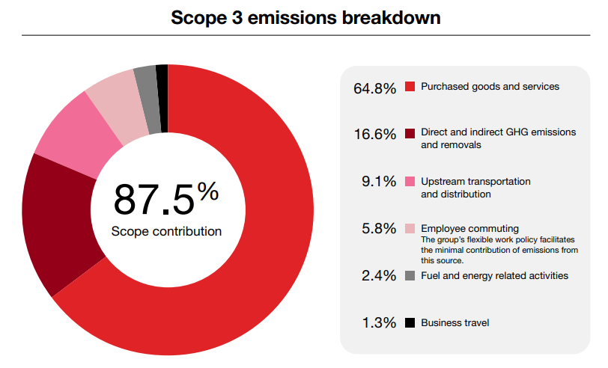
10 | Scope 3 Emissions

Slide 11









Plastic Waste to Products
From plastic waste…
Raw material
Ginning
& Spinning
Weaving
& Knitting
Processing
& Finishing
Cut, Make & Trim (CMT)
Transportation
Retail & Consumer
… to products
11 | Plastic Waste to Products

Slide 12
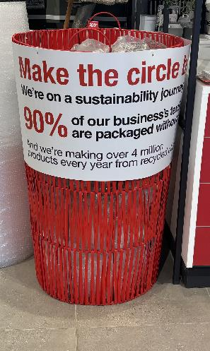


Started partnership with a local KZN supplier in 2022
By the end of FY 2023 -7000 kg of plastic packaging recycled
More plastic waste is needed to supply the quantity
Collecting at store
12 | Plastic Waste to Products

Slide 13
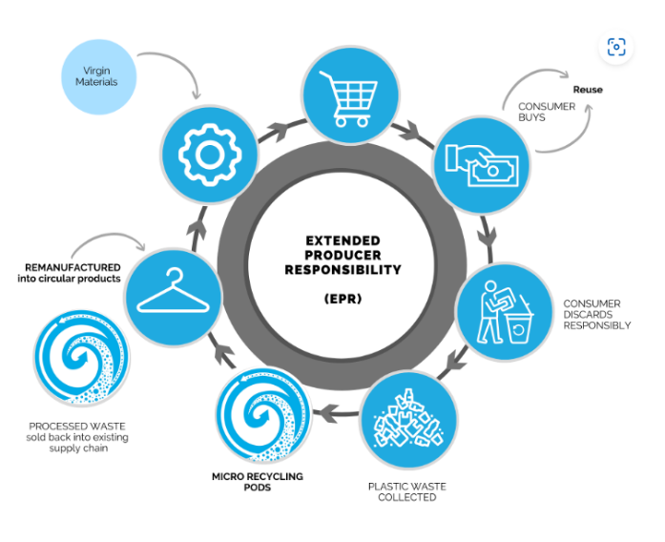
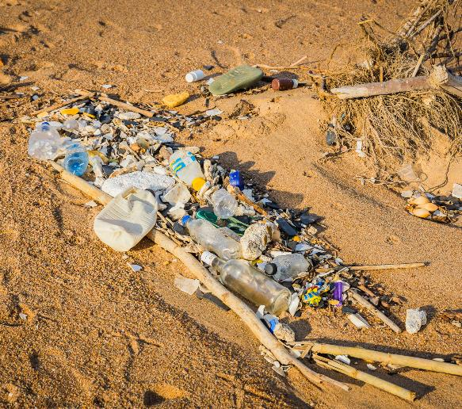
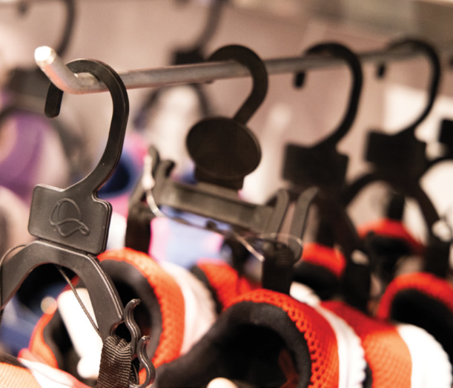
13 | Plastic Waste to Products

Slide 14
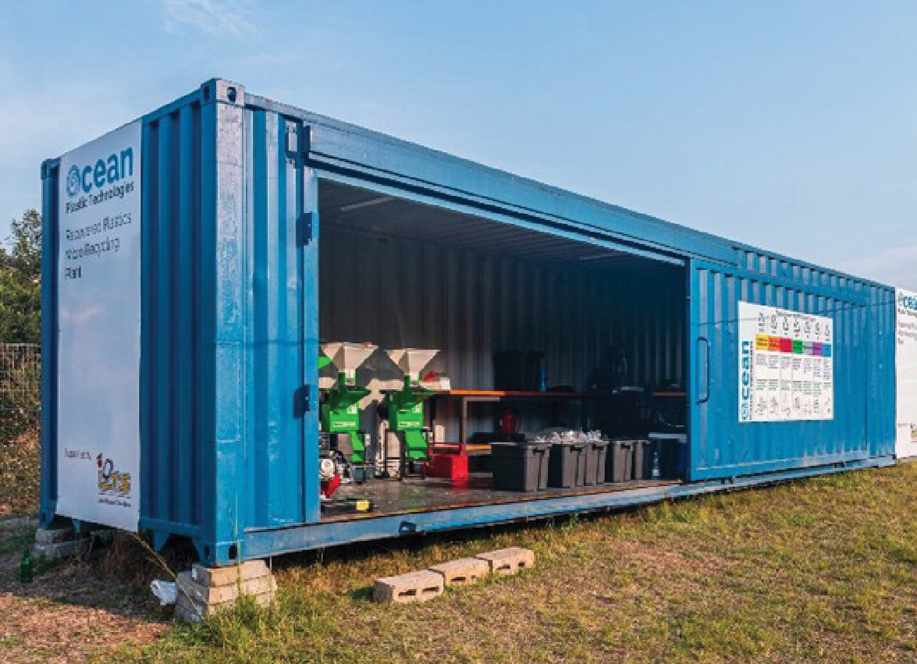
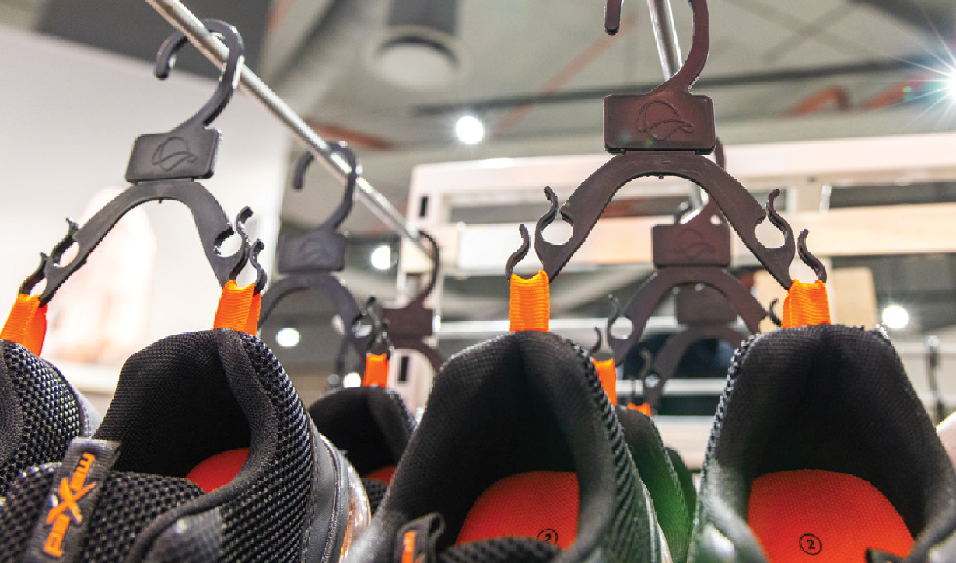

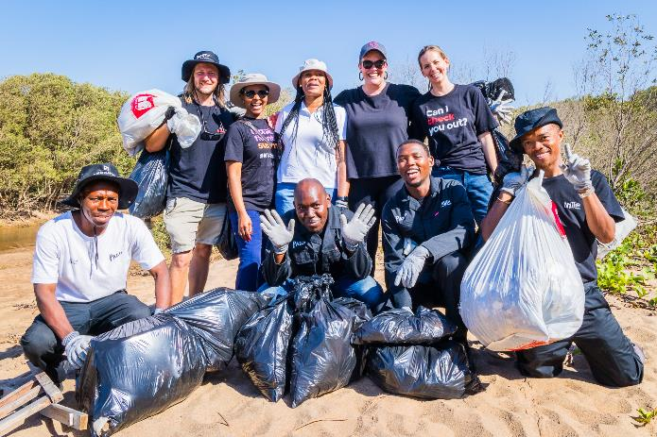
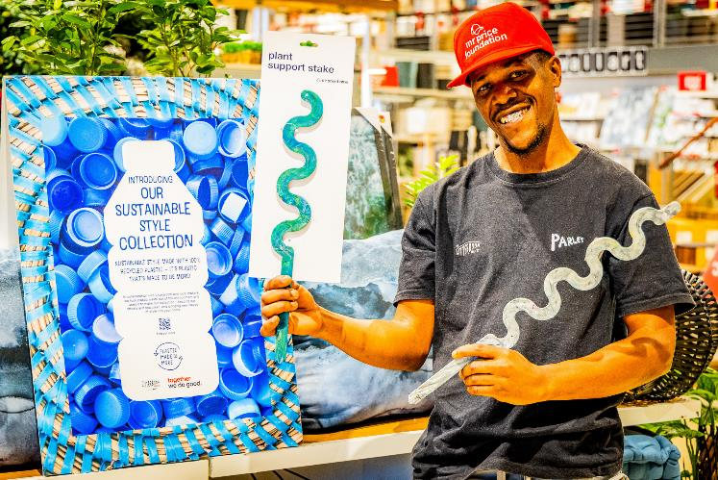

Mobile Micro Recycling Plants (MRPs)
“Our MRPs make it possible to take plastic recycling to source-taking it into the communities where pollution is a massive problem.
By monetizing the collection of plastic waste, we’re not only cleaning up these communities, but we’re also empowering the unemployed”: Oliver Nudd (Ocean Plastic Technology)
FY 2024 : Mr Price Sport
345 500 footwear hangers
Employee volunteering:
Beach clean up
14 | Plastic Waste to Products

Slide 15
Challenges
Readiness of manufacturing industry
Levels of knowledge and/or awareness
Visibility of key production plants
Local certification/verification of claims
Cost of certification
Fabric rebate rules on textile waste

Slide 16
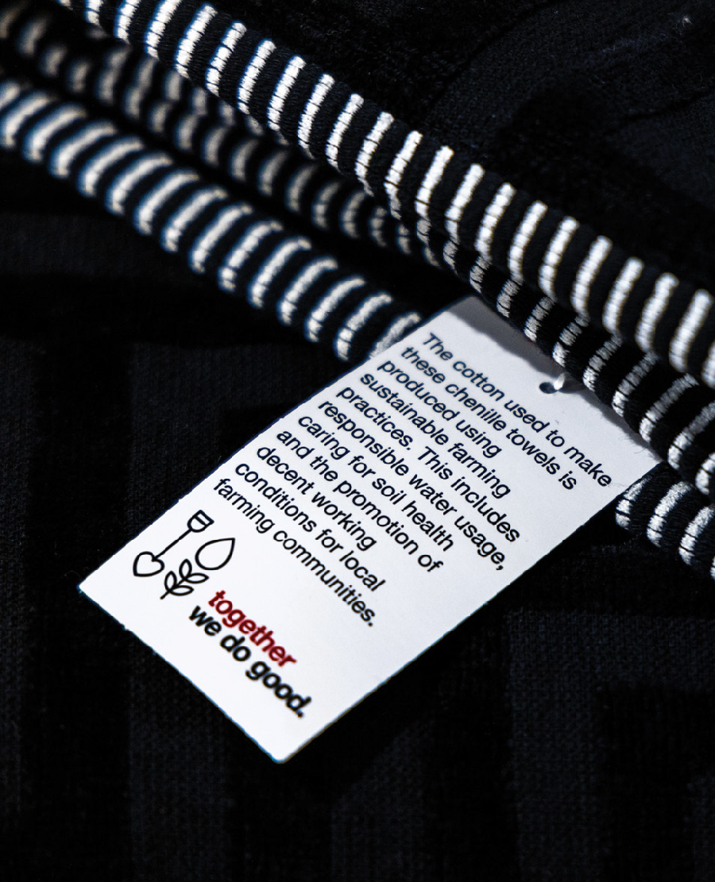

Thank you

