Slide 1



Presented by: Mr. Alamrew Ayalneh and Mr. Mamaru Tesfaye (TGiRDc)
Current Status and Next steps
on
UNIDO-GEF PROJECT
“Promotion of Circular Economy in the Textile and Garment Sector through the Sustainable Management of Chemicals and Waste in Ethiopia’’ (GEF Project ID 10683)
November 12, 2024, Johannesburg, SA

Slide 2
CONTENTS
01.
02.
03.
04.
05.
06.
07.
PPG Phase
Project Components
Project Implementation status
Next steps and the way forward
Introduction
Budget and Cost
Challenges and Measures

Slide 3




Introduction
Project Title: Promotion of Circular Economy in the TG sector through the sustainable management of chemicals and waste in Ethiopia.
    Project Objective: To promote the concept of CE in the TG sector of Ethiopia through the elimination, reuse, recycling and conversion of textile/garment discards and related wastes into economically viable and socially beneficial products and services
Funding Agency –GEF
Project Duration:- 60 Months (5 years)

Slide 4
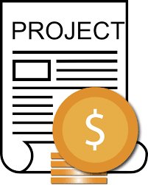

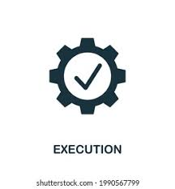
Cont…
Project Cost –GEF Project Financing ($) 3,000,000
  - Co-financing ($) 20,140,000
Implementing Agency: United Nations Industrial Development Organization (UNIDO)
National Executing Entity: Textile and Garment Industry Research and Development Center ( TGIRDC)
Regional Executing Entity: Africa Institute for the Environmentally Sound Management of Hazardous and Other Wastes (AI)

Slide 5
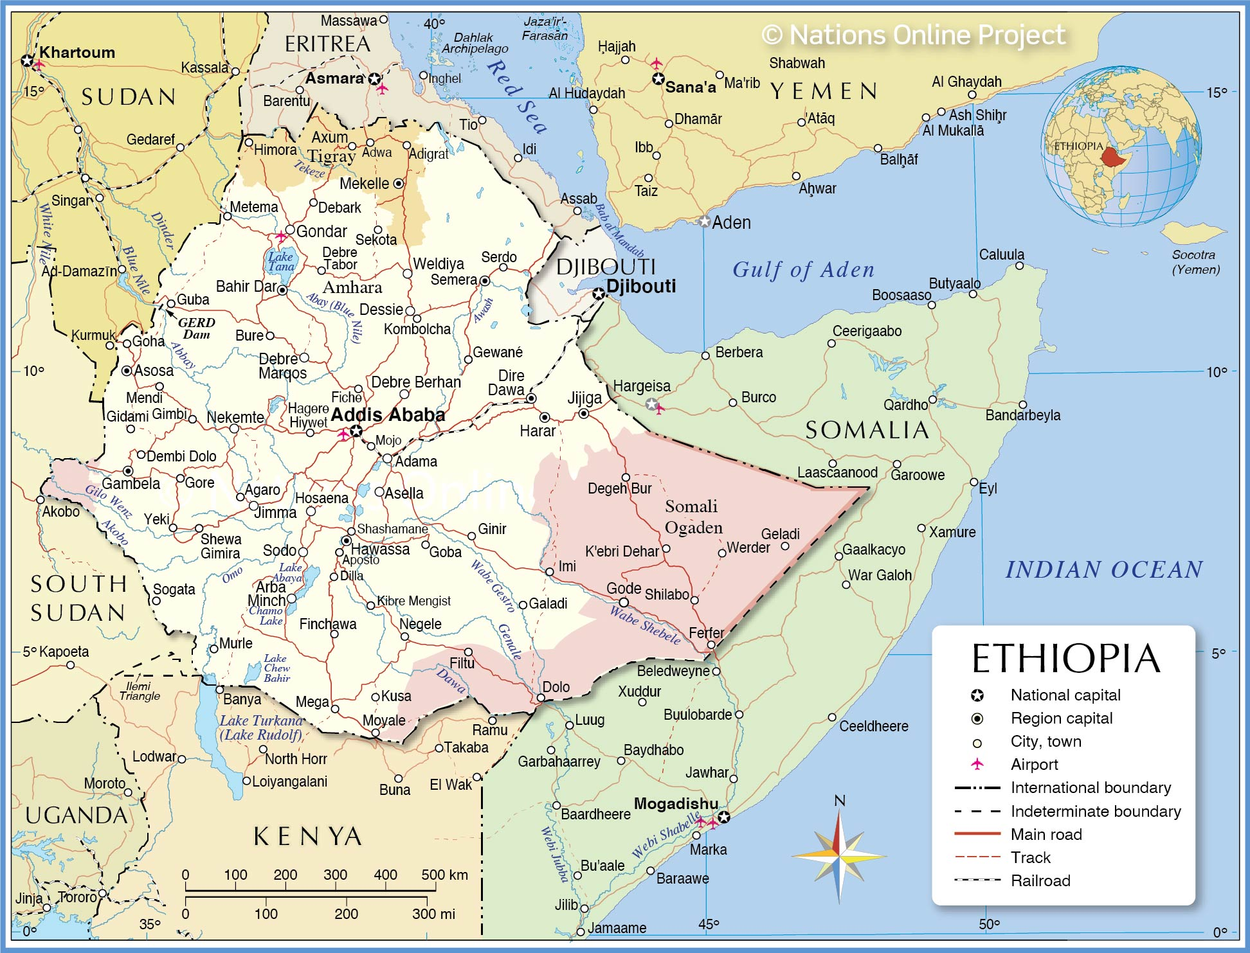

Project Map/Location

Slide 6
CONTENTS
01.
02.
03.
04.
05.
06.
07.
PPG Phase
Project Components
Project Implementation status
Next steps and the way forward
Introduction
Budget and Cost
Challenges and Mitigations

Slide 7
Assessment Studies and Baseline Data Collection was conducted on 8 T&G industries and developed six different documents:-
Project Preparation Grant (PPG) Phase
To establish a baseline data and information on generation, characterization and management of waste and chemicals in order to devise viable interventions .
94K tons TG Waste/ year
To establish a baseline data and information in the Ethiopian TG sector by identifying POPs and other hazardous chemicals and to investigate relevant BAT/BEP and RECP options required to prevent and control the impacts of the identified chemical substances in the context of circular economy.
To ensure the social and environmental impacts, risks and liabilities identified are effectively managed during the development and implementation of the activities
1. Waste Management Study
2. Identify BAT/BEP and RECP options
3. Develop an ESMP

Slide 8
Assessment Studies and Baseline Data Collection was conducted on 8 T&G industries and developed six different documents:-
Project Preparation Grant (PPG) Phase
To develop a better understanding of critical gender issues in order to devise viable interventions
To investigate the diversity of gender dynamics in the TG manufacturing sector and insights into interventions
To develop appropriate measures to mitigate or adapt climate change risks through detailed investigation and assessment.
To Study the impacts of covid-19 pandemic on the TG sector,
To identify the potential threats and opportunities;
To evaluate risks (low, medium and high) posed to the project and
To set plans/strategies to mitigate the risks; and take advantage of the opportunities.
4. Gender Mainstreaming Study
5. Climate Risk Screening
6. COVID -19 Impact and Risk Assessment

Slide 9
Project Preparation Grant (PPG) Phase
Stakeholders are identified and Engagement plan is prepared for the successful implementation of the project
Stakeholders identified includes :-
Government and regulatory bodies
Pilot industries
International and local NGOS
Academic and Research Institutions
Media and Supply chain

Slide 10
CONTENTS
01.
02.
03.
04.
05.
06.
07.
PPG Phase
Project Components
Project Implementation status
Next steps and the way forward
Introduction
Budget and Cost
Challenges and Mitigations

Slide 11

3. Project Components and Outputs
Strengthening of regulatory and institutional capacities for adoption and promotion of CE in the TG sector
1.
Output 1.1: Legal and institutional framework for life cycle management of the TG supply/value chains
Output 1.2: Regulations and incentive scheme for promotion and sustainability of circular economy in the TG sector
Output 1.3: Technical Committee for Circular Economy in the TG sector
Recyclability of TG wastes is enhanced through POPs-free textile manufacturing process and the implementation of BAT/BEP and RECP investments
2.
Output 2.1: Technical guidelines for environmental sound management of POPs chemicals and wastes
Output 2.2: SOPs and checklists POPs pollution prevention and control
Output 2.3: Techno-economic feasibility of BAT/BEP and RECP options
Output 2.4: Training and Capacity building in BAT/BEP, RECP and Circular Economy
Output 2.5: BAT/BEP and RECP options identified and implemented in facilities in each country
Project Components
3.
Introduction of CE concept for uPOPs emission reductions through ESM of TG wastes and pilot demonstration of TG wastes recycling and reuse
Output 3.4: Techno-economic feasibility study of BAT/BEP options for recycling/reuse of TG wastes
Output 3.5: Socio-economic impact assessment of project intervention
Output 3.6: Partnership and cooperation mechanism supply chain management
Output 3.7: BAT/BEP demonstration for ESM of POPs chemicals and textile/garment wastes
Output 3.1: ESM plan for textile/garment wastes.
Output 3.2: Training and capacity building in ISWM and BAT/BEP for ESM of textile and garment wastes.
Output 3.3: Financing mechanisms and business models for circular economy
4.
Output 4.1 National capacity and awareness programs developed and implemented to increase ability of textile sector and policy makers to control POPs and CoCs
Output 4.2 Regional and Global Knowledge Exchange and Management tools produced and accessed by users globally
Output 4.3 Gender and Social Action Plan implemented, and benefits accrued to women workers
Knowledge Management for Scaling up

Slide 12
CONTENTS
01.
02.
03.
04.
05.
06.
07.
PPG Phase
Project Components
Project Implementation status
Next steps and the way forward
Introduction
Budget and Cost
Challenges and Mitigations

Slide 13
Project Implementation
Project Establishment and Start Up Activities
Implementing Partner Agreement (IPAs) signed between TGiRDc and UNIDO in June 2023;
Project Management Unit (PMU) Established;
Project Implementation Committee (PIC) members are established ( 11 members)
Detailed five and One year work plan and schedule were prepared and approved by UNIDO;
  Kick-off report which includes work plan and budget for the first year were prepared and submitted to UNIDO;
  Technique Committee (TC) members are identified and Established
  National steering committee members (NSC) nominated (Two members)
  The first year budget was released in the second week of March 2024;
  National Inception Workshop conducted in April 18 ,2024

Slide 14
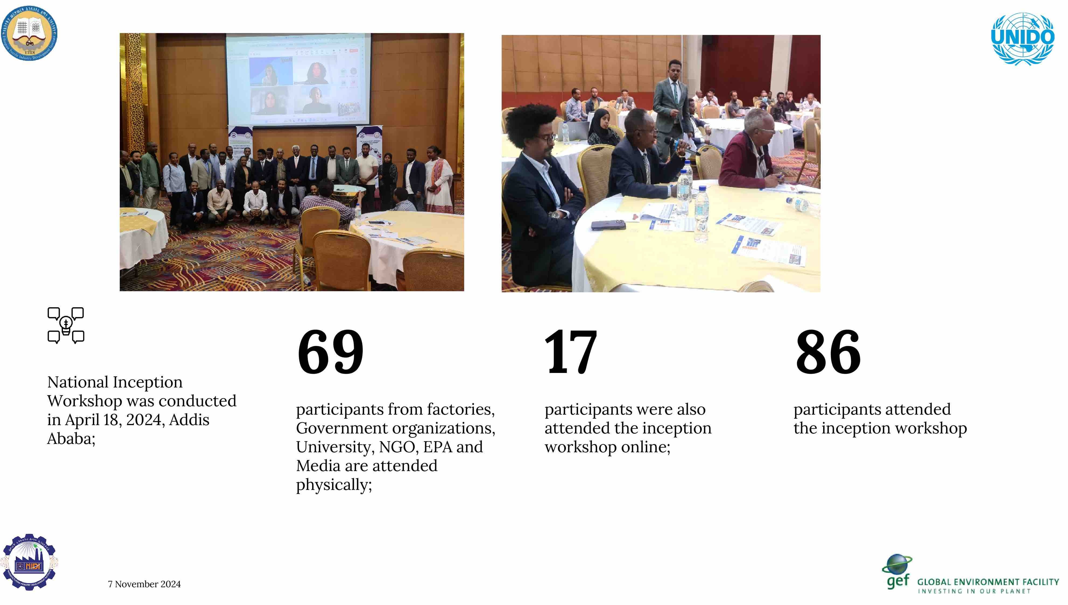
Project Implementation
National Inception Workshop conducted

Slide 15
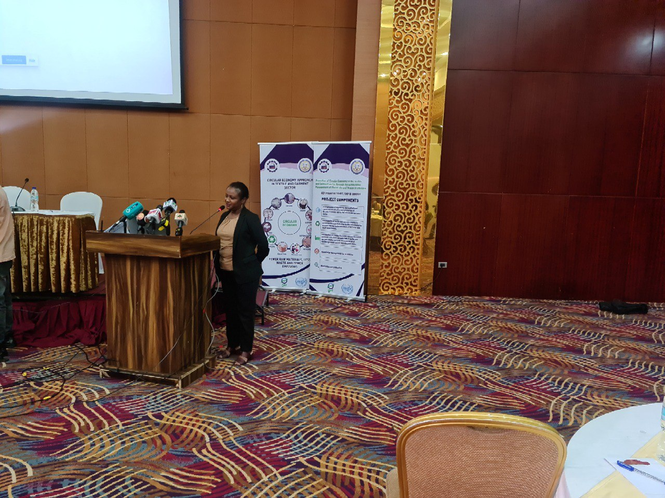
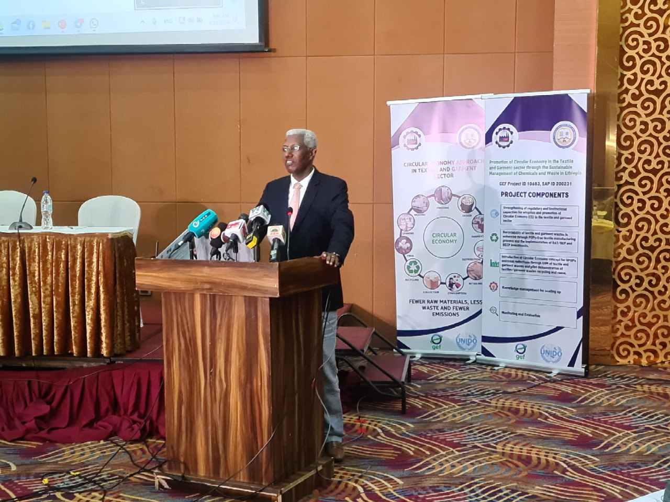
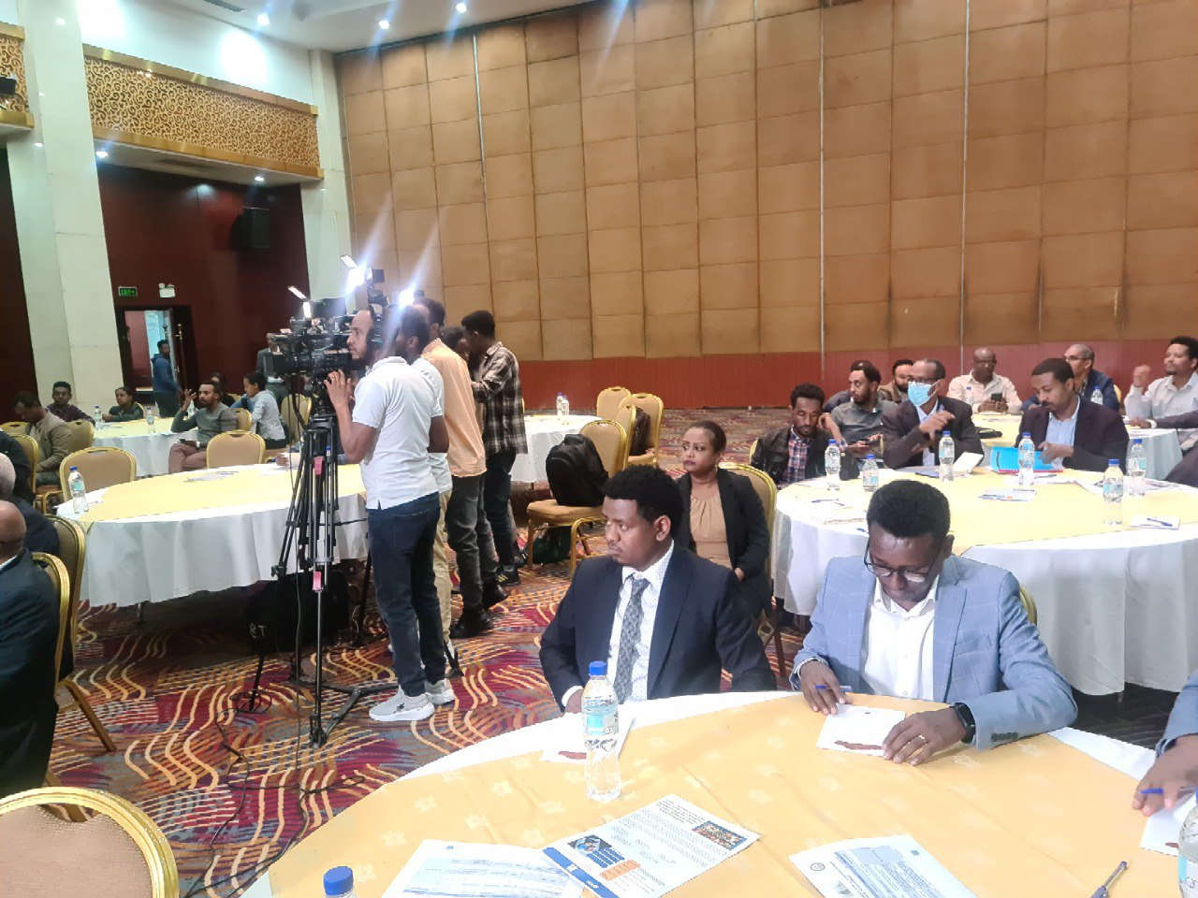
Project Implementation
The Four presentations on the inception workshop :-
Enhancing Africa’s competitive role to promote Circular Economy into the manufacturing sector - the case of textile sector in Ethiopia (by ACEN Foundation, East Africa Regional Coordinator)
Overall CE project implementation in Ethiopia, Lesotho, Madagascar and South Africa (by Africa Institute)
Promotion of Circular Economy in the Ethiopian Textile & Garment Sector (by TGiRDc)
Introduction about Zero Discharge of Hazardous Chemicals by ZDHC Teams.

Slide 16
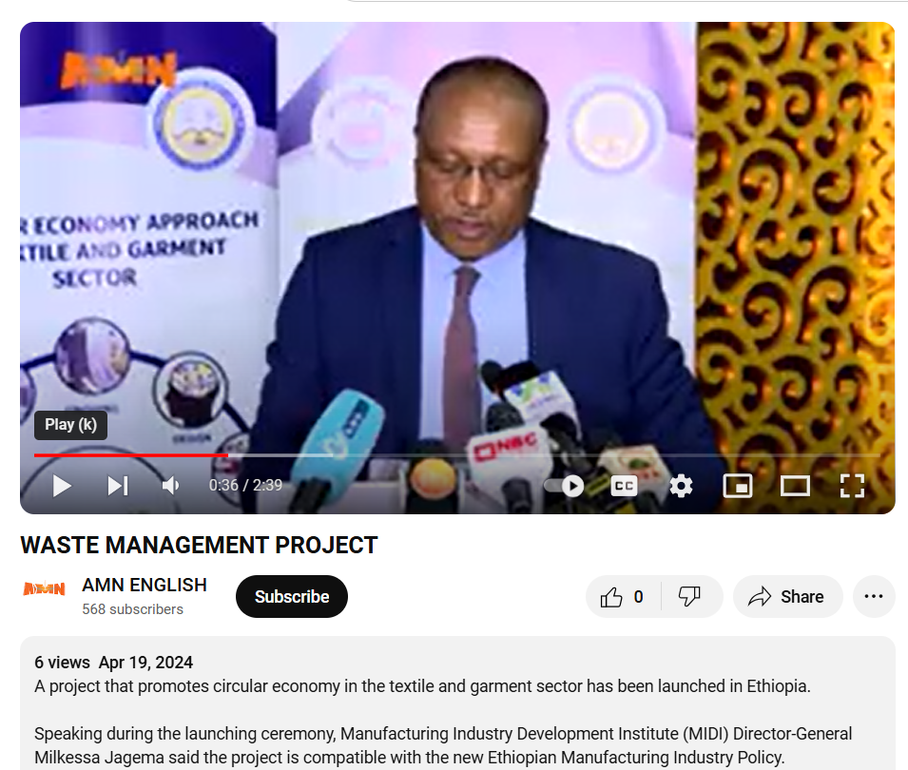


Project Implementation
.
As one of the main aim of the project is to promote circular economy in the country, the role of media coverage is crucial
11 media outlets with 22 reporters and camera men from radio and television channels have given coverage for the inception workshop

Slide 17
Project Implementation
Component one : Strengthening of Regulatory and Institutional capacities for adoption and promotion of CE for TG
National Inception Workshop conducted
Cooperation Meetings with ICLEI has been conducted
Webinars meetings were conducted with ICLEI in order to execute the planed activities with regard to Legal and institutional framework
A list of available policies, strategies, proclamations, guidelines, standards, and legislation related to POPs, hazardous chemicals, waste management in the TG sector in Ethiopia has been identified ,compiled and sent to ICLEI for review,
Gap analysis of legal mandates, institutional capacities, etc. were caried out
Existing laws and regulations were reviewed
Gap analysis and activity plan for component one is prepared and sent to ICLEI.
Task force is established for developing policy and regulatory framework with the guidance of ICLEI.

Slide 18
Project Implementation
Component Two : Recyclability of textile and garment wastes is enhanced through POPs-free textile manufacturing process and the implementation of BAT/BEP and RECP investments
National Inception Workshop conducted
Technical guidelines , protocols and procedures for safe and ESM of chemicals are being finalized.
33 participants from pilot companies and task forces were attended the webinar-based introduction to ZDHC and CMS framework training course in June 25, 2024.
Introductory Cooperation meetings with ZDHC has been conducted
Bi-weekly Webinars meetings were conducted with ZDHC Academy in order to execute the planed activities with related to CMS;
Task force has been established for developing checklist and conduct inventory database with the guidance of ZDHC.

Slide 19
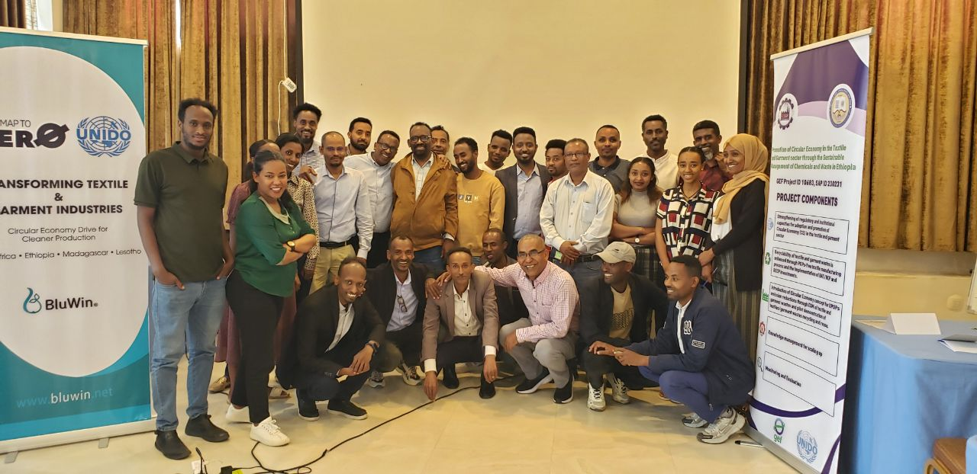
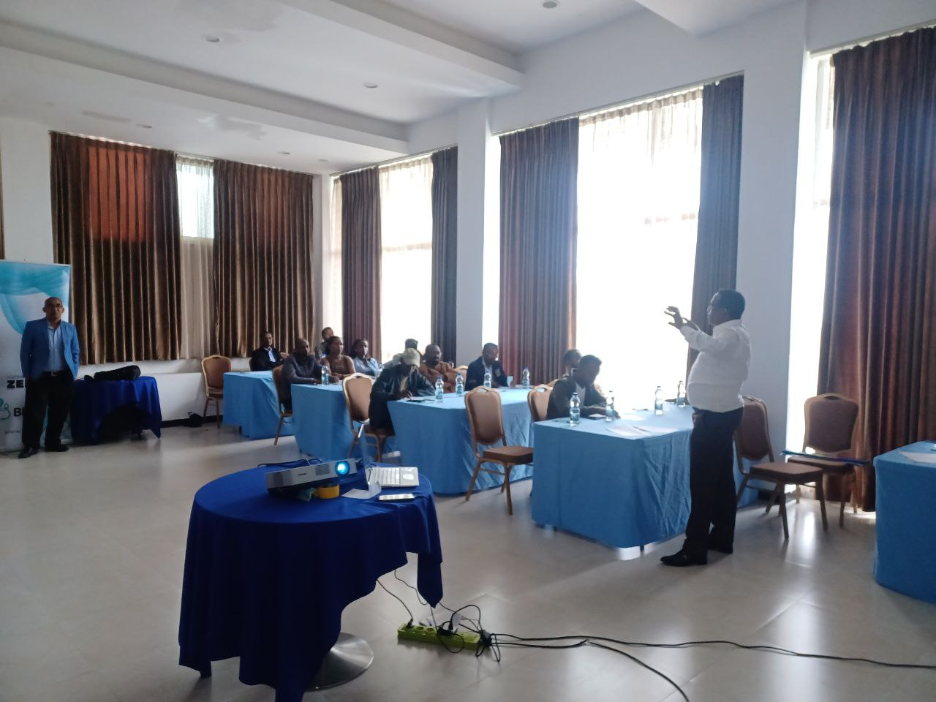
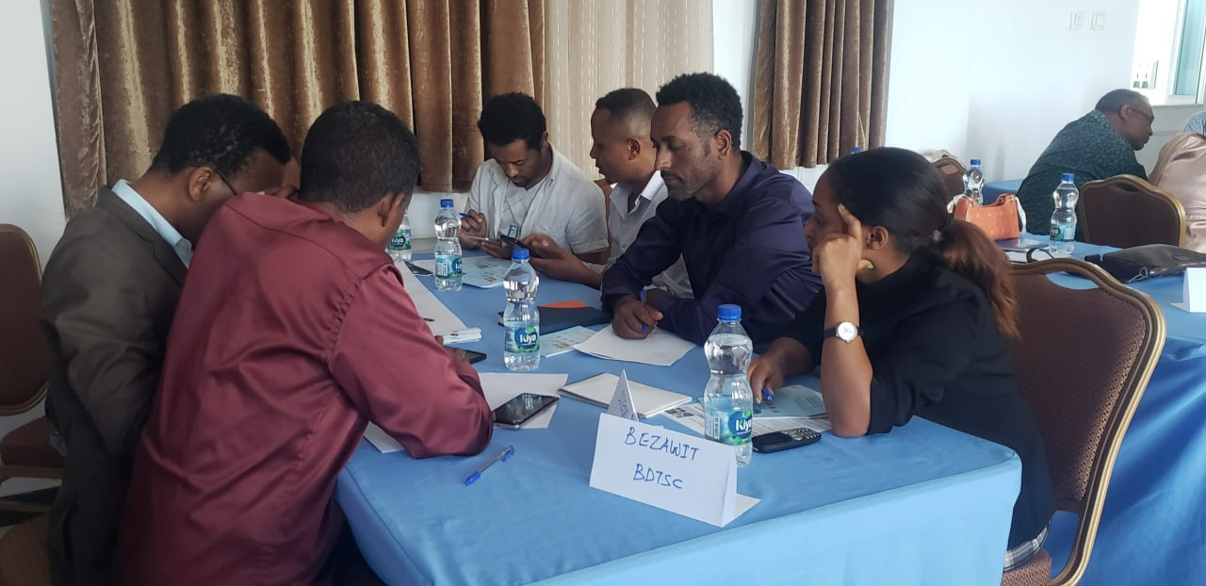
Project Implementation
Component Two : Recyclability of textile and garment wastes is enhanced through POPs-free textile manufacturing process and the implementation of BAT/BEP and RECP investments
National Inception Workshop conducted
The in-person training on the Technical Industry Guide for Chemical Management Systems and Wastewater Management was conducted from November 8 – 11, 2024 in Bishoftu
27 participants (21 Male and 6 Female) from pilot factories and task forces were attended

Slide 20
CONTENTS
01.
02.
03.
04.
05.
06.
07.
PPG Phase
Project Components
Project Implementation status
Next steps and the way forward
Introduction
Budget and Cost
Challenges and Mitigations

Slide 21


5. Budget and Costs
65,507.00 USD (3,668,392 birr) released from UNIDO to execute the activates which are planed and approved in the first year of the project implementation period.
2024 March - The first year budget released
A total of 1.55 million birr utilized so far on the national inception workshop, in-person training, and associated expenses.

Slide 22
CONTENTS
01.
02.
03.
04.
05.
06.
07.
PPG Phase
Project Components
Project Implementation status
Next steps and the way forward
Introduction
Budget and Cost
Challenges and Mitigations

Slide 23
6. Challenges and Measures Taken
  Delays in contract signing due to internal processes and procedures, and other document submission delays;
  There was a delay of releasing budget (March 2024)
  The country's physical budget year was finalized in the first week of July and made public in mid-August;
  Delays due to Service providers overlapping plan
Challenges
Weaknesses
Opportunities
  Continuous communications is being made with service providers
  Implementation of Accelerated plan
Measures
Threats

Slide 24
CONTENTS
01.
02.
03.
04.
05.
06.
07.
PPG Phase
Project Components
Project Implementation status
Next steps and the way forward
Introduction
Budget and Cost
Challenges and Mitigations

Slide 25
7. Next Steps and Way forward
1
2
3
4
5
Awareness creation for the taskforce to establish policy , regulatory and institutional framework for CE
Validation and endorsement of revised legal framework with ICLEI,
Conduct TOT training for pilot facilities and task forces in collaboration with ZDHC in the second week of December 2024.
Facility visit will be held in collaboration with ZDHC in the third week of December 2024.
Prepare inventory data base , MFA of chemicals used be December 2024.

Slide 26

Thank You

