Slide 1
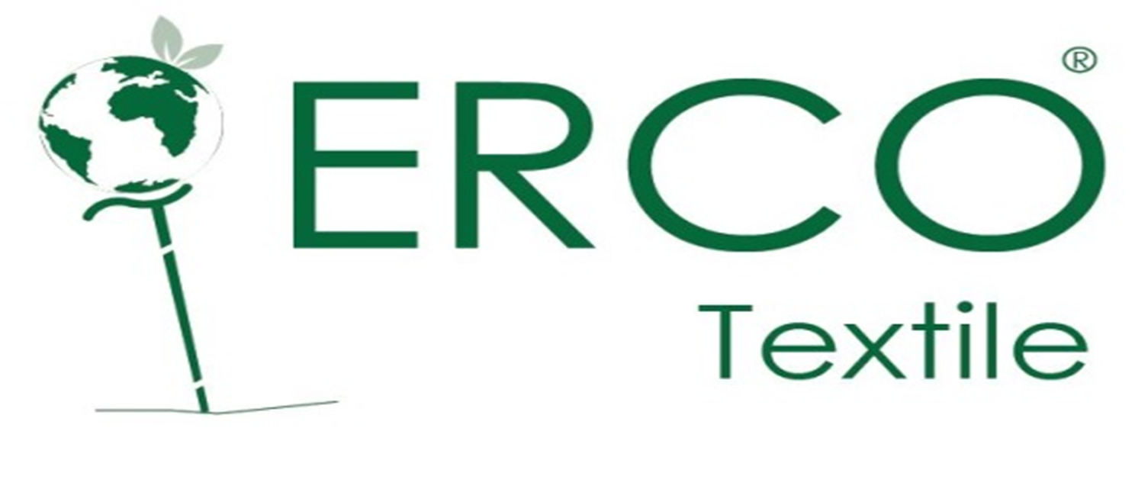
…..Quality, Sustainability, Integrity

Slide 2
Introduction to ERCO Textile Factory
ERCO Textile Factory, based in Adama Ethiopia situated on 100,000.M2 Land, stands as a leading force in sustainable textile recycling and manufacturing, with a strong economic and environmental impact on Ethiopia’s textile sector.
Focused on eco-friendly practices, ERCO converts post-industrial garment waste into regenerated fiber, which is then spun into yarn, knitted into fabric, and crafted into garments. Adding the fact that the factory does not engage in dyeing processes.
ERCO plays a vital economic role by producing quality, affordable textile products that act as import substitutes, reducing the country’s dependency on foreign goods and supporting local demand.
As one of the few companies focused on recycled materials, ERCO helps retain valuable foreign currency within Ethiopia by minimizing the need for imported textiles.
Furthermore, the company is gearing up to enter the export market in the near future, which will enhance Ethiopia's presence in the international textile industry and generate valuable foreign exchange revenue.
In 2023, ERCO faced a significant challenge when a fire destroyed its storage and finishing sections, impacting inventory and production processes..
03
04
Human Resource
Products
Private equity has successfully attracted the best and brightest in corporate America.
Private equity has successfully attracted the best and brightest in corporate America.
02
05
Facility
Process
Private equity has successfully attracted the best and brightest in corporate America.
Private equity has successfully attracted the best and brightest in corporate America.
01
06
Introduction
Summery
Private equity has successfully attracted the best and brightest in corporate America.
Private equity has successfully attracted the best and brightest in corporate America.

Slide 3
Cont…
Beyond financial investments, ERCO’s leadership took proactive steps to engage and seek support from stakeholders, including local authorities, International institutes, industry partners, and financial institutions. These partnerships aim to enhance ERCO’s recovery, increase operational efficiency, and reinforce the company’s commitment to sustainable production practices.
By fostering collaboration with these key stakeholders, ERCO gains access to technical expertise, financial resources, and industry networks that support improvements in production quality, capacity, and sustainability.
To bolster productivity and minimize operational disruptions, ERCO has also implemented an advanced ERP system, enhancing resource management, inventory control, production line management.
Today, ERCO Textile Factory emerges as a resilient leader within Ethiopia’s textile sector, committed to producing quality import-substitute products and positioning itself for international export. Its dedication to sustainability, economic impact, and recovery from recent challenges not only supports Ethiopia’s industrial growth but also sets a standard for eco-conscious manufacturing in the local textile market.
The new ownership team responded decisively, infusing an additional 200 million ETB, with 70% allocated to capital goods, such as Rebuilding the damaged section, improving safety measures and rejuvenating and upgraded machinery for the finishing process, and 30% dedicated to working capital to stabilize immediate production needs
03
04
Human Resource
Products
Private equity has successfully attracted the best and brightest in corporate America.
Private equity has successfully attracted the best and brightest in corporate America.
02
05
Facility
Process
Private equity has successfully attracted the best and brightest in corporate America.
Private equity has successfully attracted the best and brightest in corporate America.
01
06
Introduction
Summery
Private equity has successfully attracted the best and brightest in corporate America.
Private equity has successfully attracted the best and brightest in corporate America.

Slide 4
Factory Production Capacity/Day
6000 kg
5000kg
4500kg
5200Pcs
Regenerated Fiber
Yarn
Knitted Fabric
Garment Products
.

Slide 5
Product list
Four types of Products are Produced by ERCO
Recycled Fiber | Yarn NE count | Fabric | Garment
 | 20/1 | Single Jersey | T-Shirts
 | 10/1 | Rib | Sweat Pants and Pajamas
 | 9/1 | 2 end Fleeced | Tights
 | 6/1 | 3 end Fleeced | Polo Shirts
 | 5/1 | Pique | Hoodies and others
 | 4/1 | Camisole | T-Shirts
 | 0.14/1 | Double Jersey
And also any other orders required by customers.

Slide 6
Manufacturing Process
Garment Products
STEP FIVE
Production of different garment commodities utilizing knitted fabric .
STEP FOUR
Knitted Fabric
Manufacture knitted fabric products form yarn.
YARN
STEP THREE
Utilizing the recycled fiber as majority input produce yarn.
STEP TWO
Recycling Process
By recycling post industrial cotton waste produce fiber
Rag Input
STEP ONE

Slide 7
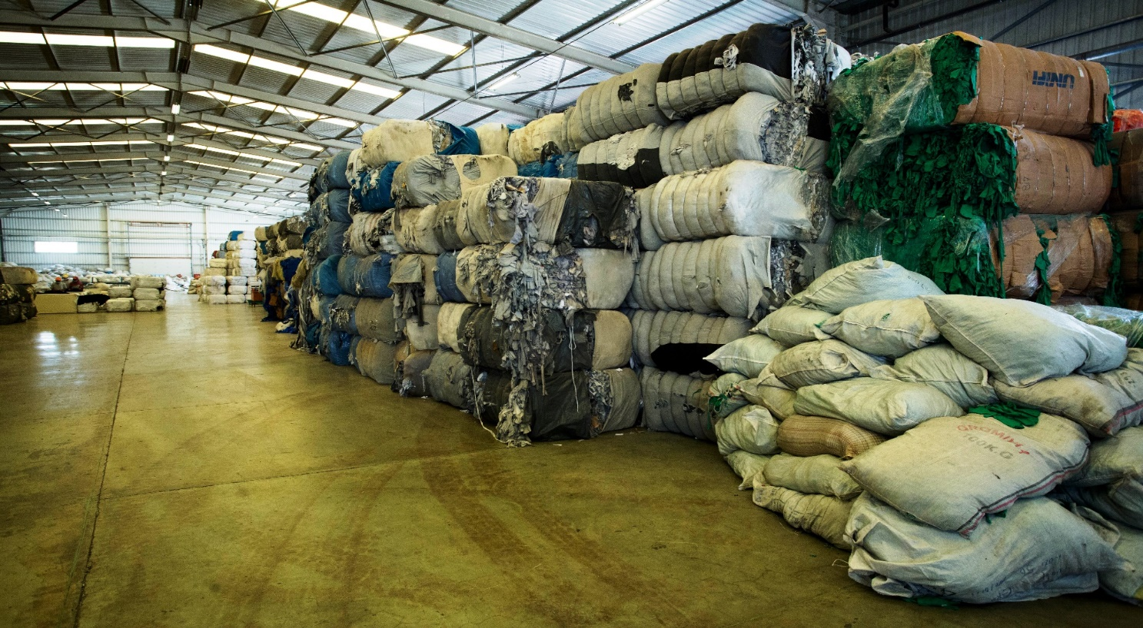
Post Industrial Cotton waste Recycling Process
Rags (clips , cuttings) procured from local as well as international market.

Slide 8
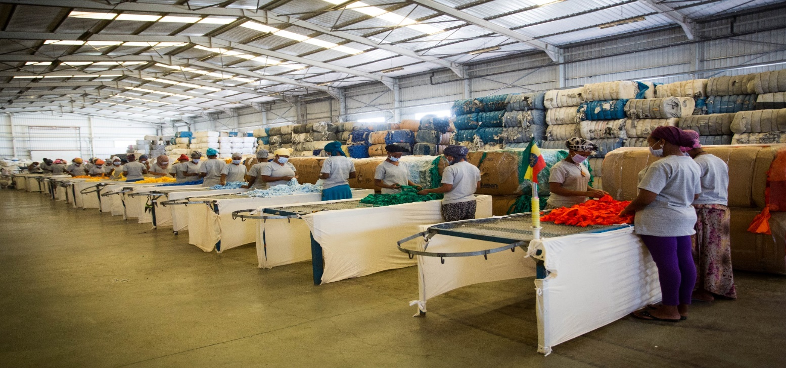
Post Industrial Cotton waste Recycling Process
Sorting Process

Slide 9
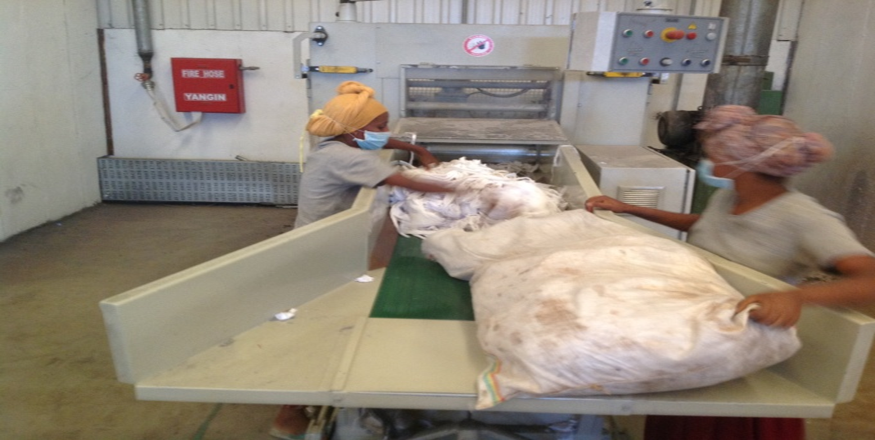
Post Industrial Cotton waste Recycling Process
Cutting Process of sorted Rags

Slide 10
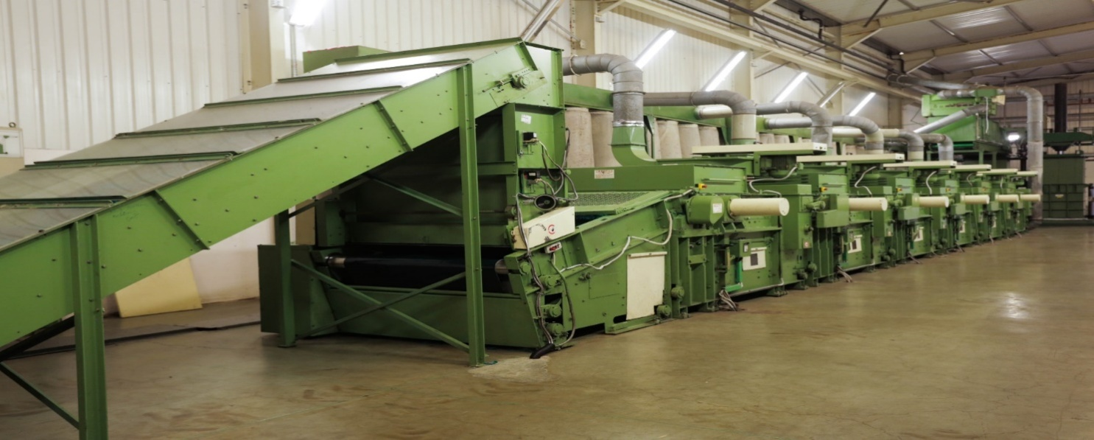
Post Industrial Cotton waste Recycling Process
B - Rags Re-Cycling
ERCO has 5 Lines of Shoddy Machine (Recycleing Lines) and 1 sliver opening line with 45 Tons per day production at average machine speed which is the final raw material of Re-Cycled fiber.

Slide 11
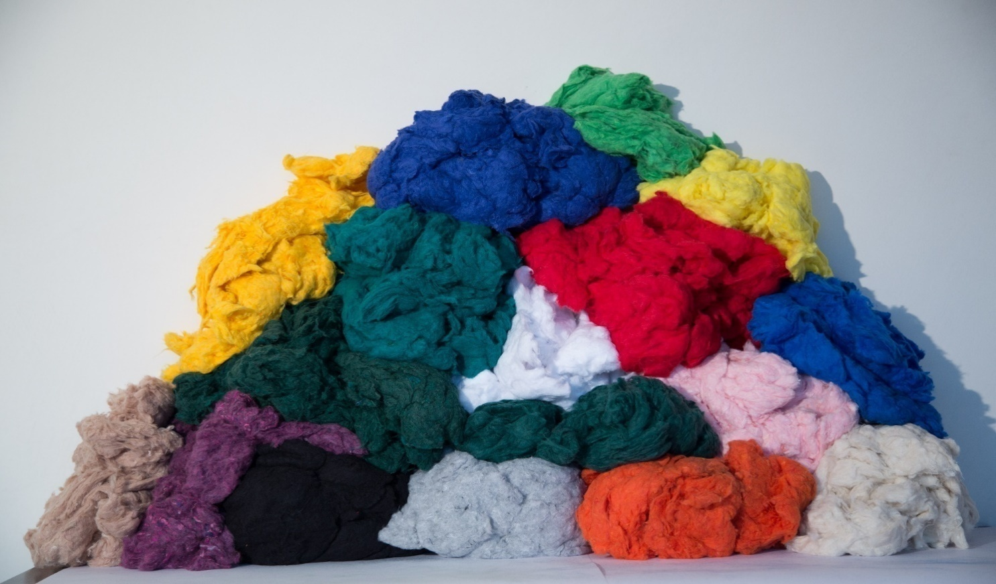
Shoddy (Re-Cycled Fibers) Ready for Spinning

Slide 12
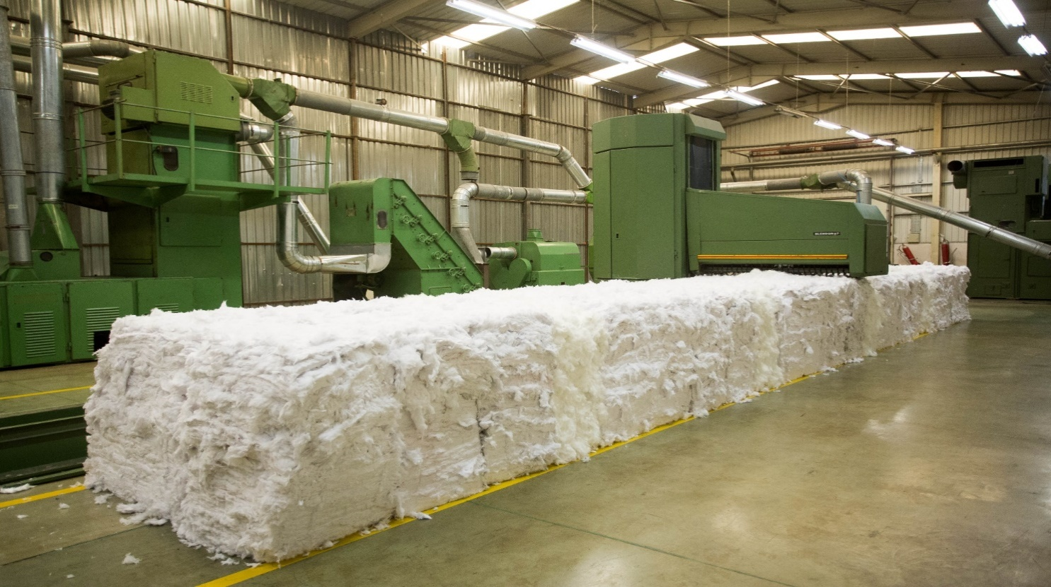
YARN Production Process
Fiber Preparation, Blending and Conditioning:
ERCO has 9 lines of Fiber preparation lines and conditioning metal boxes to reach optimum mixture of different fibers in the blend for proper quality of Re-Cycled yarn spinning.

Slide 13
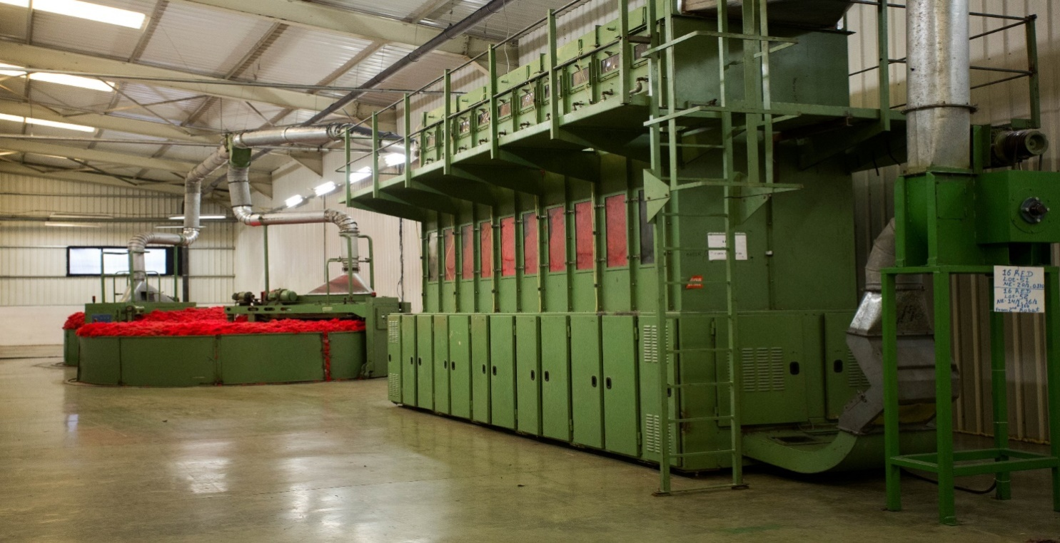
YARN Production Line
Fiber Blending Lines

Slide 14
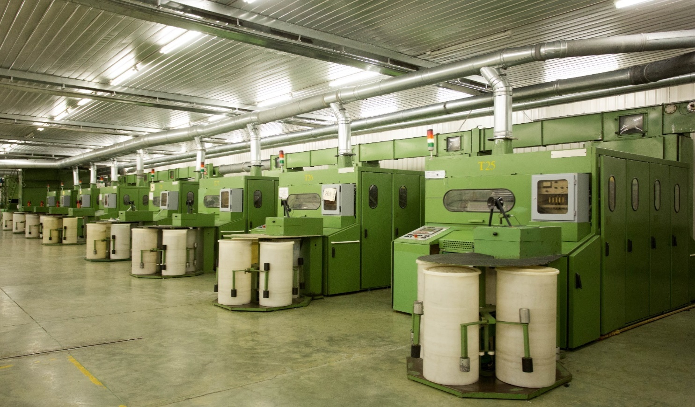
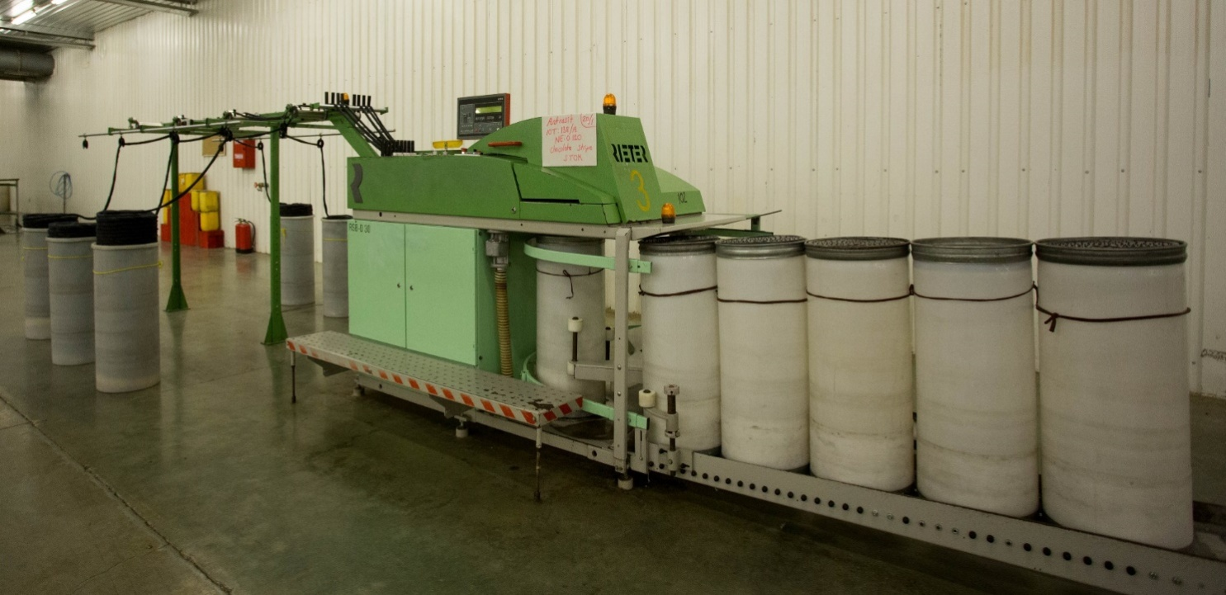
YARN Production Line
Carding & Drawing ;
In the Carding Section there are 36 carding machines and 9 drawing frames.

Slide 15
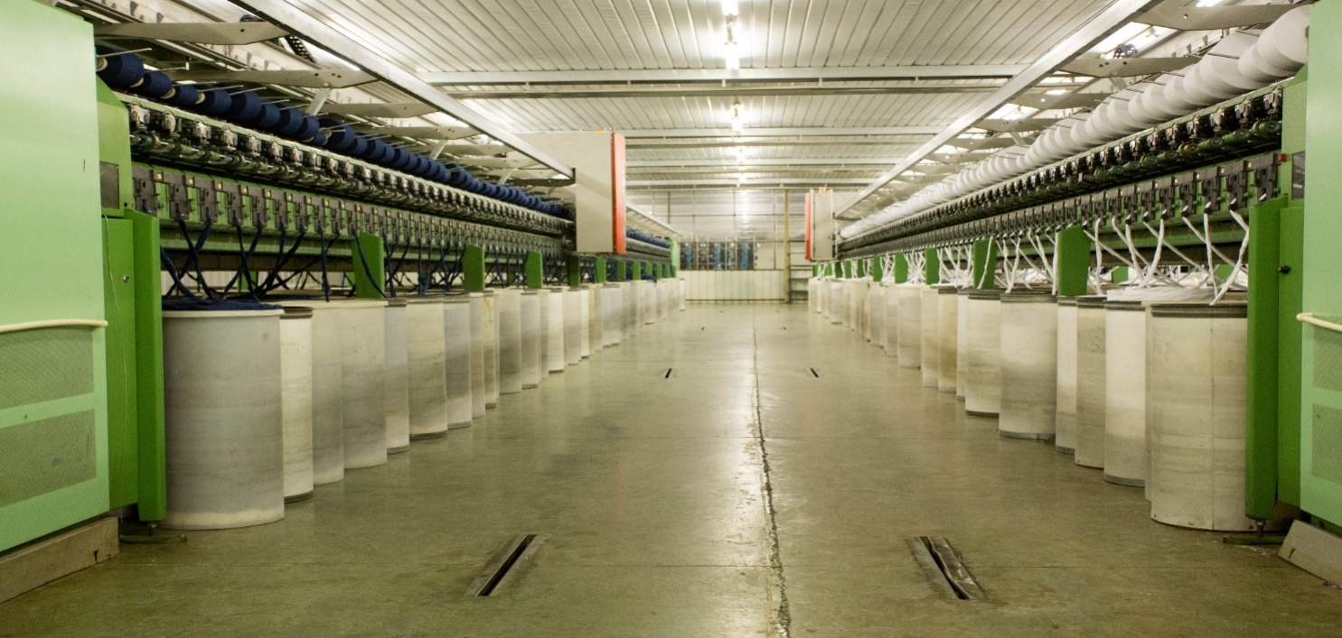
YARN Production Line
Re-Cycled Open End Yarn production :
ERCO is manufacturing Re-Cycled yarns with 3792 Rotors.

Slide 16
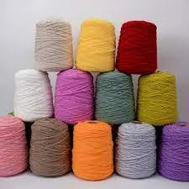
YARN PRODUCTS

Slide 17
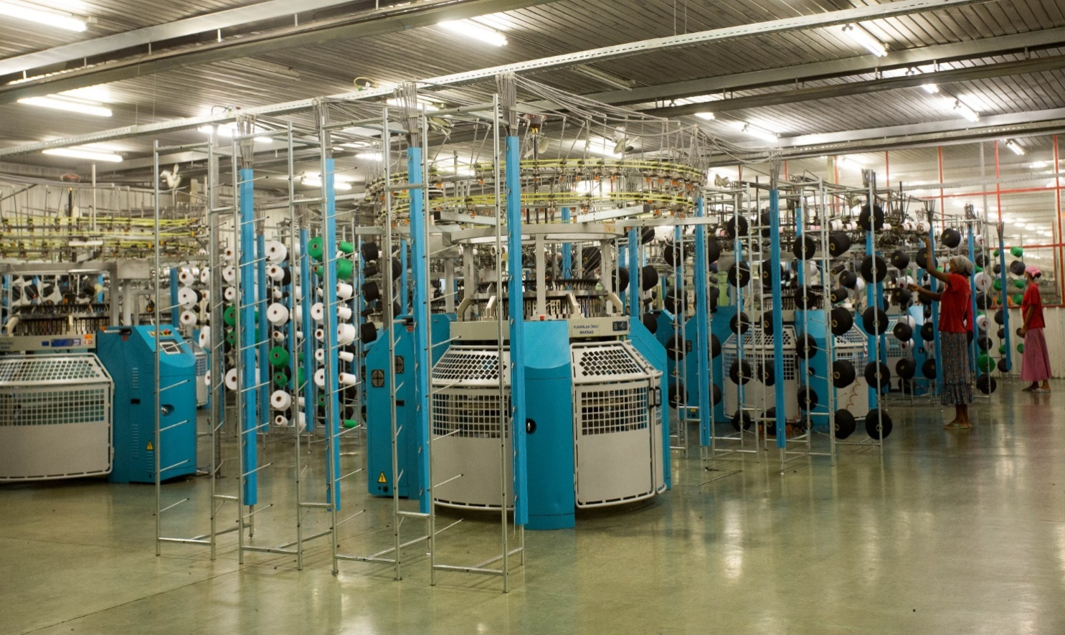
FABRIC Production Line
Circular Knitting Machines

Slide 18
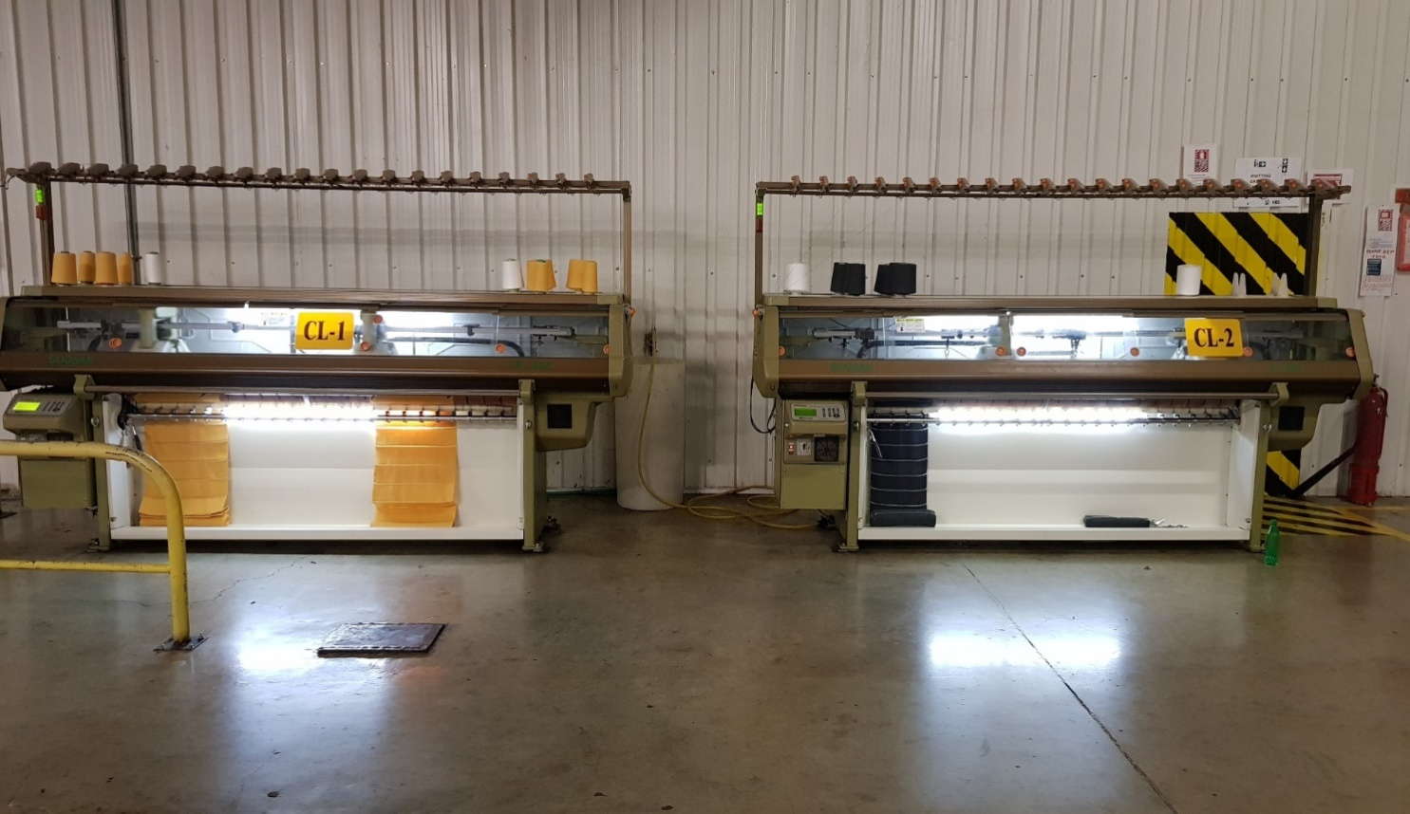
FABRIC Production Line
Collar & Cuff Machines

Slide 19
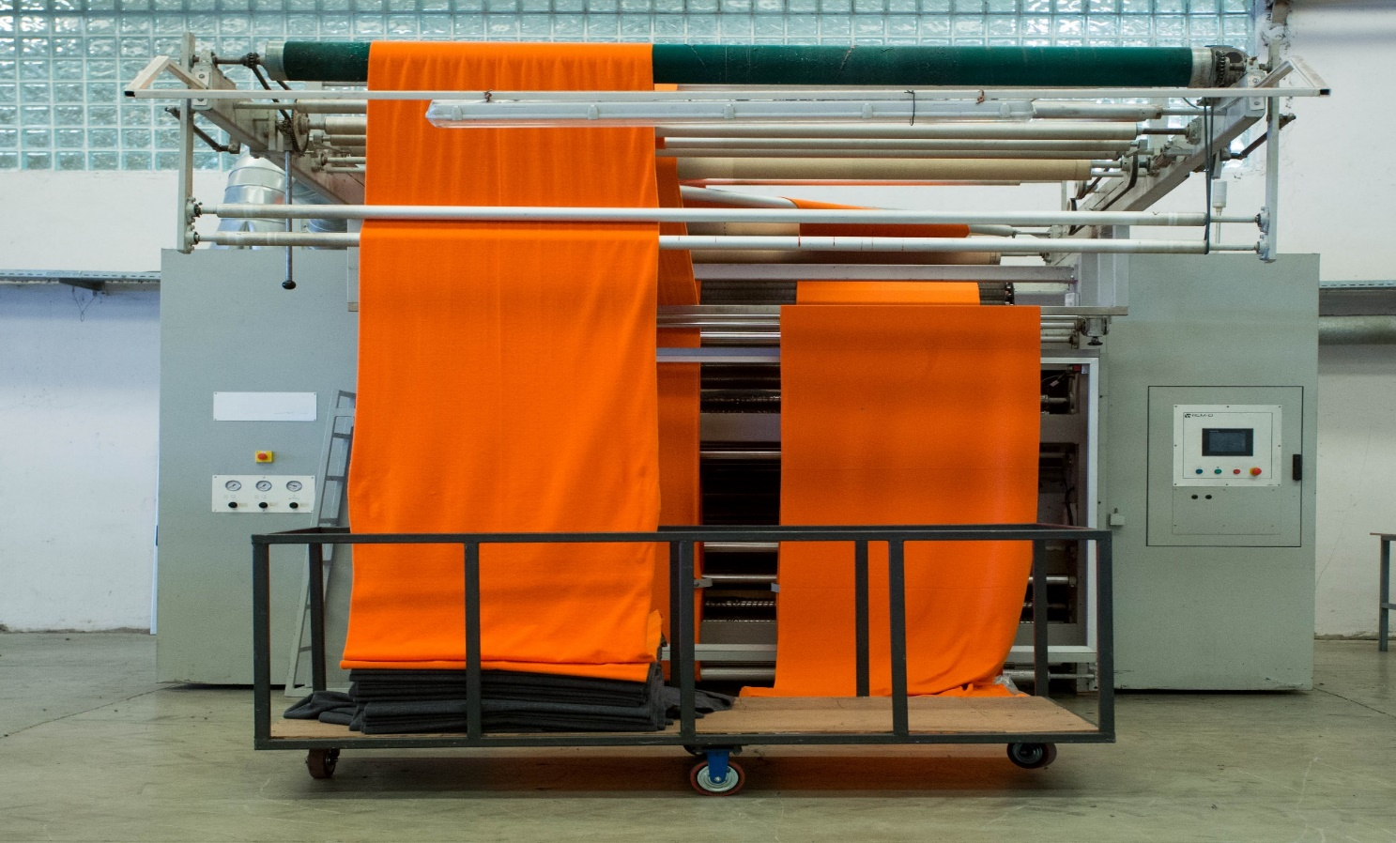
FABRIC Production Line
Brushing / Raising / Fleecing

Slide 20
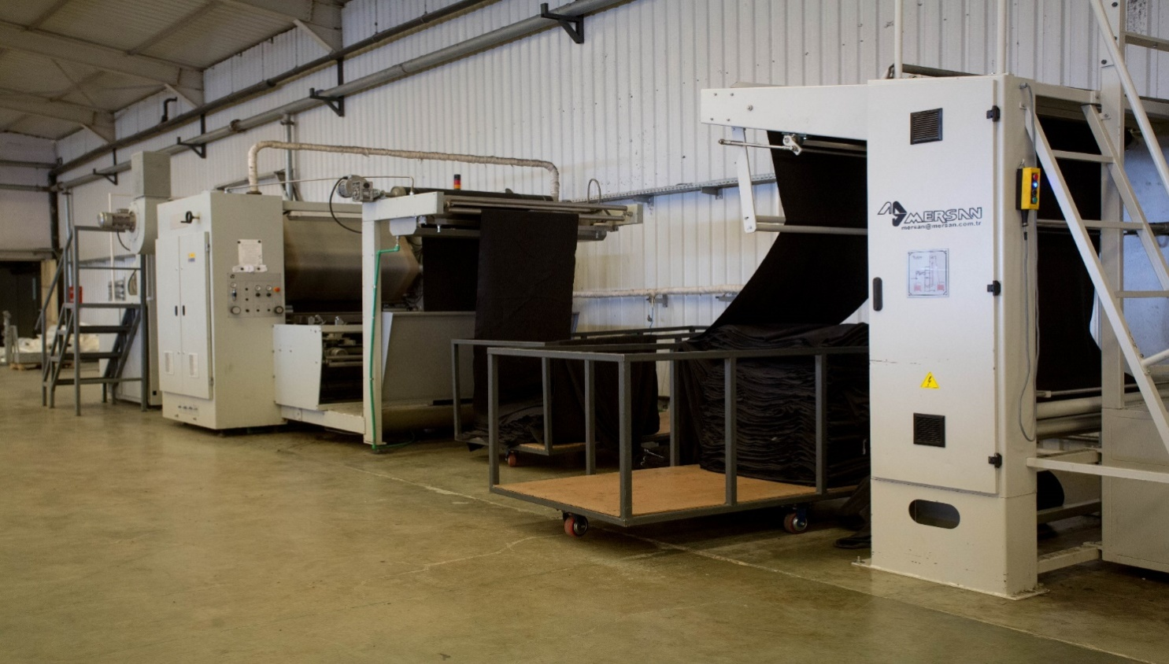
FABRIC Production Line
Compacting / Sanforazing Machine

Slide 21
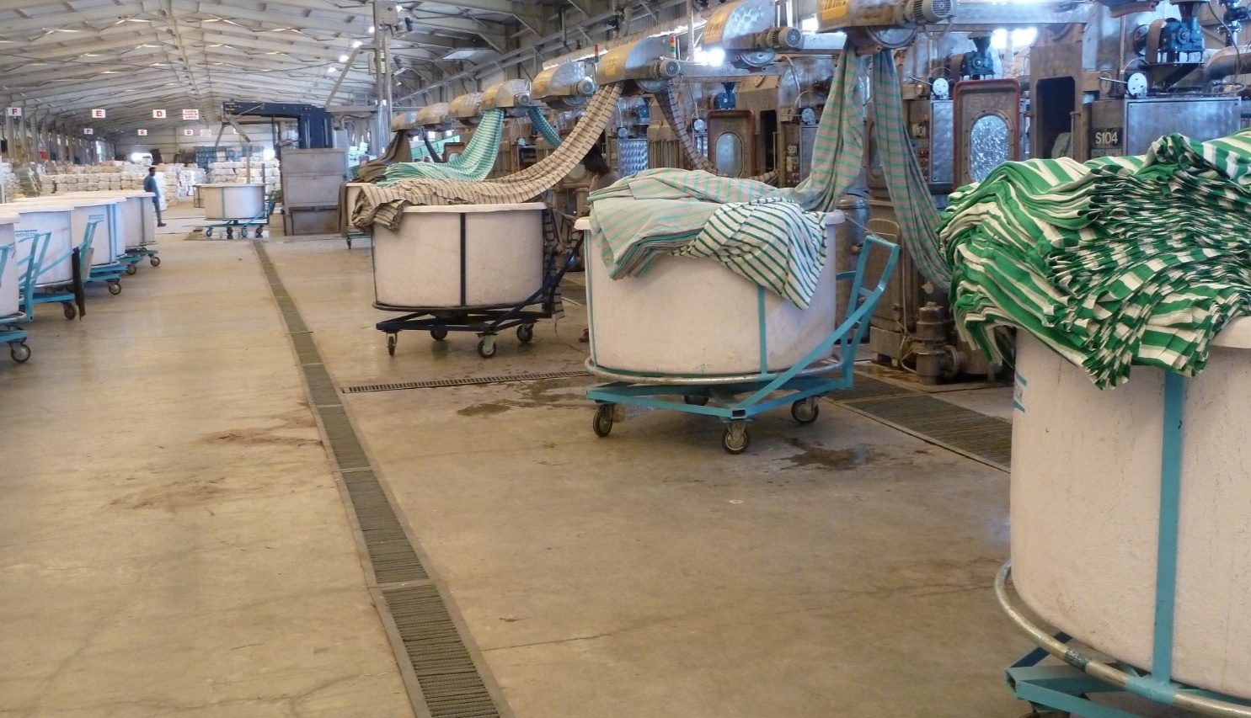
FABRIC Production Line
Wet Process Fabric Finishing , 12 tons / Day

Slide 22
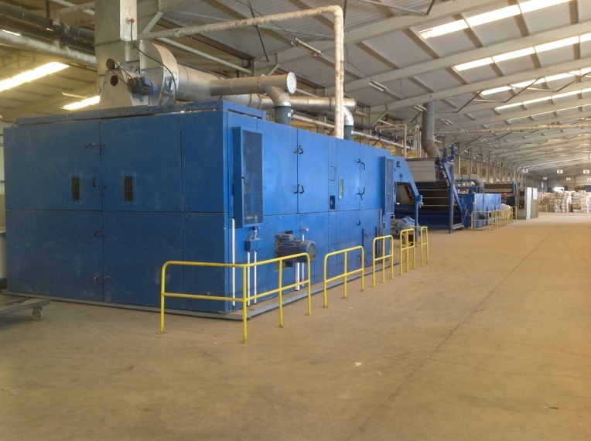
Fabric Washing and finishing Continued….
FABRIC Production Line

Slide 23
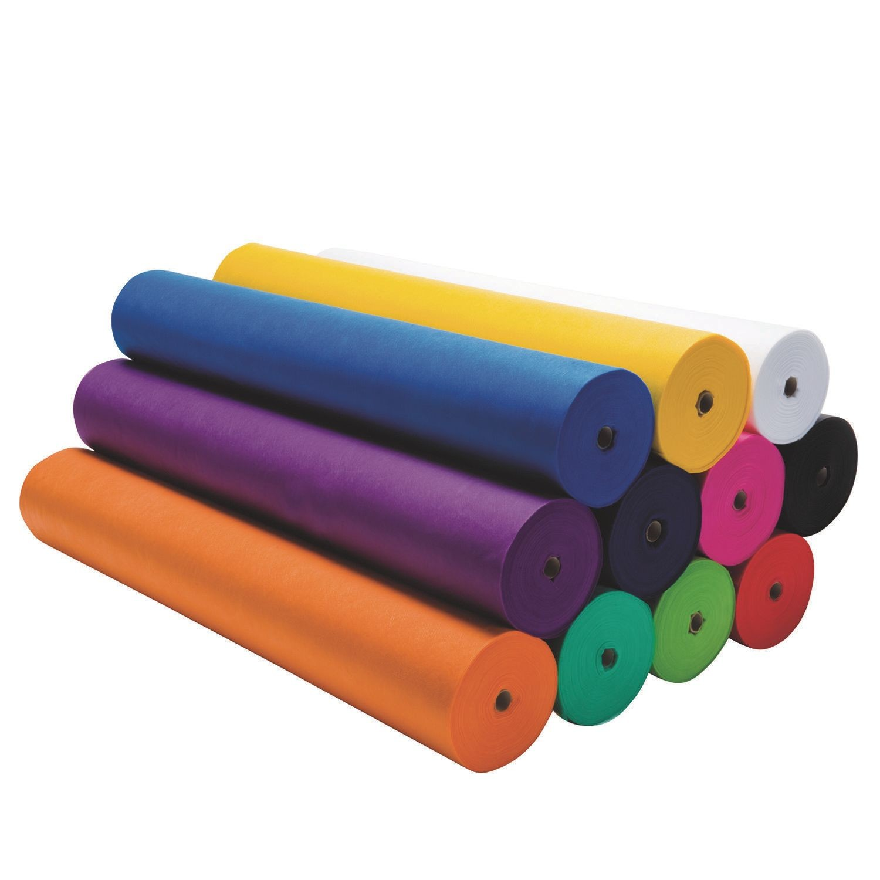
FABRIC PRODUCTS

Slide 24
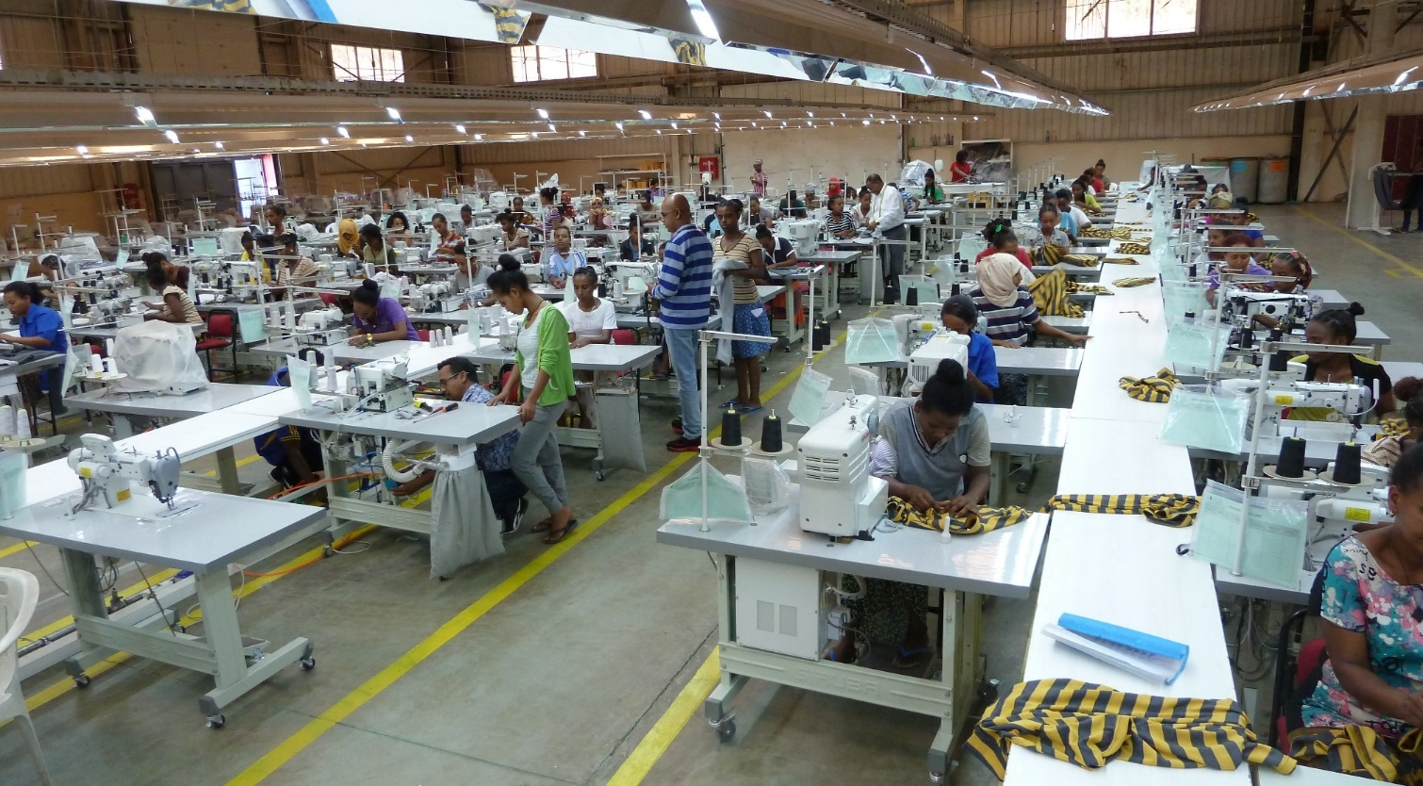
ERCO has plan to manufacturing garments with 12 lines and has already reach know 9 lines.
GARMENT PRODUCTION:

Slide 25
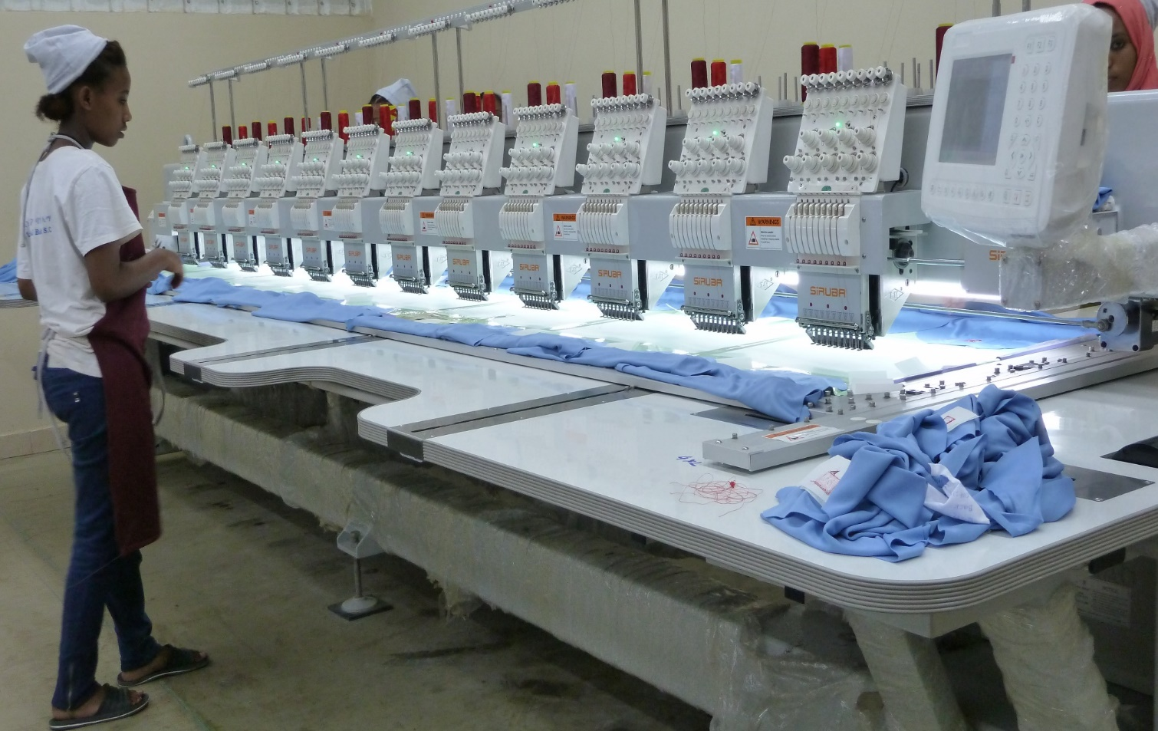
Embroidery Department Prepares as per customers designs and requests in the total of 24 heads in 2 machines with 12 color each.
GARMENT PRODUCTION:

Slide 26
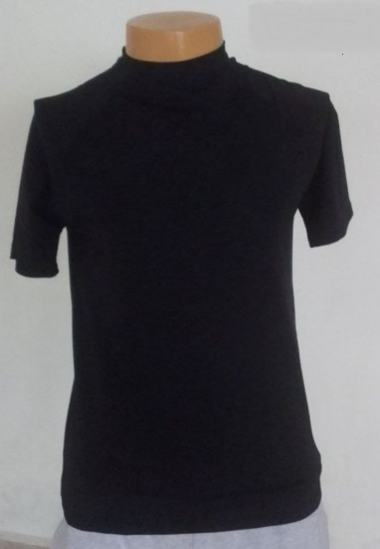
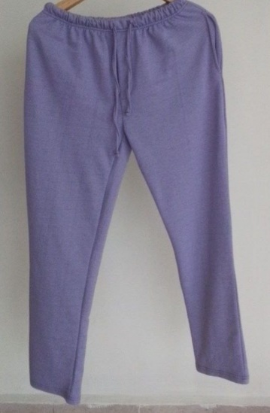
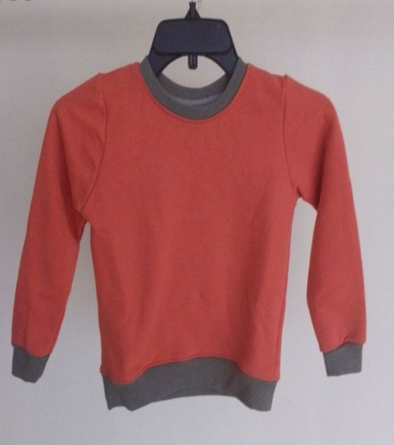
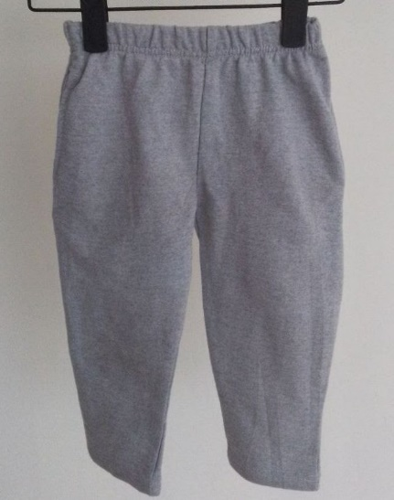
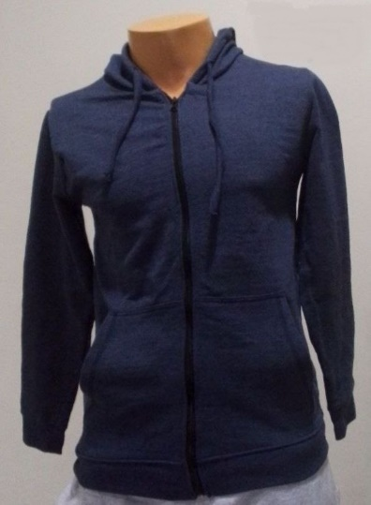
GARMENT PRODUCTS
Sample Products….

Slide 27
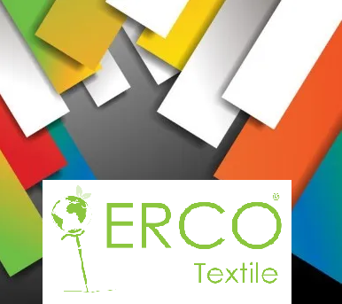
Thank you!!

