Slide 1



Promotion of Circular Economy in the Textile/Garment Sector through sustainable management of chemicals and wastes
Regional project in Lesotho, Madagascar and South Africa
Country project in Ethiopia
Regional Inception Workshop – 12 November 2024

Slide 2
Presentation Outline
What? – project information
Why? – justification
Where? – location
Who? – stakeholders
Expected Impact
How? – implementation

Slide 3
WHAT?
Projet Title: Promotion of Circular Economy in the Textile & Garment Sector through sustainable management of chemicals and waste
Countries: Lesotho, Madagascar, South Africa and Ethiopia
Donor: Global Environment Facility
GEF Focus area: Chemicals and waste
GEF Project ID: 10543 & 10683
Funds: USD $ 7 400 000 – Regional; USD$ 3 000 000 - Ethiopia
Duration: 2022 – 2027
Objective: To promote the concept of circular economy in the textile and garment sector through a value chain approach that addresses the upstream resource use as well as the downstream - reuse, recycling and conversion of textile/garment discards & related wastes into economically viable & socially beneficial products and services

Slide 4
WHY?
Large use of Hazardous Chemicals along the value chain (dyestuffs, brighteners, finishing) - CoCs, POPs chemicals: PFOS; PFOA; deca-BDE; hexabromocyclododecane; Short Chain Chlorinated Paraffins (SCCP) and PCP.
This presents obstacles to recycling and circularity along the value chain.
Offcuts and textile discards – Landfills, incinerated or subjected to open burning operations: emissions of dioxins, furans and greenhouse gases.
GHGs emitted from textile production as there is often high energy consumption.
World Bank estimates that nearly 20% of global wastewater is produced by the fashion industry- particularly in the dyeing and finishing treatment + microfiber contamination of water channels

Slide 5
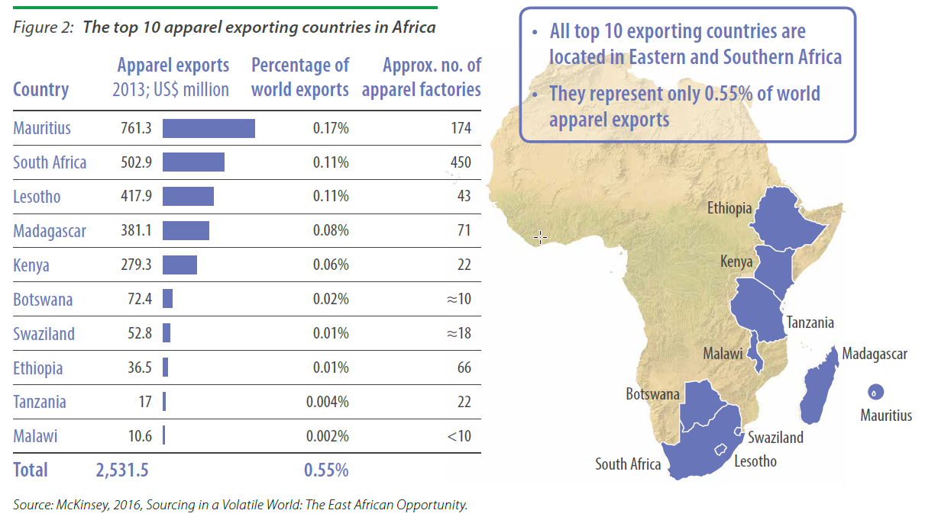
WHERE?
In Sub-Saharan Africa the apparel and footwear market is estimated to be worth US$ 31 billion
In the countries where the project is being implemented the TG sector employs over 600 000 people

Slide 6
WHERE?
Country Project
Regional Project
Lesotho
estimated quantity of TG Wastes generated
16,800
tonnes/yr
Madagascar
estimated quantity of TG Wastes generated
10,000
tonnes/yr
South Africa
estimated quantity of TG Wastes generated
81,096
tonnes/yr
Ethiopia
estimated quantity of TG wastes generated
100,000
tonnes/yr
26,032 Tonnes
burned, incinerated or dumped in landfills
16,800 Tonnes
Imported
25,000 Tonnes
burned, incinerated or dumped in landfills
20%
Recycled locally or exported to South Africa
80%
incinerated or dumped in landfills
Most
burned, incinerated or dumped in landfills
38,264 Tonnes
Low value recycling/re-use automotive and household carpeting, insulation, furniture/beddings/mattresses and
landfills
unintentionally produced POPs (u-POPs)

Slide 7
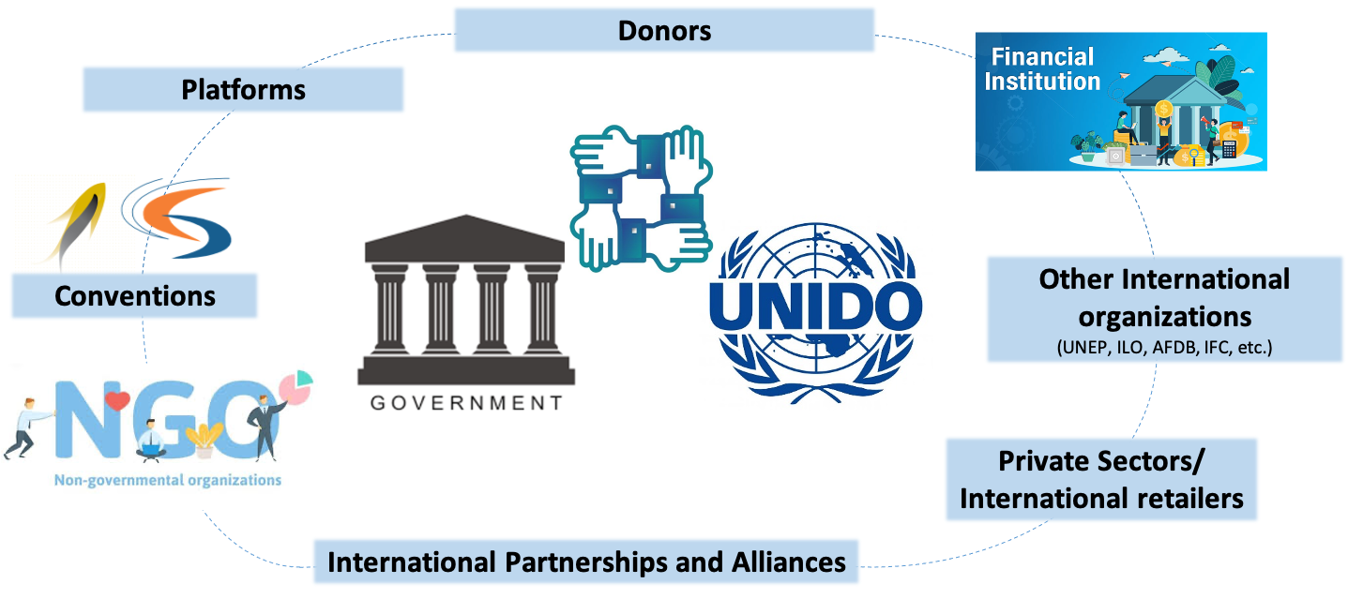


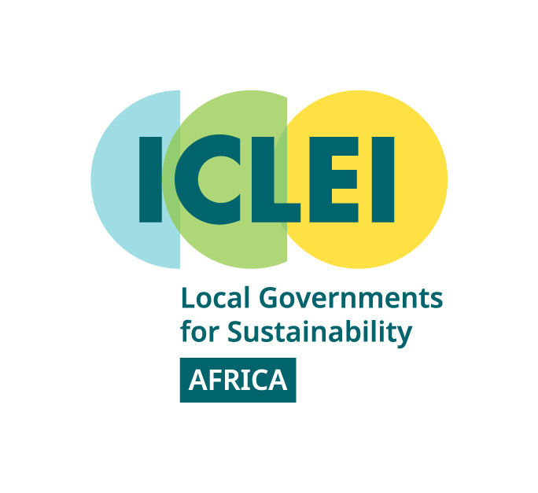

WHO?
Main Partners & Service Providers
Notes:
Main Partners & Service Providers
Regional Technical Service Providers:
ICLEI Africa - Local Governments for Sustainability - Working with the national executing entities and providing expertise on developing regulatory/policy frameworks
Zero Discharge of Hazardous Chemicals (ZDHC) – working with beneficiaries providing expertise on chemicals and waste management at facilities
Natural Resources Defense Council (NRDC) – working with national executing entities to integrate and scale up knowledge in synergy with a similar UNEP circular economy project in Asia.
Cambridge University Circular Economy Center – will be providing training on circular economy concepts and financing mechanisms to beneficiaries, academic institutions and policy makers.

Slide 8
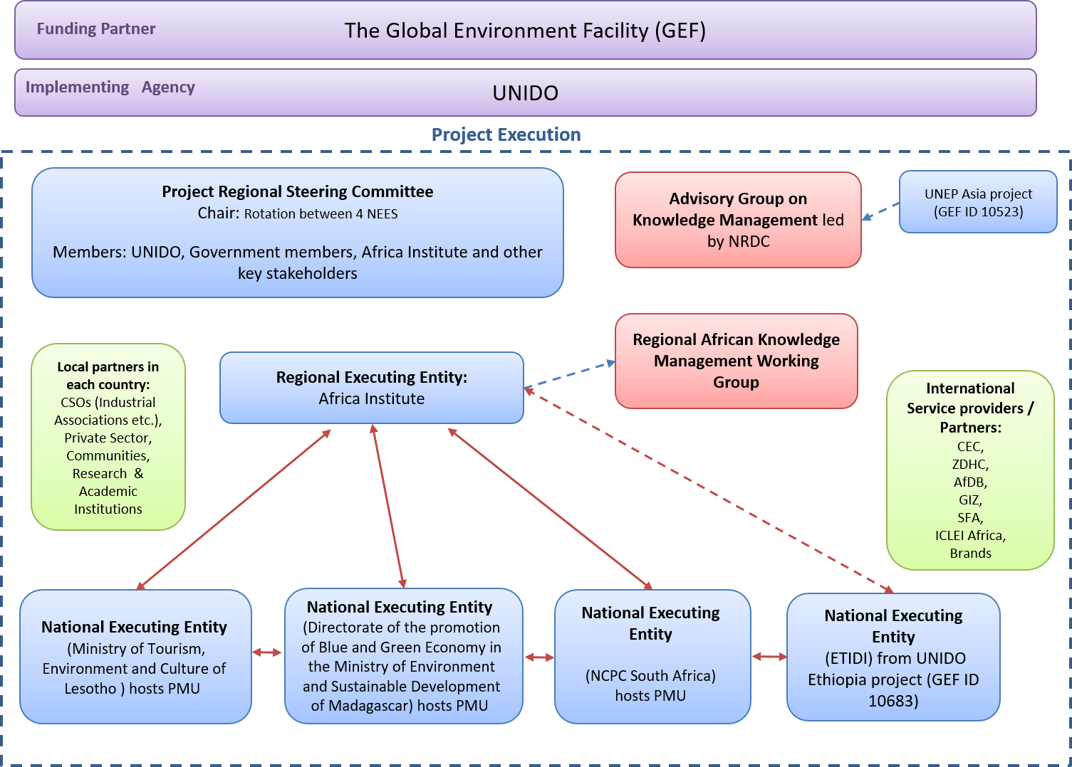
Lesotho
Ministry of Environment & Forestry
Madagascar
Directortate for the promotion of Blue and Green Ecconomy in the Ministry of Environment and Sustainable Development
South Africa
National Cleaner Production Centre
(NCPC)
Ethiopia
Textile & Garment Industry Research & Development Centre
(TGIRDC)

Slide 9
Expected Impact & Environment Benefits
Elimination of 9 tonnes of PFOS/ PFOA /PFAS/ PFHxS /other chemicals.
Elimination of 7,690 tonnes of POPs contaminated wastes.
Reduction/avoidance of 19 gTEQ emissions of POPs to air.
Prevention of land degradation from open-burning and landfilling of textile/garment wastes.
Prevention of groundwater and soil contamination by chemicals and microfibers
Climate Change Mitigation – GHG emissions reduction.
Resource conservation through the recycling and reuse of textile/garment wastes
Resource productivity and reduced pollution intensity through RECP/BAT/BEP

Slide 10
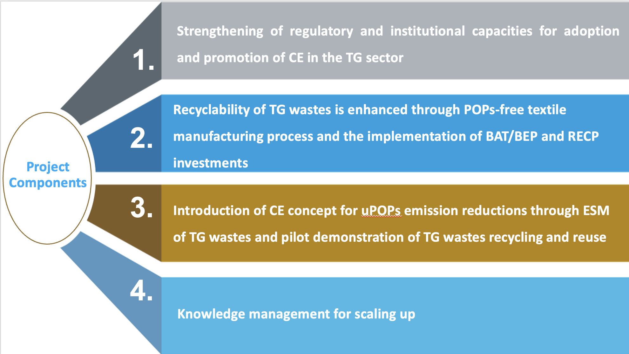
HOW ?

Slide 11

Email: f.beru@unido.org

