Slide 1



Belgotex and NCPC Collaboration Through:
CIRCULAR ECONOMY IN THE TEXTILE AND GARMENT SECTOR THROUGH THE SUSTAINABLE MANAGEMENT OF CHEMICALS AND WASTE IN LESOTHO, MADAGASCAR, SOUTH AFRICA AND ETHIOPIA.
Thomas Brown
Circularity Specialist
November 2024
Revision 1

Slide 2

Agenda
Belgotex – Our Sustainability Reach
NCPC – Belgotex Collaborations

Slide 3

Transformation at Belgotex.
Every time we purchase something, we are essentially voting for the kinds of things we want in the world. It’s through our purchase preferences, as individuals, as governments and as organisations, that we can encourage or discourage industries, services and products based on what we want to see continue.
This is where there is great opportunity for change, as many of the products and services that fill our economy today have huge impacts on the planet, offer up many inequities along the supply chain and are designed to break’
- Leyla Acaroglu .

Slide 4
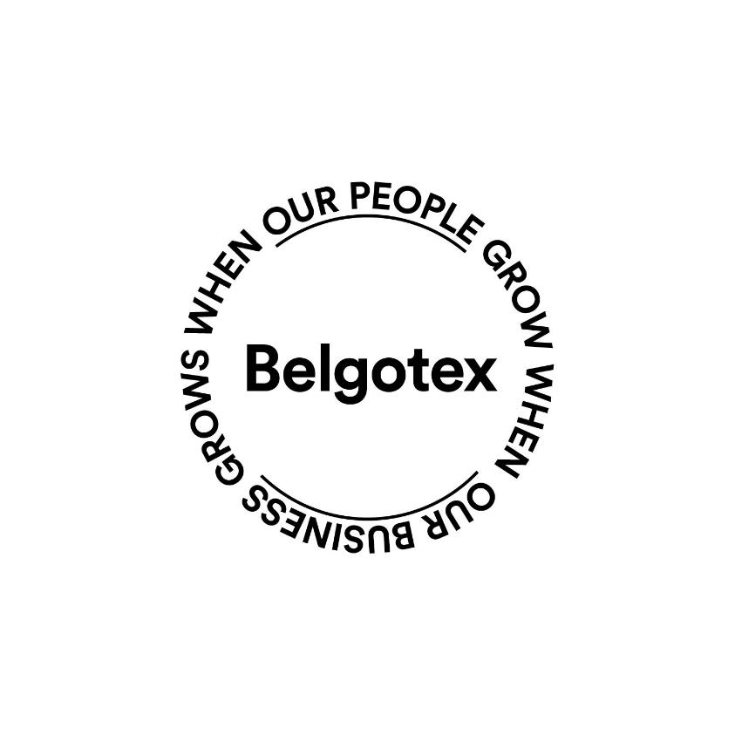
Belgotex at a Glance
As Africa's leading manufacturer of carpets and artificial grass, and a distributor of vinyl, Belgotex is based in Pietermaritzburg, KwaZulu-Natal, and proudly part of the Belgotex International network.
Our reach extends across Africa, India, the Middle East, Brazil, Europe, Australia, and New Zealand, enabling us to make a global impact.
We are a purpose-driven company that prioritizes the triple bottom line—social, environmental, and financial.
Guided by a philosophy of accountability and transparency, we tread softly yet boldly, committed to sustainability at every step

Slide 5
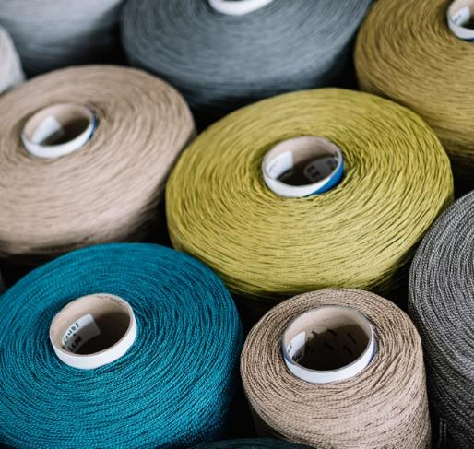
What Sustainability Means To Us.
Our commitment as a South African flooring manufacturer is founded on care for people, stewardship of the environment, strong governance, and a desire to create value and well-being. These principles form the foundation of a sustainable business for today and the future.
With these foundations in place, we’re strategically focused on optimizing, democratizing, and transforming our ecosystem, products, and business processes.
Our vision is to foster a world where everyone can realize their potential with dignity and equality, leading prosperous and healthy lives within safe, inclusive workplaces. We are also committed to protecting our planet from degradation by promoting sustainable consumption, circular production, and climate action, all within nature’s boundaries
Sustainability development is development that meets the need of the present without compromising the ability of future generations to meet their own needs.
- Brundtland Report, 1987

Slide 6

Commitment to UN SDGs 2030
At Belgotex, we embrace a philosophy of continual improvement, guided by ISO standards like ISO 14001 for environmental management and ISO 9001 for quality management.
This commitment to ongoing development allows us to actively contribute to key Sustainable Development Goals (SDGs) and ensure lasting positive impacts as reflected in the SDGs we endeavour to progress on:

Slide 7





Factory Certifications and Memberships.
Quality Management System: ISO 9001:2015
Environmental Management System: ISO 14001:2015
Health and Safety Management System: ISO 45001:2018
SEDEX Members and have annual 4 Pillar SMETA Audit
Green Building Council of SA
ILFI (International Living Future Institute)
Ellen MacArthur Foundation and have completed Circulytics 2.0 assessment

Slide 8
Stewardship
Greenhouse Gas Emissions.
We have measured and verified our:
Scope 1 emissions (direct emissions from resources owned and controlled by us) – Since 2015
Scope 2 emissions (emissions from electricity purchased from Eskom) – Since 2015
Scope 3 emissions (all emissions along our supply chain) – Since 2020
Our energy efficiency and renewable energy objectives have resulted in the reduction of our GHG emissions:
Our Scope 1 & 2 emissions - gas, coal, diesel & electricity: reduced by over 5000 tCO2e since 2015.
Our Scope 2 emissions - Solar 1 installation alone: avoided over 7 300 tonnes CO2e since 2015.
The carbon intensity of our operations as well as in our products is of key interest to us when considering our energy and emissions reduction strategy.
Environmental Stewardship.
Renewable energy:
  in 2015, invested 1MW solar installation.
  In 2019, NERSA license granted.
  The 2020 planned 1.4MW Solar 2.0 implementation was delayed due to the financial impact the COVID-19 lockdown had on our business.
  Commenced Solar 2.0 in 2021. Our Solar 1.0 installation has saved us 6.7 million kWh of electricity consumption from the grid.
  Solar 2.0 was completed in 2022.
  Solar 3.0 in planning phase.

Slide 9
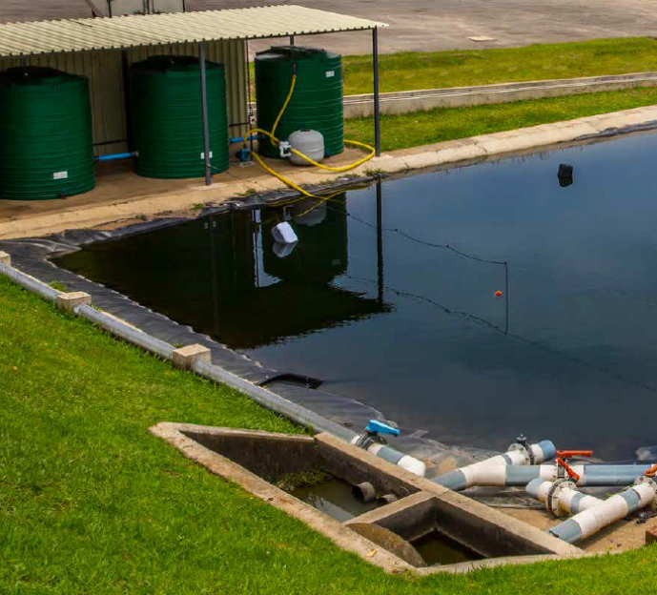
Stewardship: Water.
Our factory is based in a water-stressed catchment, and our responsibility as a manufacturer with regards to water consumption is one which has led to many innovations over time.
Our water intensity (and energy use) was reduced when we converted our operation to produce Solution Dyed yarns and fibre: Yarn & Fibre dye at extrusion
We also constructed a water harvesting dam, whereby rainwater is captured and is now used in various applications. To date, we have harvested over 110 000 kl of rainwater, thus avoiding municipal water consumption in processes where the water quality is acceptable for use.

Slide 10
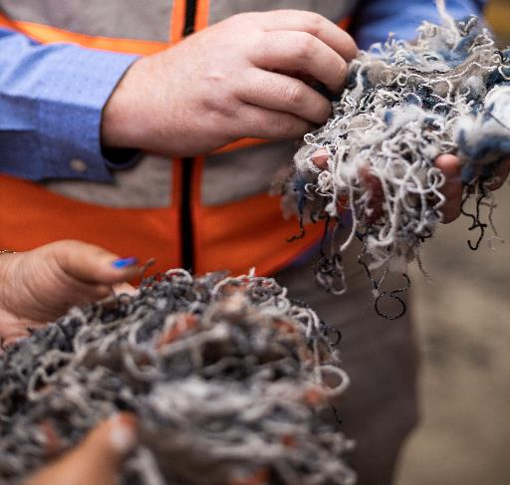
Resource Optimisation.
Extensive internal and external waste management systems and infrastructure are in place to reduce waste materials generated by our production processes and to keep our materials in use.
We celebrate a steady decline in waste generated by our operations, as well as increased opportunities to reuse and recycle the waste that is generated. Our internal reuse processes enable us to produce flooring with up to 20% recycled content.
Projects are underway to identify opportunities to eliminate waste and increase recyclability of our products and raw materials.
In the past 6 years, we have decreased the total amount of waste generated by 30%, and waste disposed of to landfill by 13%.

Slide 11
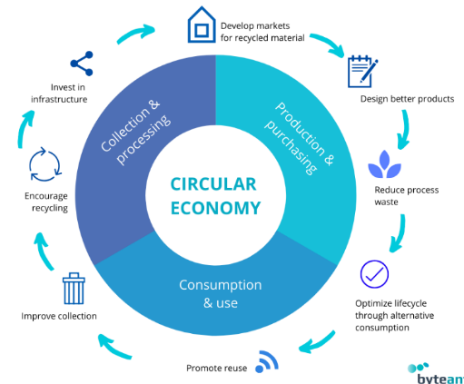
Resource Optimisation and Circularity.
Circularity is embedded in our vision at Belgotex.
A circular economy with regards to manufacturing has 3 main principles i.e., Design out waste and pollution; Keep materials and products in use; Regenerate natural systems.
Circularity – designing for EoL to ensure materials return to supply chain.
Our Green Underlay is one of our circularity solutions i.e., waste fibre utilised in the manufacture of this product.
Certain waste yarn, such as nylons, and fibres are sent through EREMA and used for Seal and Black colours.

Slide 12
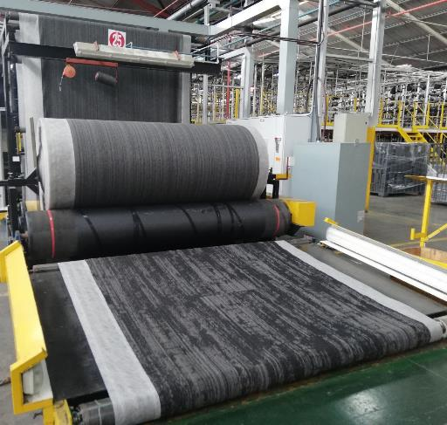
Product Certification.
Our work done on materials, waste, energy, water and emissions, as well as the certifications we have achieved for our factory and SHEQ management systems, and our social responsibility commitments, have enabled us to make significant progress with regards to the sustainability of our products.
We have third party, type III ecolabels for most of our commercial offerings, with further certifications planned for the future.
Product Life Cycle and environmental impacts:
  GreenRate and LCA Rate certifications
  Environmental Product Declarations (EPDs)
Material Transparency, Health and VOCs
  Product Health Declaration Platinum certifications

Slide 13

Product Certification.
In order to achieve a PHD HEALTH certification rating, Global GreenTag requires manufacturers to provide 100 percent transparency – to 100 parts per million – of any product’s individual ingredients’ toxicity information. The certification:
Supports product manufacturers “doing the right thing” who are prepared to disclose toxicity information.
Reduces risks for building professionals to confidently make distinctions between products that are safer for human health and those that are not and, make it easier to communicate health related product decisions to clients/and building occupiers.
Respect the rise up of conscious consumers, who studies show want healthier choices and greater access to more authentic product information, which they can trust because “Absolute transparency brings total peace of mind” – Global GreenTag.

Slide 14
Belgotex – NCPC Collaborations

Slide 15
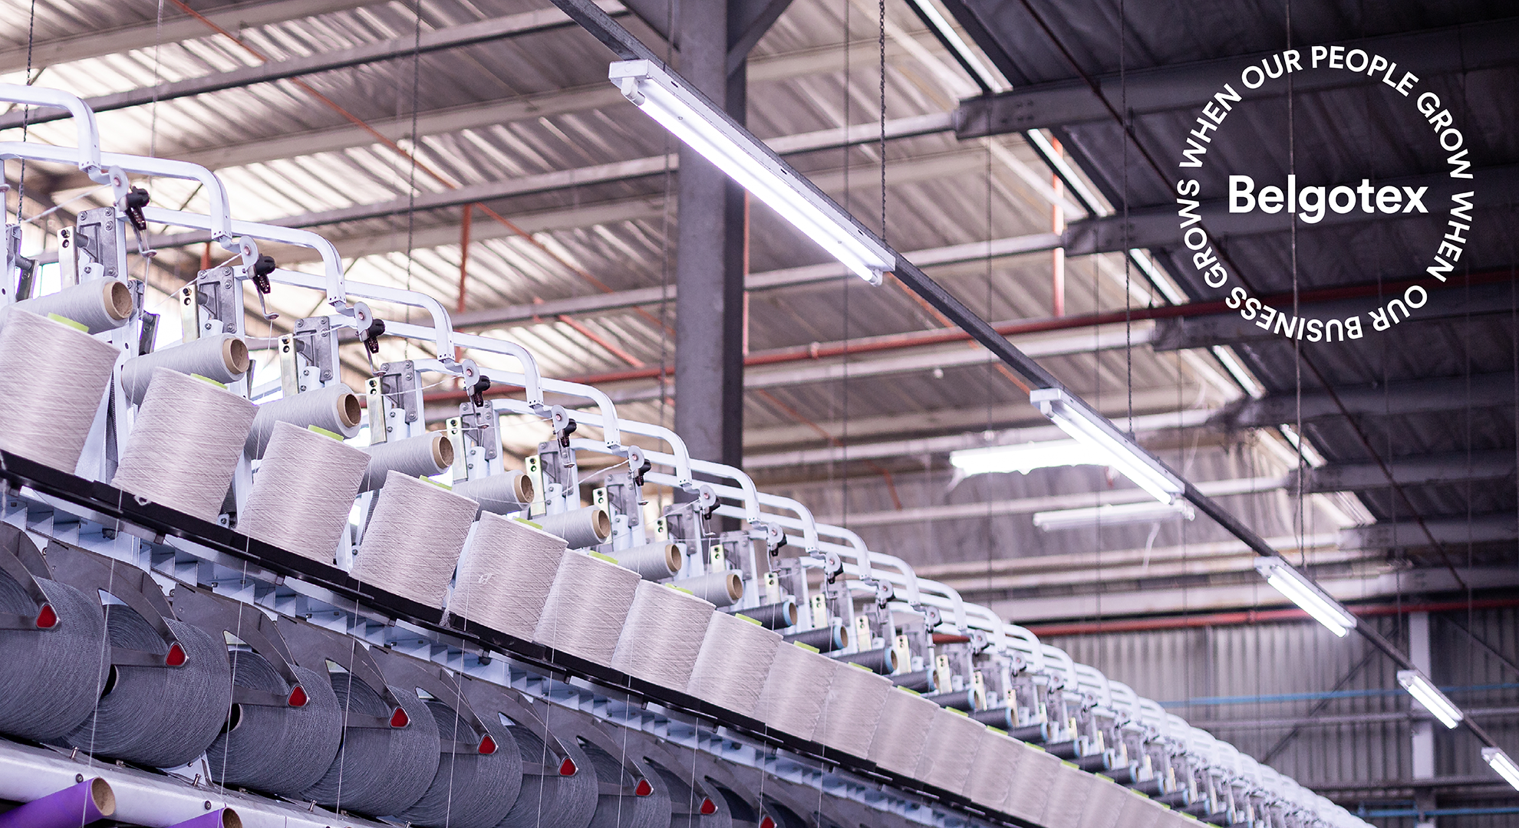
Benefits from NCPC Involvement – Energy Efficiency
Physical Improvements:
  Light sensors
  Natural Lightning
  LED Technology
  New compressors
  New equipment
Behaviour Improvements:
  Air and Steam leak identification program
  Installed lighting equipment for Tufting Creel zones
  Temperature controls on boiler
  Identification and installation of insulation on steam, chilled water and hot oil lines.

Slide 16
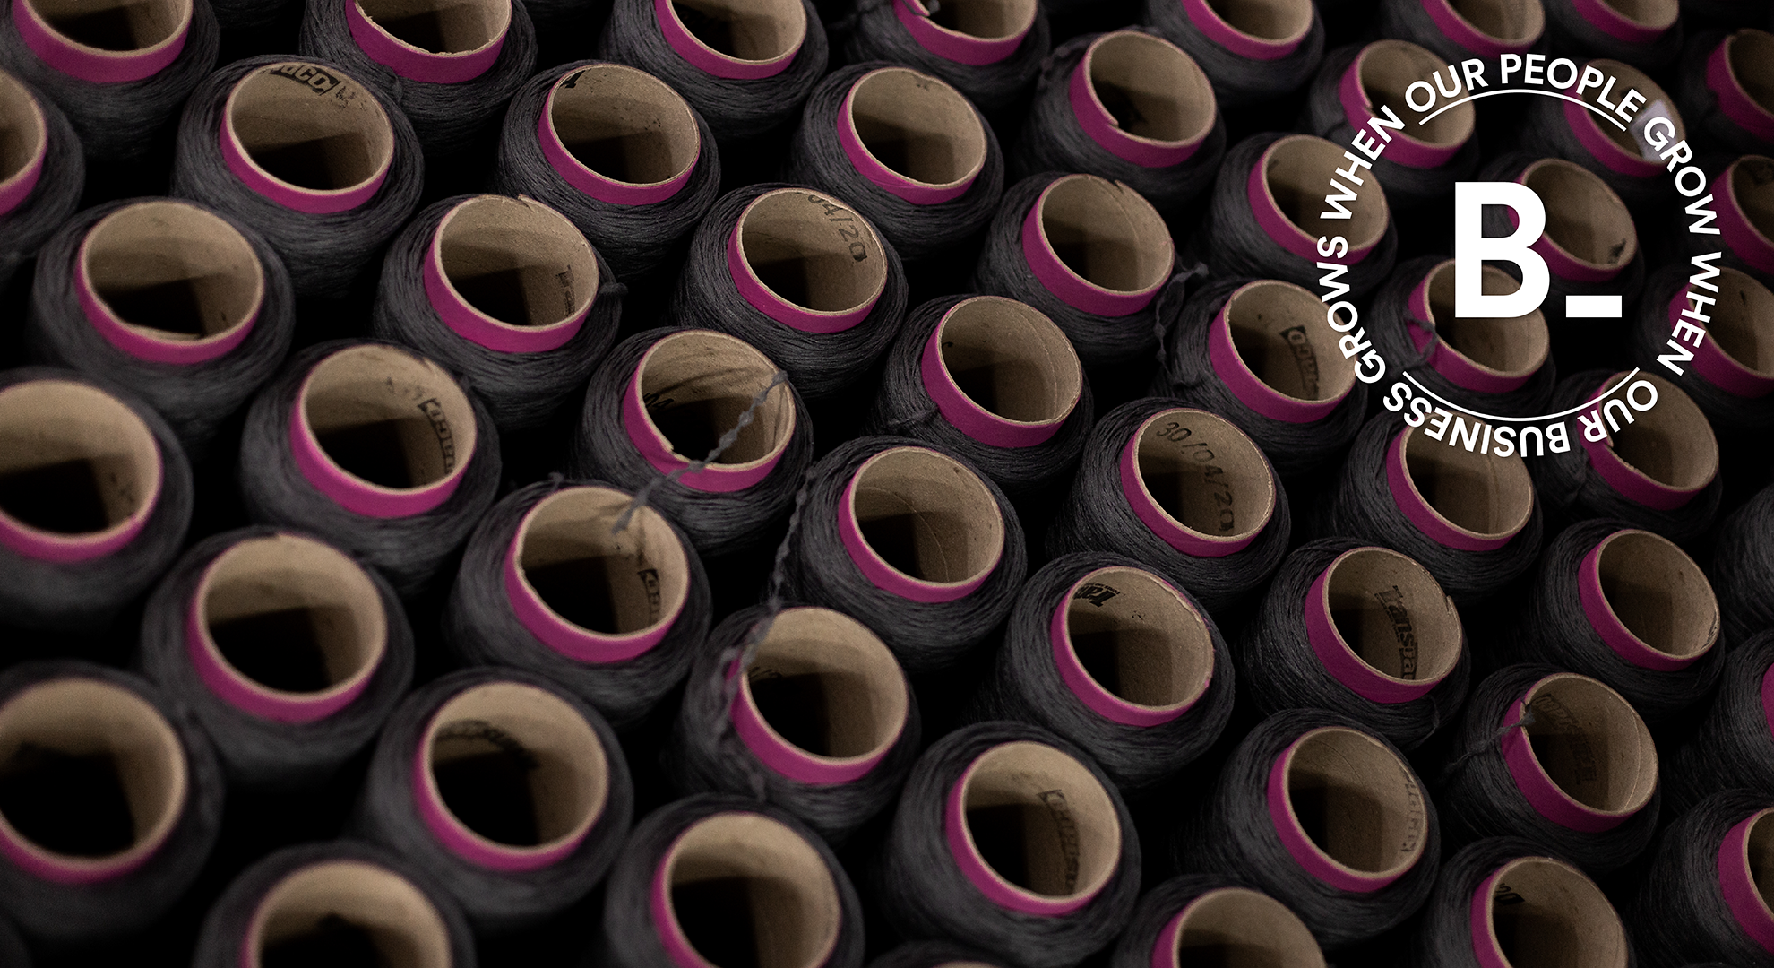
Benefits from NCPC Involvement – Energy Efficiency
NCPC Guidance Resulted In:
  Greater Understanding of energy efficiency
  Allowed us to see gaps in our knowledge
  Allowed us to engage with authority with consulting companies which gave rise to Digital Twinning the factory through IoT technology
  Provided us with better understanding of solar and the benefits of solar implementation for a factory setting.

Slide 17
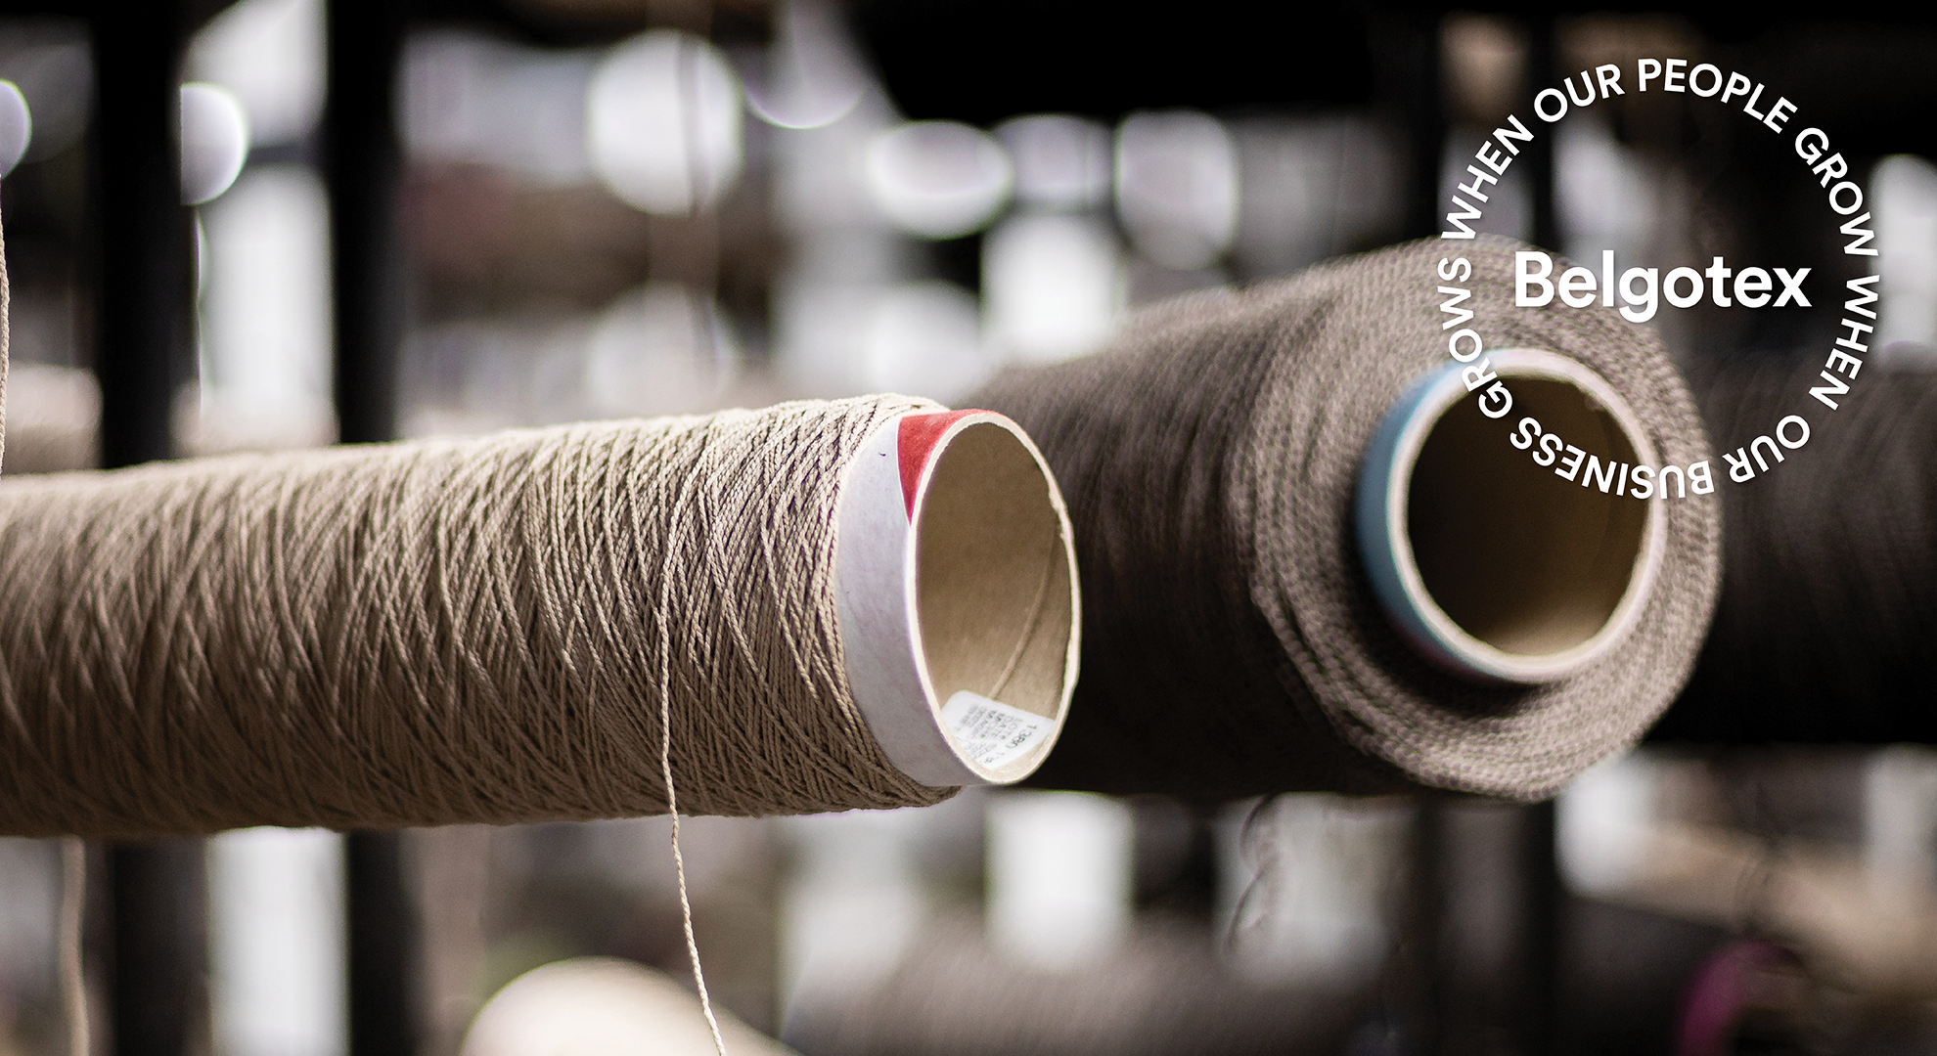
Benefits from NCPC Involvement – Resource Efficiency
Circularity is at the heart of Belgotex Products and Processes.
Following EMF principles of:
Design out waste and pollution.
Keep materials and products in use.
Regenerate natural systems.
Belgotex utilised learnings from NCPC and identified materials that could undergo reuse or recycle was initiated:
Production waste of PA6 undergoes extrusion through EREMA and is used in Seal and Black yarns and fibre.
Waste yarn and fibre is used to create our Green Underlay product which is sold as a product to support our broadloom installations.

Slide 18
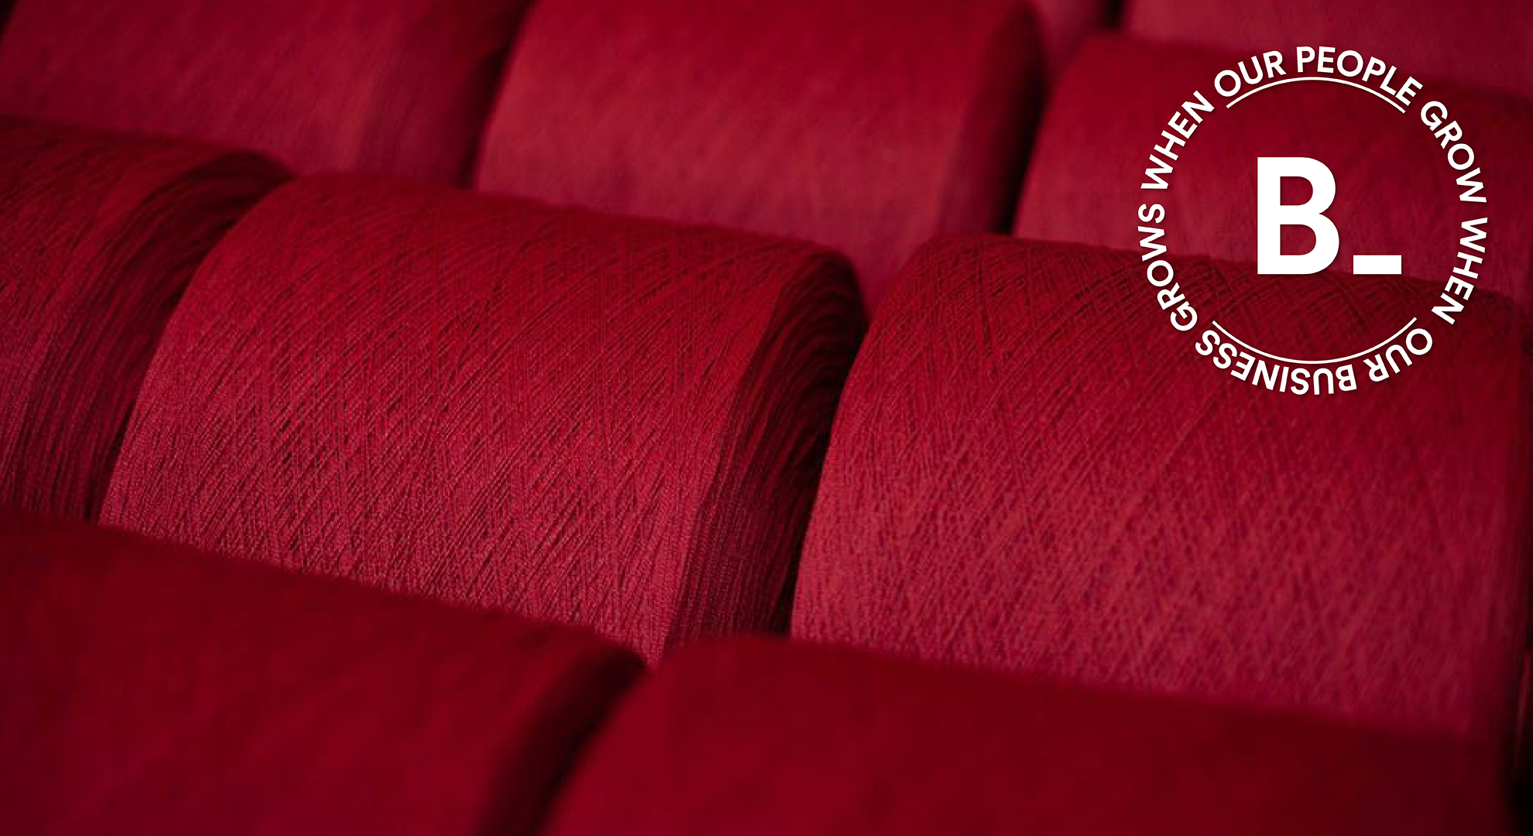
Benefits from NCPC Involvement – Process LCA Identification
NCPC Guidance Resulted In:
  Knowledge sharing of LCA processes
  Greater understanding of LCA in respect to textile products.
  The creation of a LCA for B_ Sport Division Artificial Grass
  Development of LCM capabilities model and the training provided in respect to ISO 14040 and ISO 14044.
As a result from the guidance shared, Belgotex is busy developing in-house LCA capabilities to understand it’s products and processes.

Slide 19
CE in Textile and Garment Sector Through Sustainable Management of Chemicals and Waste
August 2024
NCPC, Bluwin, UNIDO, Africa Institute Visit
Visit assessed CMS
Visit assessed implementation of CIL
Visit assessed progressive work towards ZDHC MRSL

Slide 20
CE in Textile and Garment Sector Through Sustainable Management of Chemicals and Waste
Key Points from visit:
Chemical Inventory Assessment:
Reviewed Safety Data Sheets (SDS) for all processing and auxiliary chemicals to ensure compliance with the Globally Harmonized System (GHS) and provided onsite advice to enhance GHS compliance.
Assessed chemicals currently in use and recommended improvements to align with ZDHC MRSL requirements.
Noted chemicals requiring storage in cool, dry, and ventilated conditions.
Chemical Inventory List:
Provided onsite support for developing and implementing a CIL based on the ZDHC Standard Template.
Evaluated chemical manufacturers/suppliers and established communication for obtaining GHS-compliant SDS and Technical Data Sheets

Slide 21
CE in Textile and Garment Sector Through Sustainable Management of Chemicals and Waste
Key Points from visit:
Chemical Management in Processing:
Provided technical advice on optimizing chemical usage in processing, selecting the best chemicals, and replacing hazardous ones with safer options.
Assessed labelling, documentation, and safety measures, and made recommendations for improvement.
Knowledge Gain:
Shared guidance on sustainable chemistry practices.
Emphasized the importance of continuous improvement in chemical management
Guidance on wastewater treatment options.

Slide 22
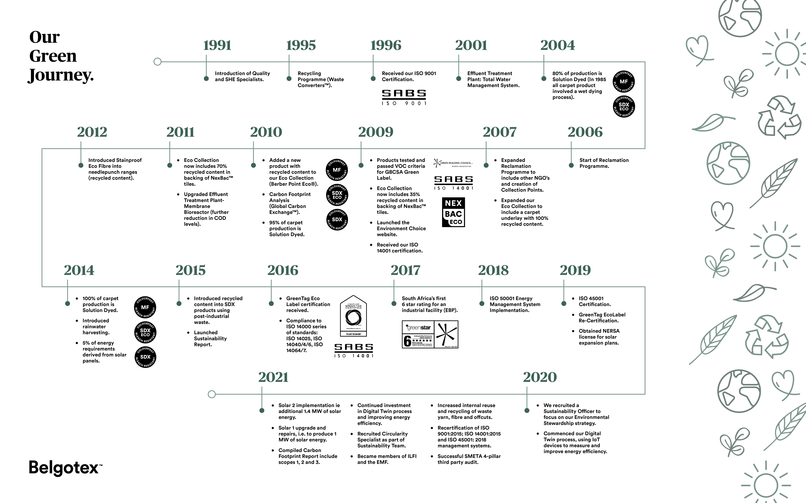

Slide 23
Thomas.brown@belgotex.co.za
Contact Details.

Slide 24

Thank You.
Questions?

