Slide 1
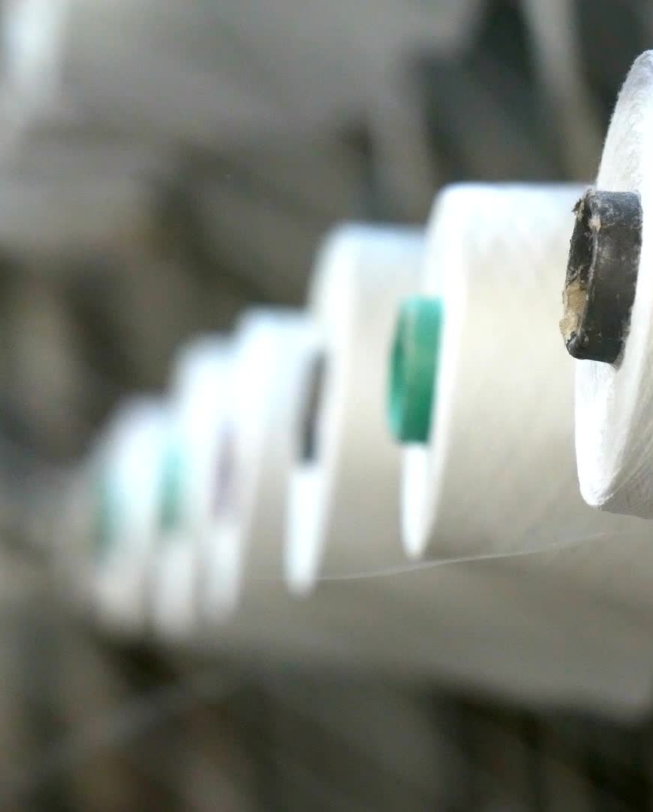
BRITS NONWOVEN (PTY) LTD
CIRCULAR ECONOMY IN TEXTILES - BRITS RECYCLING
November 2024

Slide 2
Brits Recycle Focus
Key focus :
  Support the circular economy into non- wovens.
  Remove illegal textile goods from economy to protect local jobs.
  Prevent textile goods from ending up in landfill.
  Clean up the environment to prevent illegal dumping of textile goods.
  Provide a means, mechanism and process whereby textile goods can be repurposed to find a new life.
  Key problem areas:
    Collection and sorting of goods.
    Cutting and shredding capacity at point of collection – transport costs
    Market acceptance and preference for recycled goods.
    Finding market outlets – you must have end use for recycled shoddy !!

Slide 3
Recycling Methods
Mechanical Recycling: Shred textiles into fibers; reprocess into new products.
Chemical Recycling: Break down fibers into components for new textiles.
Textile-to-Textile Recycling: Develop closed-loop systems for high-quality recycling.

Slide 4
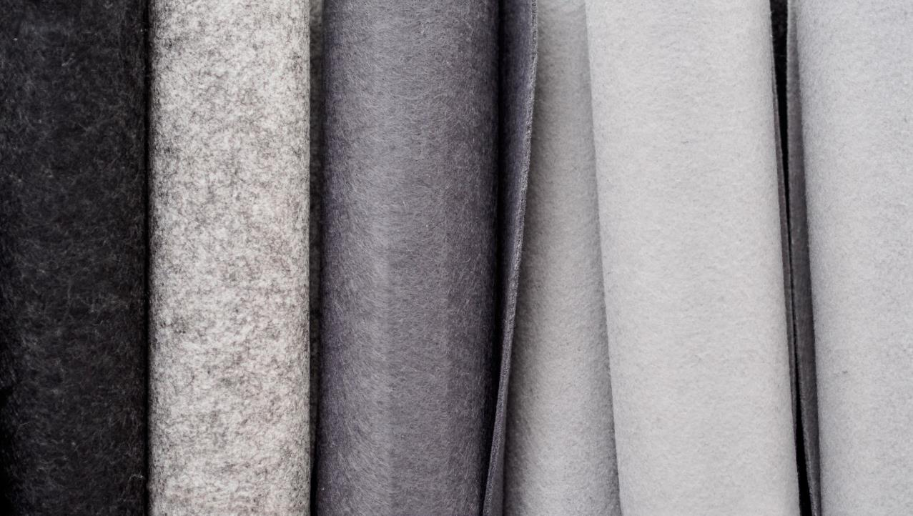
How is recycling of textiles actually happening –
SA Perspective
Brits Nonwoven

Slide 5

Brits Recycling Business Model
Purchase of Recycled Polyester fibre in White, Black and Green
Purchase of Recycled Bicomponent Fibre in White and Black
Recycling of Textile products into Shoddy Fibre.

Slide 6
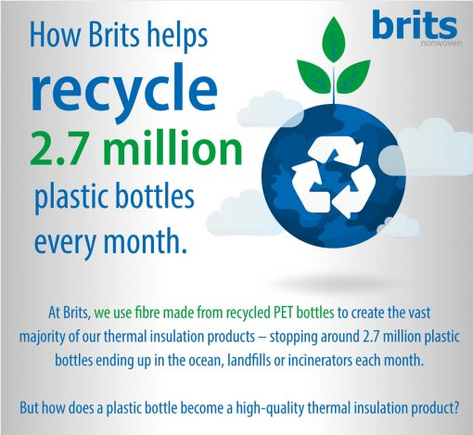

Slide 7
Textile Recycling - Brits
Current rate of Recycling
Available Capacity and Market size
Current Programs
Restrictions and Limitations of current Strategy
Process for Recycling
Moving from Recycling to the Circular Economy

Slide 8
Current Rate of Recycling
Process incorporates 5 processes – Robot Loader, Cutting, Tearing, Trim removal and Baling.
Currently running 8-10 ton per day or 150 to 200 ton/month.
Process only operates Monday to Friday 42 hours a week.
Waste is sorted into Cotton rich, Wool rich, Polyester rich or complete blend of anything and everything.
No Trim removal required – the Trims are automatically ejected during the Tearing stage.

Slide 9
Available Capacity and Market Size
Available Capacity on a 24/7 basis for 26 days = 624hrs.
Theoretically Brits could recycle close to 700 tons/month.
Only operating at approximately 30% Capacity.
Market size currently requesting recycling is close to 300tons/month.
There is a 100tons/month that Brits is not accepting at the moment.
Actual market is much bigger – must be closer to 1500t/month.

Slide 10
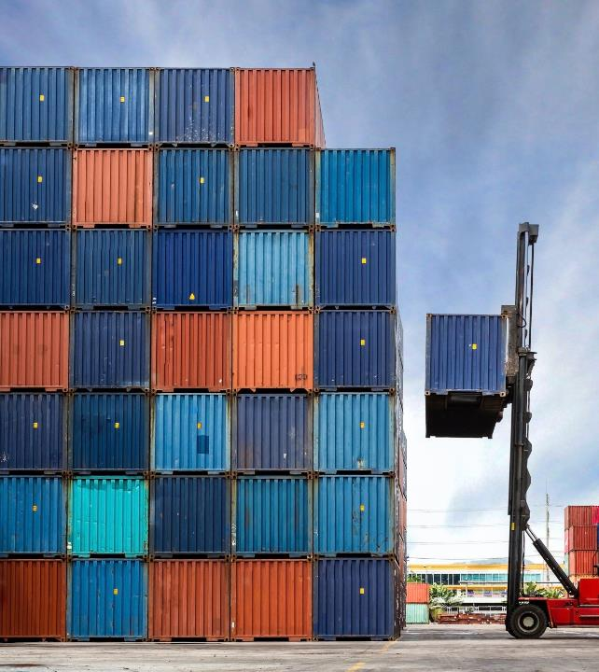
CURRENT RECYCLING PROGRAMS
Abandoned containers with clothing – controlled by SARS and Shipping companies. Estimated at 1650 tons.
Seized goods by SARS – currently in warehouses countrywide. These are tendered for to obtain contracts. Estimated at 12000 tons.
Rebated fabrics used to manufacture garments – the cut offs and waste has to be destroyed under SARS supervision.
Contract Uniforms for Govt Departments.
Fibre, yarn, fabric, nonwoven and selvedge waste from surrounding textile companies.
Fibre waste from wool and cotton producers.
Our own waste from manufacturing facilities.

Slide 11

Current Strategy Restrictions and Limitations
Insufficient end use applications for recycled fibre – hence the low utilisation at Brits of recycling line.
Current programs fill all the market demands for pads, mattresses, underfelt, insulation and acoustic products.
Government Programs causing supply spikes – SARS and SAPS.
Storage and Sorting limitations means that most waste produced is mixed – so again restricting end use applications.
Market acceptance of recycled products in premium applications.

Slide 12
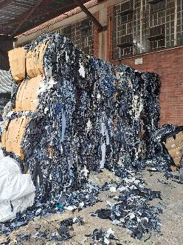
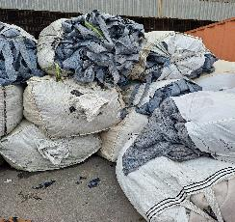
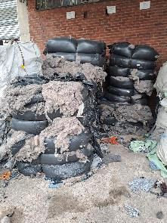
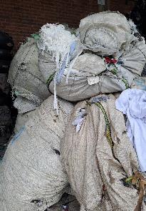
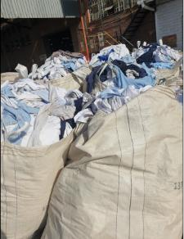
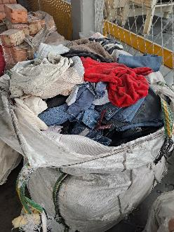
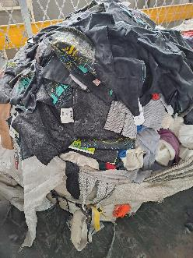
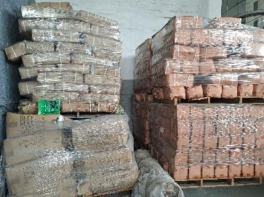
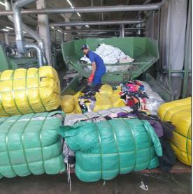
PROCESS AT BRITS - Downcycling

Slide 13
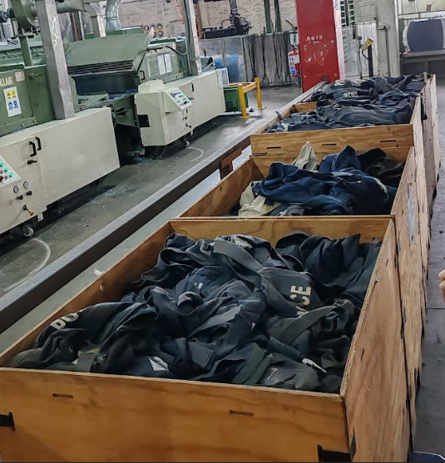
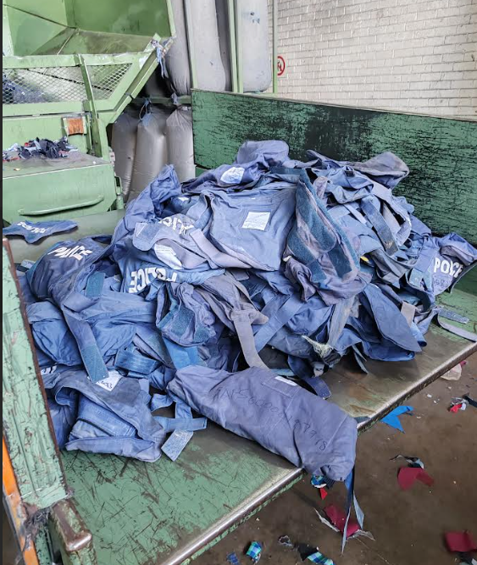
Restricted Items

Slide 14
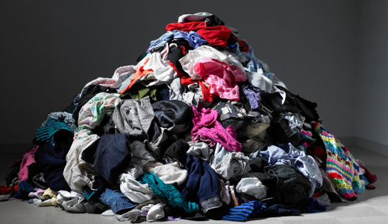
Complete garment recycling – no trims removed

Slide 15
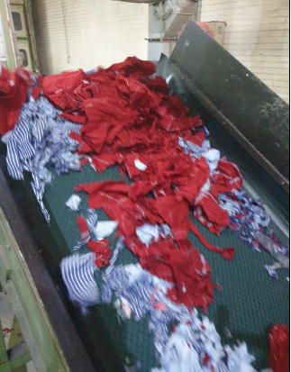
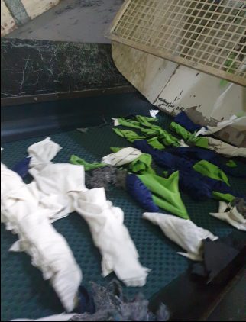
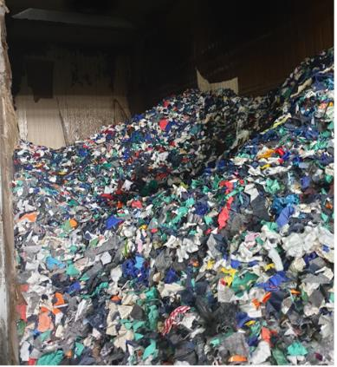
Step 1 – Cut everything into small pieces

Slide 16
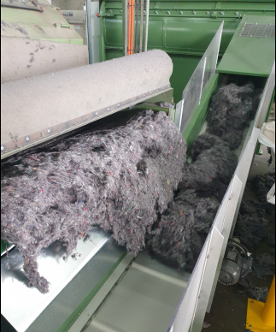
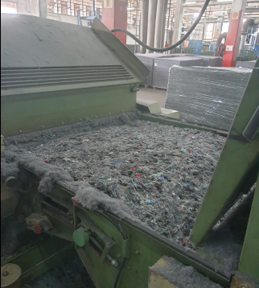
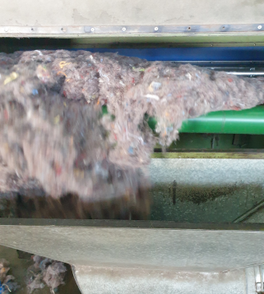
Step 2 Tear cut pieces into fibrous flock
Metal and Plastic trim auto removed

Slide 17
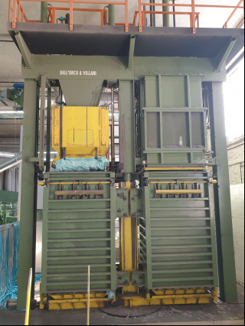
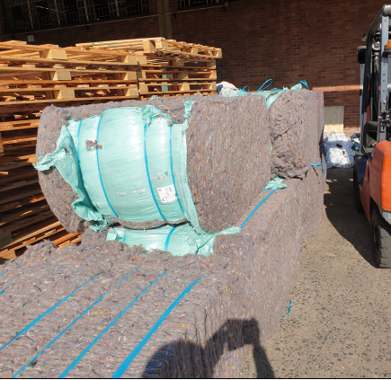
Baling of the fibrous flock (Shoddy)

Slide 18
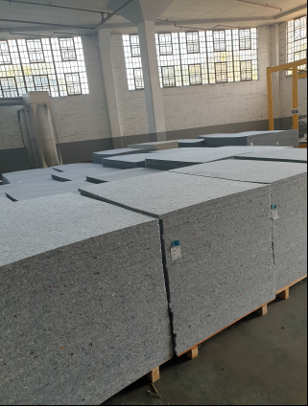
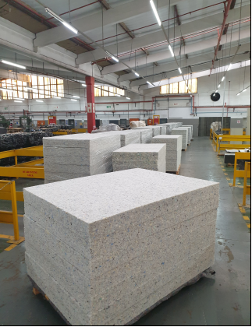
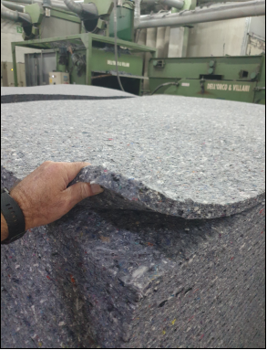
New products from recycled flock

Slide 19
Circular Economy Viability
Current recycling by Brits = Mainly down cycling.
Tearing shoddy = fibre damage.
Cost of sorting and separation. Colour control ?
Fine opener for denim/cotton/polyester – 30% can go for new yarn.
Circular economy = 30% of blend in new yarns for denim.
Key focus now is preventing landfill and downcycling into nonwovens. Nonwoven to nonwoven is then circular and repeatable.
Additional measures can be taken – dependant on support as applied for.

Slide 20

Questions?

