Slide 1



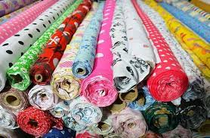
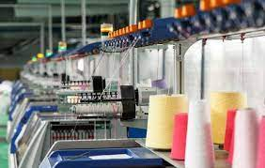
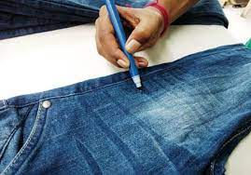
Promotion of circular economy in the textile and garment sector through the sustainable management of chemicals and waste in Lesotho, Madagascar, South Africa, and Ethiopia
REGIONAL INCEPTION WORKSHOP
12 November 2024
GEF ID: 10543 and 10683
THANDEKA MBATHA
AFRICA INSTITUTE

Slide 2

Overview
The Africa Institute
Project Context
Beneficiary Countries
Roles and Responsibilities
Project Components
Current Status
Workshop Objectives

Slide 3

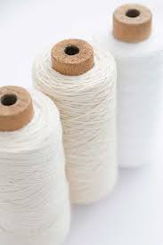
Africa Institute
Intergovernmental Organization established in accordance with Articles 14 of the Basel Convention and Article 12 of the Stockholm Convention
Established through a treaty that member countries from within the English-speaking region
Eight countries that have ratified this treaty and others are at different stages of the process - Botswana, Lesotho, Mauritius, Namibia, Nigeria, Tanzania, South Africa and Zambia
Initially established as the Basel Convention Regional Centre (BCRC) for all English-speaking African countries
AI was endorsed in April 2011 to also serve as the Stockholm Convention Regional Centre (SCRC) in Accordance with article 12 of the Stockholm Convention
Africa Institute provides training and capacity building, dissemination of information, Awareness raising and technology transfer, information exchange, and any other function that countries may assign to it
Africa Institute is based in Pretoria, South Africa housed within the Department of Fisheries, Forestry and Environment

Slide 4
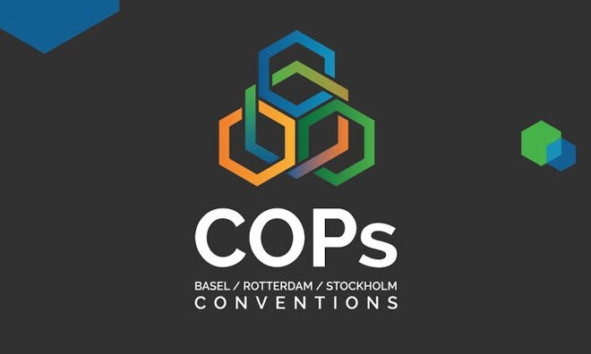
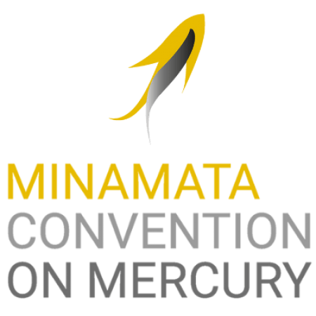
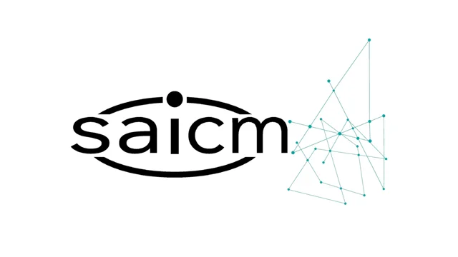
Africa Institute
BASEL CONVENTION
  Control of Trans-Boundary Movement of Hazardous Wastes and their Disposal
STOCKHOLM CONVENTION
  Protection of human health and the environment from the effects of persistent organic pollutants (POPs)
ROTTERDAM CONVENTION
  Prior informed procedure on certain hazardous chemical and pesticides in international trade
Strategic Approach to International Chemicals Management (SAICM)
  Global policy framework to foster the sound management of chemicals
MINAMATA CONVENTION
  Designed to protect human health and the environment from anthropogenic emissions and releases of mercury and mercury compounds
Multi-Lateral Environmental Agreements

Slide 5

Project Context
Many textile industries in many African countries are still using POPs chemicals in their industrial operations and due to lack of waste management policy framework and infrastructure off cuts and textiles discards are either disposed in open burning operations and or in open landfills.
The open burning operations results in the emission of dioxins and furans and greenhouse gases with serious harmful effects on human and the environment.
To effectively promote Circular Economy in the textile and garment sector, UNIDO developed the initiatives to promote Circular Economy in the textile and garment value chain in Ethiopia (GEF ID 10683) as well as a regional one in Lesotho, Madagascar and South Africa (GEF ID 10543) through sustainable management of POPs chemicals and wastes; and the reuse, recycling and remanufacturing of textile/garment discards and wastes.

Slide 6
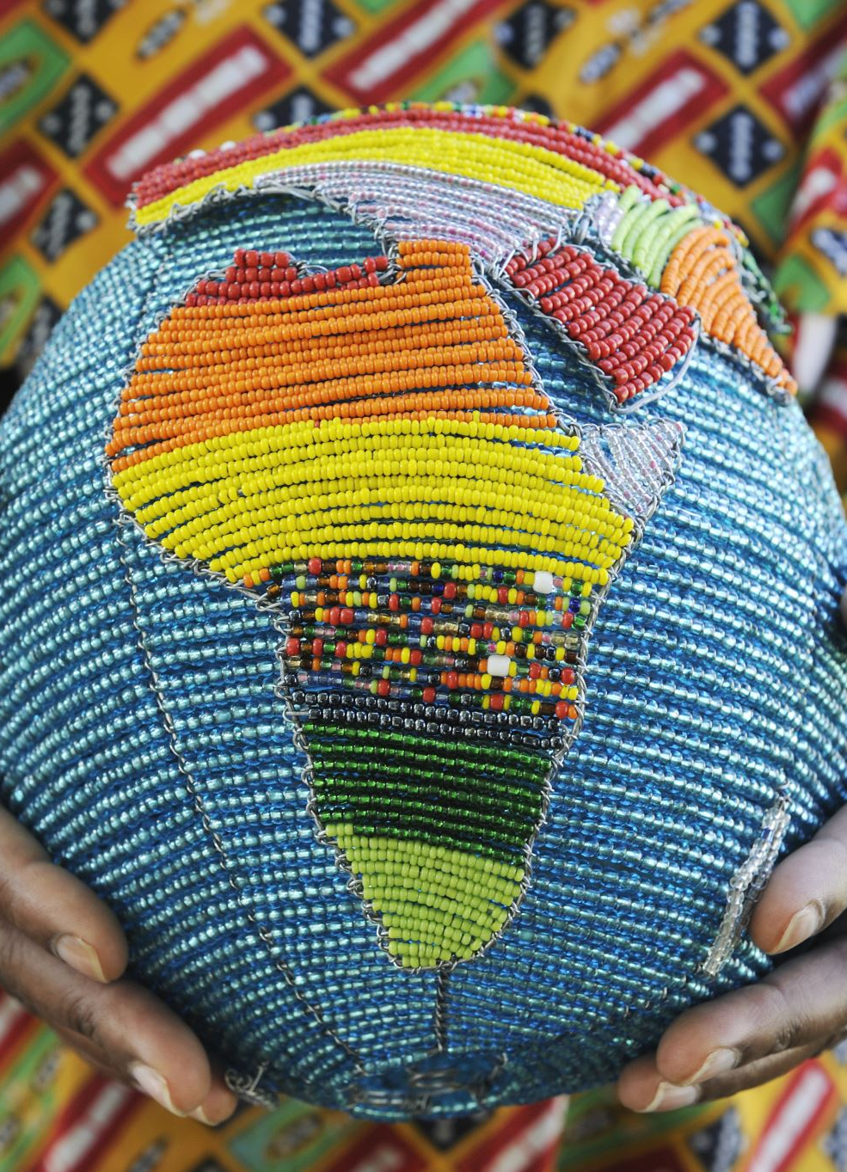
Project Context
The project will assist the selected countries to implement the provisions of the Stockholm Convention on persistent organic pollutants with synergistic effects of also reducing the emission of greenhouse gases, thereby addressing the issue of climate change.
The objective of this project is to promote the Circular Economy in the Southern African Textile and Garment (TG) sector through sustainable Chemical and Waste Management and in particular the phase out of POPs.

Slide 7
Workshop Objectives
Introduction of the project to partners and stakeholders
To establish shared understanding of project goals, activities and roles
Discuss the implementation and management arrangements, including the roles of various partners and stakeholders
Presenting the project's technical elements and approaches
Defining roles and discussing collaboration

Slide 8
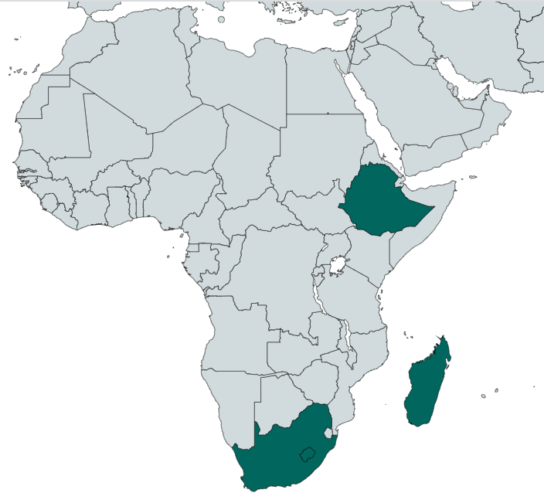
Beneficiary Countries (NEEs)
Project No. 10543
  South Africa – National Cleaner Production Company
  Lesotho - Ministry of Environment and Forestry
  Madagascar - Ministry of Environment and Sustainable Development
Project No. 10683
  Ethiopia - Textile and Garment Industry Research and Development Center (TGiRDc)
Notes:
12 Beneficiary countries.
Mauritius completed phase out of PCBs in her country. Mostly did awareness activities
The rest had at least one piece of equipment to phase out.

Slide 9


Roles and Responsibilities
Funder: Global Environment Fund (GEF)
Implementing Agency: United Nations Industrial Development Organization (UNIDO)
Regional Executing Entity (REE)
National Executing Entity (NEE)
Notes:
- Contribution to project outputs.
- Support the national execution.
- Project execution management.

Slide 10
Project Components
Component 1 - Strengthening of regulatory and institutional capacities for adoption and promotion of Circular Economy (CE) in the textile and garment sector
Component 2 - Recyclability of textile and garment wastes is enhanced through POPs-free textile manufacturing process and the implementation of BAT/BEP and RECP investments
Component 3 - Introduction of Circular Economy concept for UPOPs emission reductions through ESM of textile and garment wastes and pilot demonstration of textiles/garment wastes recycling and reuse
Component 4 - Knowledge management for scaling up

Slide 11
Current Status
Contracts signed with Implementing Agency
Workplans and budgets (Year 1) submitted
Contract international service providers
Inception workshops
Regional inception workshop
Needs Assessment

Slide 12

Ms. Thandeka Mbatha
Projects Coordinator
Africa Institute
Tel: +27 12 399 8517
Cell: +27 76 869 2649
E-mail: thmbatha@dffe.gov.za
THANK YOU

